Slide 1


Writing Across the Curriculum
Enhancing Instruction to Advance Psychology Scholarship and Student Success
Brought to you by the American Psychological Association

Slide 2


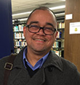

Presenters
Joel M. Williams
Quality Enhancement Plan Director / Writing Program Administrator
Edward Waters College
Nestor Matthews
Professor, Department of Psychology & Neuroscience Program
Denison University
Dennis Millan
Director, Center for Academic Enhancement
Holy Family University
Robin Musselman
Professor of Social Science
Lehigh Carbon Community College

Slide 3
Peer-to-Peer Writing Workshops Across the Psychology Curriculum

Slide 4

Denison University Context
4-Year Residential Liberal Arts College
~240 Faculty College Wide
~2,200 Students College Wide
~300 Intro Psyc (w/Lab) Students Annually
~60 Psychology Senior Majors Annually
~13 Tenure-Track Faculty
~10 - ~30 Typical Class Size

Slide 5

Motivation For Peer-to-Peer W.W.
Increase Student Learning via Increased Engagement
“The one who does the work does the learning!”
-José Antonio Bowen (CUR - June 2018)
https://en.wikipedia.org/wiki/Push-up#/media/File:Marines_do_pushups.jpg

Slide 6
Goals For Peer-to-Peer W.W.
APA Guidelines for the Undergraduate Psychology Major
GOAL 4: Communication
4.1 Demonstrate effective writing for different purposes
4.1A Construct arguments clearly and concisely using evidence-based psychological concepts and theories
4.1B Craft clear and concise written communications to address specific audiences (e.g., lay, peer, professional)
4.1C Use grammar appropriate to professional standards and conventions
4.1E Tailor length and development of ideas in formats that fit the purpose
4.1G Seek feedback to improve writing quality resulting in multiple drafts

Slide 7
Goals For Peer-to-Peer W.W.
APA Guidelines for the Undergraduate Psychology Major
GOAL 4: Communication
4.3 Interact effectively with others
4.3A Show capacity for listening and decoding both overt and covert messages
4.3C Interact sensitively with people of diverse abilities, backgrounds, and cultural perspectives

Slide 8
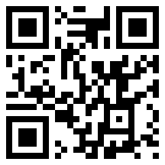
Writing Workshop Ingredients
Open Science Framework
https://osf.io/9y8fr/
Assignment Prompt
2. Writing Rubric
3. In-Class Procedure

Slide 9
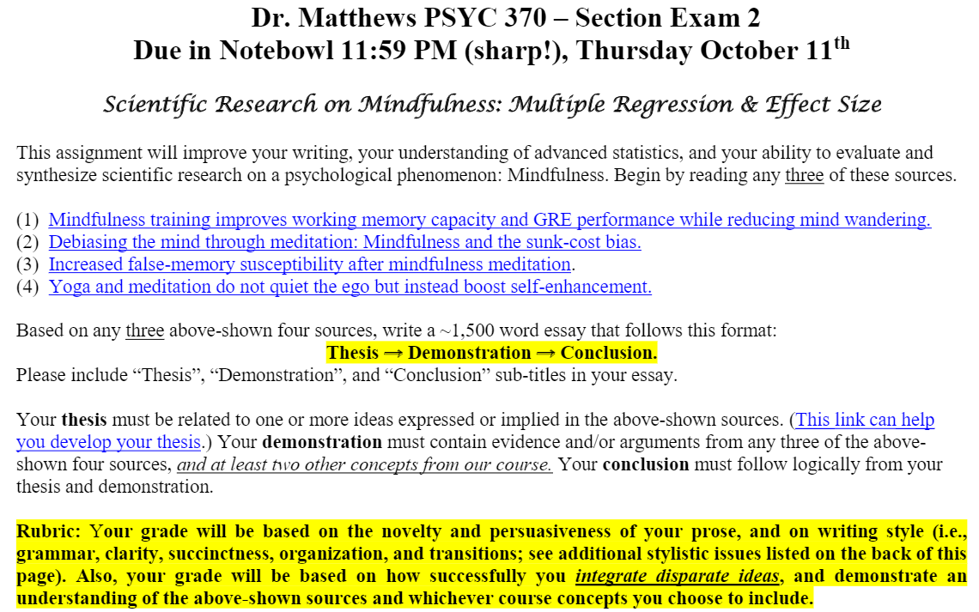

Slide 10
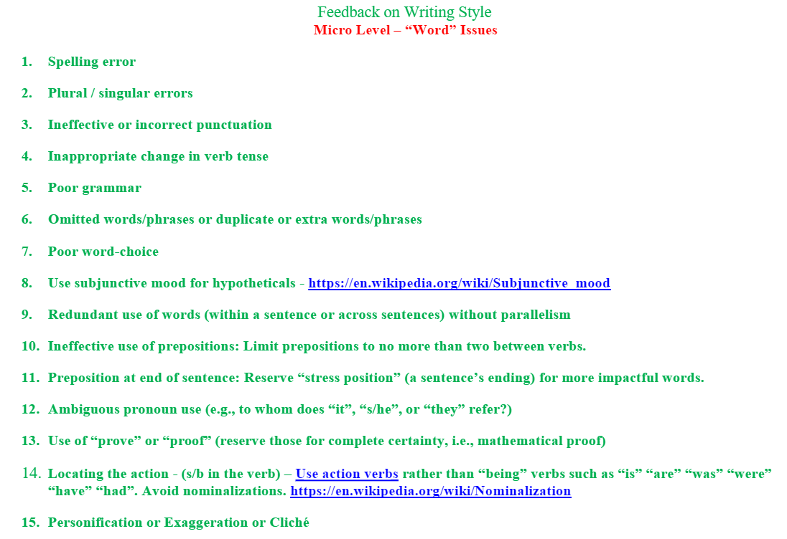

Slide 11
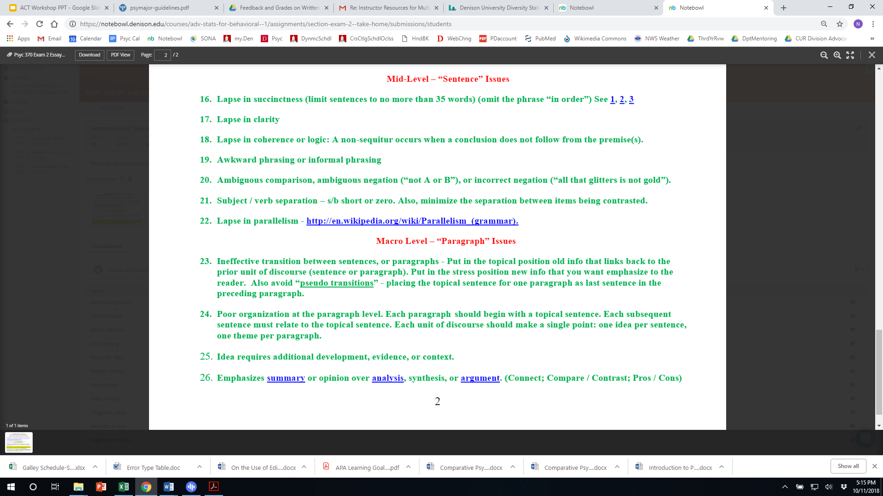

Slide 13
In-Class Procedure for W.W.
Students submit essay electronically prior night
Students bring stapled, anonymized print-copy to class
Printed essays are shuffled on front table
Students pick-up …
  An essay that is NOT their own
  A copy of “Feedback on Writing Style” (FOWS) form
  A blue pen

Slide 14
In-Class Procedure for W.W.
“To Learn, Retrieve” https://makeitstick.net/
  Students study the 26 F.O.W.S. items for 3 minutes.
  Students retrieve items (written recall) for 3 minutes.
The goal is to get the F.O.W.S. items eventually into LTM.

Slide 15
In-Class Procedure for W.W.
Round 1 - The Blue Round (10 minutes)
  Students write an ID on the back of the essay
  Students use the F.O.W.S. form to enumerate edits
  Students are free to add other comments
Round 1 Recap (3 minutes)
  Students verbally report examples of strong writing
  Students verbally report ways to improve writing

Slide 16
In-Class Procedure for W.W.
Round 2 - The Green Round (10 minutes)
  Papers are shuffled again on front table
  Students pick up a new essay, and a green pen
  Students write an ID on the back of the essay
  Students use the F.O.W.S. form to enumerate edits
  Students are free to add other comments
Round 2 - Recap (3 minutes)
  Students verbally report how the Round 1 (Blue) editor did

Slide 17
In-Class Procedure for W.W.
Round 3 - The Purple Round (10 minutes)
  Papers are shuffled again on front table
  Students pick up a new essay, and a purple pen
  Students write an ID on the back of the essay
  Students use the F.O.W. form to enumerate edits
  Students are free to add other comments
Round 3 - Recap (3 minutes)
  Were some papers stronger than others? Why?

Slide 18
Benefits of Peer-to-Peer W.W.
Students are fully engaged the entire period!
  “The one who does the work does the learning”
  The Writing Workshop (W.W.) adds variety to in-class activities.
2. Students Learn…
  How to apply a writing rubric (F.O.W.S.).
  About the range of writing competency in the room.
  Civility in providing written / oral feedback.
3. Instructors gain insight into each student’s editing skills.
4. Instructors have a head-start on grading the essays!

