Slide 1
Biological Psychology: Micro Level - Neural Communication

Slide 2
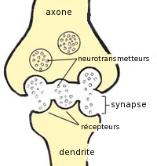
Neural Communication
http://www.thefreedictionary.com/synapse
Synapse - The junction across which a nerve impulse passes from an axon terminal to a neuron, muscle cell, or gland cell.
http://commons.wikimedia.org/wiki/File:Synapse.png

Slide 3
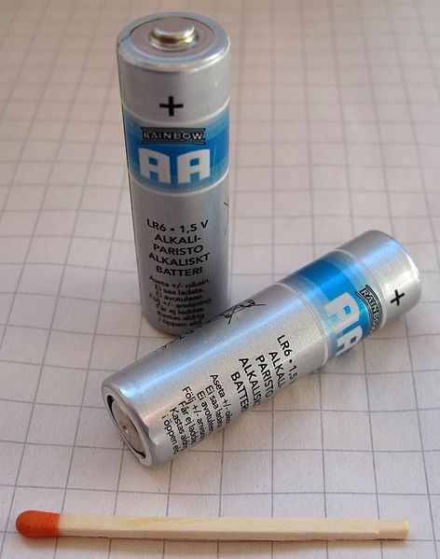
Neural Communication
https://commons.wikimedia.org/wiki/File:AA_matchstick-1.jpg
Metaphor → Neurons are like tiny batteries!

Slide 4
Neural Communication
Resting Potential - The membrane potential of an inactive cell.
Electrical state for R.P.s typically -70 millivolts
The inside of neuron is negatively charged relative to the outside
Synonyms for the resting potential include
“Resting state”
“Stable state”
“Polarized state”

Slide 5
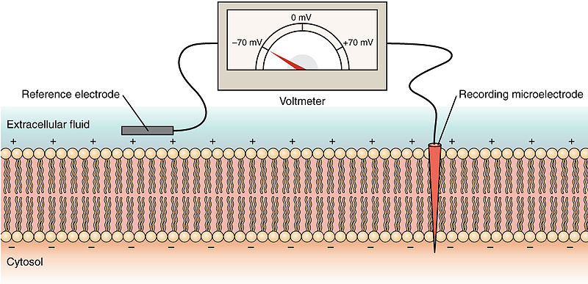
Neural Communication
http://commons.wikimedia.org/wiki/File:1220_Resting_Membrane_Potential.jpg
Resting Potential → -70 millivolts
]
Cell
Membrane

Slide 6
Neural Communication
Action Potential – A short term change in the electrical potential that travels along a cell such as a nerve or muscle fiber.
Common threshold to launch A.P. → ~ -55 millivolts
Synonyms for action potential include
“nerve impulse”
“firing”, “nerve firing”, or “firing rate”
“spiking”, “spike”, or “spike rate”
“Depolarization”

Slide 7
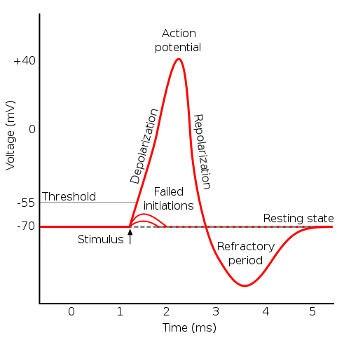
Neural Communication
http://commons.wikimedia.org/wiki/File:Action_potential.svg
Schematic of an action potential

Slide 8
Neural Communication
http://commons.wikimedia.org/wiki/File:Action_potential.svg
Action potentials obey the “All-or-None Rule” - If the stimulus exceeds the threshold potential, the nerve or muscle fiber will give a complete response; otherwise, there is no response.
Schematic of an action potential

Slide 9
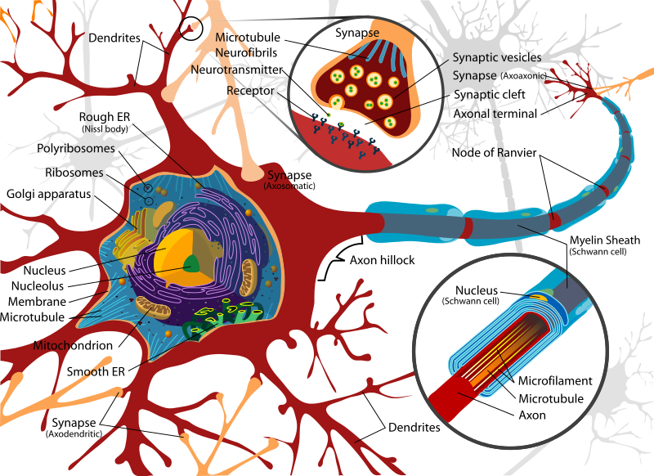
http://commons.wikimedia.org/wiki/File:Complete_neuron_cell_diagram_en.svg

Slide 10
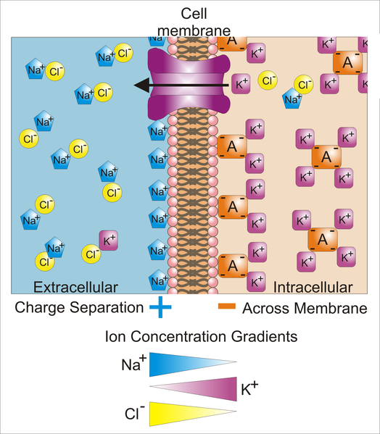
Neural Communication
http://en.wikipedia.org/wiki/File:Basis_of_Membrane_Potential2.png

Slide 11
Neural Communication
http://en.wikipedia.org/wiki/Membrane_potential
Key: Blue pentagons - sodium ions; Purple squares - potassium ions; Yellow circles - Chloride ions;
Orange rectangles – Anions (these arise from a variety of sources including proteins).
The large purple structure with an arrow represents a transmembrane potassium channel
and the direction of net potassium movement.
Differences in concentration of ions on opposite sides of a cellular membrane lead to a voltage
called the membrane potential. Typical values of membrane potential are in the range –40 mV
to –80 mV. Many ions have a concentration gradient across the membrane, including
potassium (K+), which is at a high inside and a low concentration outside the membrane.
Sodium (Na+) and chloride (Cl–) ions are at high concentrations in the extracellular region,
and low concentrations in the intracellular regions. These concentration gradients provide the
potential energy to drive the formation of the membrane potential.
This voltage is established when the membrane has permeability to one or more ions. In
the simplest case, illustrated here, if the membrane is selectively permeable to potassium,
these positively charged ions can diffuse down the concentration gradient to the outside of the cell,
leaving behind uncompensated negative charges. This separation of charges is what causes the
membrane potential. Note that the system as a whole is electro-neutral. The "uncompensated" positive
charges outside the cell, and the uncompensated negative charges inside the cell, physically line up on the
membrane surface and attract each other across membrane. Thus, the membrane potential is physically
located only in the immediate vicinity of the membrane. It is the separation of these charges across the
membrane that is the basis of the membrane voltage. Note also that this diagram is only an approximation
of the ionic contributions to the membrane potential. Other ions including sodium, chloride, calcium and
others play a more minor role, even though they have strong concentration gradients, because they
have more limited permeability than potassium.

Slide 12
