Slide 1
Biological Psychology: Methods

Slide 2
Inferring Brain Activity from Behavior
http://www.nature.com/nrn/journal/v5/n11/box/nrn1535_BX1.html
Double Dissociations – The phenomenon in which a direct manipulation affects “Behavior X” without affecting “Behavior Z”, and a different manipulation affects “Behavior Z” without affecting “Behavior X”.
Double dissociations constitute evidence that the neural events governing “Behavior X” are distinct (“dissociated”) from those governing “Behavior Z”.

Slide 3
Inferring Brain Activity from Behavior
http://www.nature.com/nrn/journal/v5/n11/box/nrn1535_BX1.html
Psychophysics – The science of establishing quantitative relations between physical stimulation and psychological events.
Psychophysical experiments can reveal that participants make an informative pattern of errors. The error pattern can reveal clues about the underlying neural activity.
Example: “Tooth-pic Lab” and Cortical Representation.

Slide 4
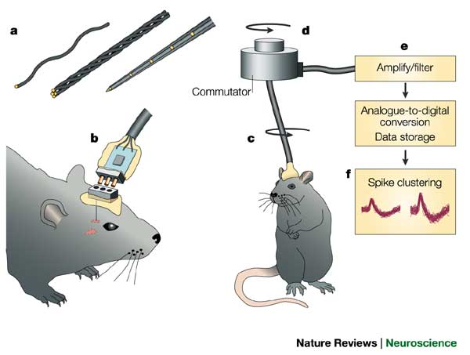
Single (or Multi) Unit Recording
http://www.nature.com/nrn/journal/v5/n11/box/nrn1535_BX1.html

Slide 5
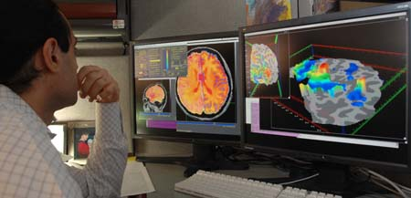
Functional Magnetic Resonance Imaging (fMRI)
http://en.wikipedia.org/wiki/File:Researcher-test.jpg
Oxygenated and De-oxygenated blood have different magnetic properties.
fMRI measures the so-called “B.O.L.D.” (blood oxygen level dependent) signal.

Slide 6
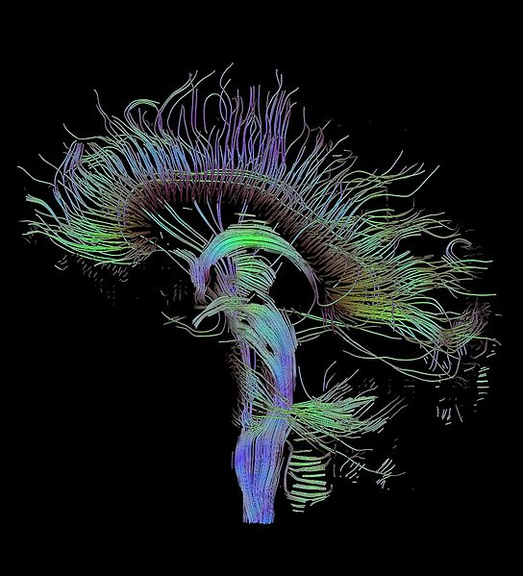
Diffusion Tensor Imaging (DTI)
http://commons.wikimedia.org/wiki/File:DTI-sagittal-fibers.jpg
DTI measures the rate at which water molecules diffuse across membranes.
DTI informs us about “white matter” quality.

Slide 7
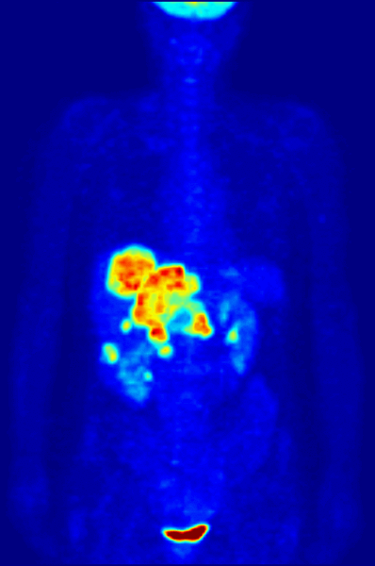
PET: Positron Emission Tomography
http://en.wikipedia.org/wiki/File:PET-MIPS-anim.gif
Patients / Participants
ingest a radioactive
tracer that makes
targeted biochemical
pathways visible.

Slide 8
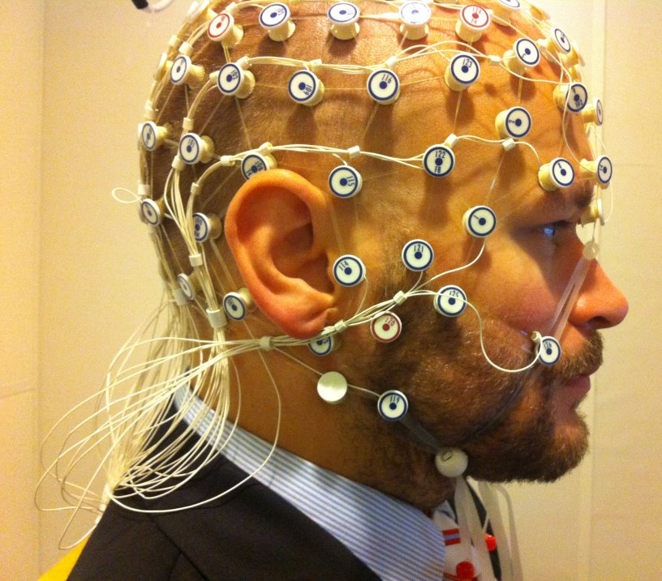
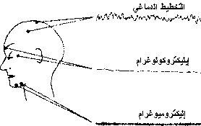
ElectroEncephaloGraph (EEG)
http://upload.wikimedia.org/wikipedia/commons/3/39/EEG_recording.jpg
EEG Research Question:
Given the stimulus or task,
what’s the brain activity?
http://commons.wikimedia.org/wiki/File:EEG.jpg

Slide 9
Neural Decoding
http://upload.wikimedia.org/wikipedia/commons/3/39/EEG_recording.jpg
Neural Decoding
Research Question:
Given the brain activity,
what was the stimulus or task?
https://en.wikipedia.org/wiki/Neural_decoding
http://commons.wikimedia.org/wiki/File:EEG.jpg

Slide 10
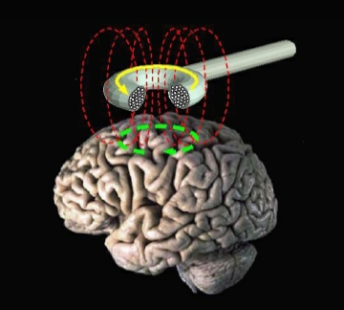
Transcranial Magnetic Stimulation (TMS)
http://en.wikipedia.org/wiki/File:Transcranial_magnetic_stimulation.jpg

Slide 11
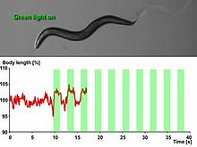
Optogenetics
https://en.wikipedia.org/wiki/Optogenetics
https://en.wikipedia.org/wiki/File:Microbial-Light-Activatable-Proton-Pumps-as-Neuronal-Inhibitors-to-Functionally-Dissect-Neuronal-pone.0040937.s007.ogv

Slide 12
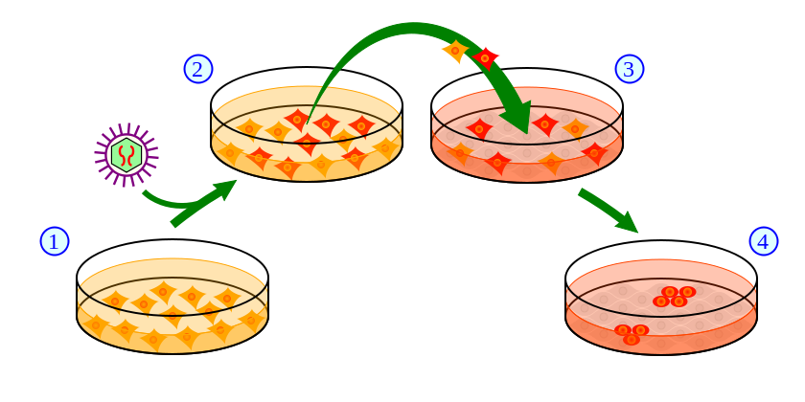
Induced Pluripotent Stem Cells (IPSCs)
https://en.wikipedia.org/wiki/Induced_pluripotent_stem_cell#/media/File:Induction_of_iPS_cells.svg
https://en.wikipedia.org/wiki/Induced_pluripotent_stem_cell

Slide 13
Clinical Observations
Examples
“split brain” patients.
http://en.wikipedia.org/wiki/Split-brain
Students with learning disabilities
Brain Injury / Brain Disease Patients
Accidents (automobile, bicycle, skiing)
Alzheimer’s, Parkinson’s, Stroke patients, Traumatic Brain Injury, Chronic Traumatic Encephalopathy

Slide 14
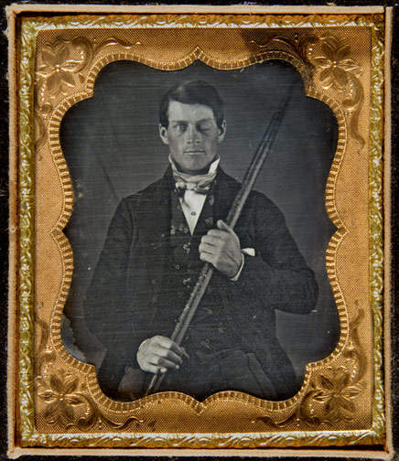
Clinical Observations
http://en.wikipedia.org/wiki/File:Phineas_Gage_Cased_Daguerreotype_WilgusPhoto2008-12-19_Unretouched_Color.jpg
Phineas Gage.

Slide 15
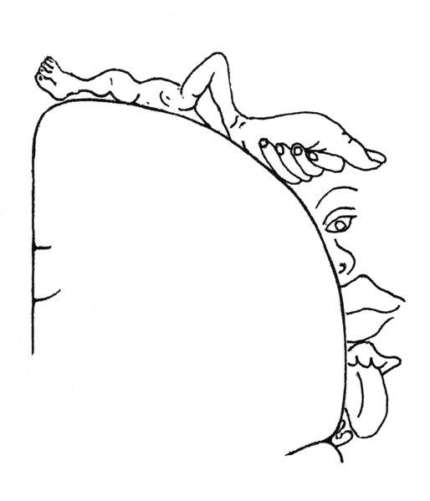
Clinical Observation: Homunculus
http://en.wikipedia.org/wiki/File:Sensory_Homunculus.png
http://en.wikipedia.org/wiki/Wilder_Penfield

Slide 16
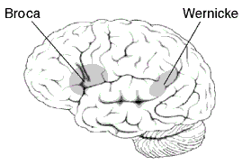
Clinical Observations
http://en.wikipedia.org/wiki/File:BrocasAreaSmall.png
Broca’s Arear – Speech Production
Wernicke’s area – Speech Comprehension

Slide 17
Clinical Observation
Knowledge about the cortex comes from studying brain damage.
Localized brain damage can produce:
Aphasias (disordered language)
Apraxias (disordered action)
Agnosias (disordered perception)
Disorders of planning or social cognition

Slide 18
Plasticity
The nervous system is modifiable:
Modifications in how much neurotransmitter a presynaptic neuron releases
Modifications in new connections by growing new dendritic spines
Modifications in neuron sensitivity to neurotransmitters

Slide 19


