Slide 1
Cognition:
Mental Representations
Judgment & Reasoning

Slide 2
Mental Representations
http://en.wikipedia.org/wiki/Mental_representation
Mental Representation - “a hypothetical internal cognitive symbol that corresponds to external reality”.
Note: Be careful to distinguish these…
Brain States – e.g., action potentials, firing rates, synchronized neural firing, EEG recordings, B.O.L.D. signals, rCBF (regional cerebral blood flow).
“Mental” States – e.g., sensations, perceptions, attention, memories, thinking, reasoning, mental (audio / visual ) imagery, emotions, intentions, beliefs, attitudes.

Slide 3

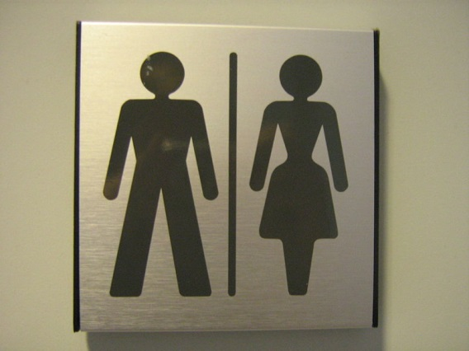
Analogical Representations
http://commons.wikimedia.org/wiki/File:Gender_neutral_toilet_sign_gu.jpg
Analogical Representation - a symbol that physically resembles its referent.
Onomatopoeia – Clickity-Clack, meow, moo, woof, oink, “splat”, “Ca-Ching!”
Some Roman Numerals – I, II, III
http://commons.wikimedia.org/wiki/File:Right_hand_curve_sign_%28India%29.png

Slide 4

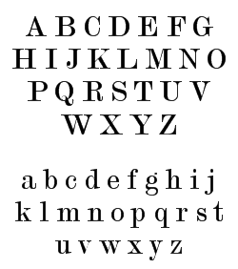

Symbolic Representations
http://commons.wikimedia.org/wiki/File:English_alphabet_-_Modern_No._20_script.png
Symbolic Representation – an arbitrary correspondence between two systems.
Most Words – blue, short, inconsequential, “Liberal Arts College”, “Psychology”
Some Roman Numerals – IV, X, XCVII
http://commons.wikimedia.org/wiki/File:Vienna_Convention_road_sign_B2a.svg
http://commons.wikimedia.org/wiki/File:MUTCD_R1-2.svg

Slide 5
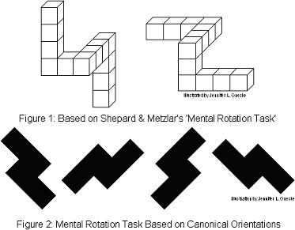
Mental Images
https://en.wikipedia.org/wiki/File:MR_TMR.jpg
Mental Rotation – Shepard & Metzlar, 1971
PubMed ID 5540314
Greater Rotational Angles → Longer Reaction Times

Slide 6

Judgment & Reasoning
http://en.wikipedia.org/wiki/File:Daniel_KAHNEMAN.jpg
Judgment – The process of extrapolating from evidence to draw conclusions.
Daniel Kahneman (b. 1934)
2002 Nobel Prize in Economics
Princeton Psychologist / U.C. Berkeley Ph.D. in Psychology
Judgment & Decision Making

Slide 7
Heuristics
Heuristic – a judgment strategy that favors speed and ease over accuracy.
http://en.wikipedia.org/wiki/Heuristic
Critical Thinking Question – Why might evolution favor heuristics?
Critical Thinking Question – How might evolution lead to stereotyping?

Slide 8
Availability Heuristic
http://en.wikipedia.org/wiki/Availability_heuristic
Availability Heuristic – a cognitive shortcut that relies on the ease of generating (“availability of”) examples.
Function: Judging frequency
Implementation: Use example-accessibility to indicate frequency (probability).
Limitation: Errors arise when availability (ease of generating examples) is NOT correlated with the empirically observed frequencies.

Slide 9
Availability Heuristic
http://en.wikipedia.org/wiki/Availability_heuristic
Availability Heuristic –
Examples:
Does the letter “R” occur more frequently in the first or third position of words?
People can more easily recall words with “R” first than with “R” third.
They incorrectly conclude “R – First” is more frequent.
Are male and female students late to class equally frequently?
Our answer may be skewed if we base our judgments on easily recallable male or female students.

Slide 10
Representativeness Heuristic
Representativeness Heuristic – a cognitive shortcut that assumes each member of a category is typical (representative) of a category.
Function: Judging categories
Implementation: Use resemblances to indicate category membership.
Limitation: Errors increase with the category’s heterogeneity.

Slide 11
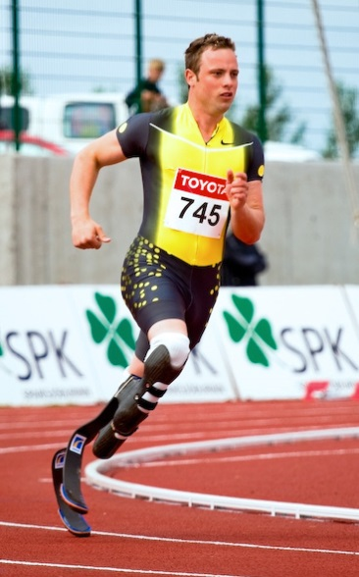
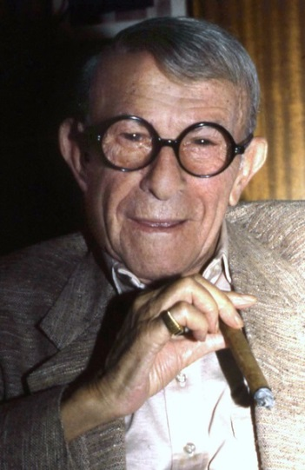
Representativeness Heuristic
Representativeness Heuristic –
Examples
Anecdotes (“Man who….” stories)
When anecdotes are offered as the justification for assigning categories, one assumes that the anecdote is typical.
http://en.wikipedia.org/wiki/File:Oscar_Pistorius-2.jpg
http://en.wikipedia.org/wiki/File:George_Burns_Allan_Warren.tif

Slide 12
Confirmation Bias
http://en.wikipedia.org/wiki/Confirmation_bias
Confirmation Bias – the tendency to be persuaded by information consistent with one’s prior beliefs.
Critical Thinking Question – Generate a novel and persuasive example of a confirmation bias.

Slide 13
Dual Process Theory
http://en.wikipedia.org/wiki/Dual_process_theory
Dual Process Theory – Proposes that judgments rely on two systems, one sacrifices accuracy for speed, and one that sacrifices speed for accuracy.
System 1 – The fast but less accurate system in dual processing theory.
Heuristic Based
System 2 – The slow but more accurate system in dual processing theory.
Algorithm Based- a step-by-step procedure for decisions

Slide 14
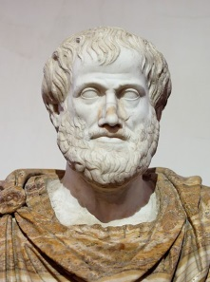
Syllogism
http://en.wikipedia.org/wiki/Syllogism
http://en.wikipedia.org/wiki/File:Aristotle_Altemps_Inv8575.jpg
Syllogism – typically, a 3-line argument containing two premises (lines 1 & 2) in support of a conclusion (line 3).
Not all syllogisms contain true premises.
Not all syllogisms contain valid logic.
Valid logic – a conclusion that NECESSARILY follows from the premises.
Syllogisms that contain true premises and valid logic are said to be “sound”.

Slide 15
Modus Tollens
http://en.wikipedia.org/wiki/Modus_tollens
Modus Tollens – A valid form reasoning that arises from denying the consequent.
Antecedent – The first portion of a proposition.
Consequent – The last portion of a proposition.
If P is true, then Q is true
Q is not true
Therefore, P is not true

Slide 16
Modus Ponens
http://en.wikipedia.org/wiki/Modus_tollens
Modus Ponens – A valid form reasoning that arises from affirming the antecedent.
Antecedent – The first portion of a proposition.
Consequent – The last portion of a proposition.
If P is true, then Q is true
P is true
Therefore, Q is true

Slide 17
