Slide 1
Experiments
&
Causation

Slide 2
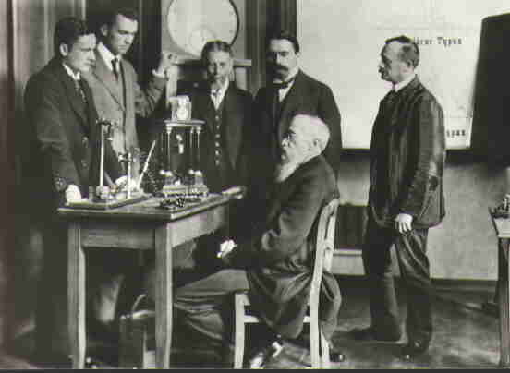
Experiments
https://commons.wikimedia.org/wiki/File:Wundt-research-group.jpg
Wilhelm Wundt’s Experimental Psychology Lab – 1879
University of Leipzig, Germany

Slide 3
Experiments
In principle, experiments can determine cause and effect relationships.
Characteristics of experiments
Direct manipulation of indep variable
Control group(s) or Control Condition(s)
Random assignment to groups / conditions

Slide 4
Causal Inference
Three conditions must be met to conclude something CAUSED something else.
Correlation (necessary but not sufficient)
Time-order relationship (causes precede effects)
Elimination of plausible alternative explanations

Slide 5
Experiments
Well designed experiments eliminate demand characteristics, i.e., cues that suggest how a participant should behave.
A placebo condition, i.e., one containing no active ingredient or manipulation, can be used to eliminate demand characteristics.
“Active Placebos” produce noticeable side effects. https://en.wikipedia.org/wiki/Active_placebo
Double Blind Study – Occurs when neither the participants nor data-collectors know who is in which condition. This minimizes demand characteristics & researcher bias.

Slide 6
Experiments
Between-Subject Experiments: Each participant receives only one level of the independent variable.
Ex: A participant receives either the drug or the placebo, but not both.
Within-Subject Experiments: Each participant receives all levels of the independent variable.
Ex: A participant receives the drug at one time, and placebo at another. Precaution is needed to prevent an effect merely from the sequence of conditions (“order effect”).

Slide 7
