Slide 1
Genes
&
Evolution

Slide 2
Genes & Evolution
The two engines of evolution
  Random Mutation
  Non-Random Selection
Mantra – Selection is highly NON-random!
  This point is often misunderstood by critics of evolution who ask, “How can the eye (or whatever) have evolved from random mutation alone?”.

Slide 3
Converging Evidence for Evolution
The evidence for modern evolutionary theory comes from many sources, including:
  Examination of the resemblance between genomes of various organisms. (molecular)
  The geographic distribution of animals, and plants.
  The fossil record (least important…we’re lucky that fossils even occur at all…what a bonus that the fossil record is confirmatory!)

Slide 4
Evolution is Falsifiable
We could find evidence that contradicts the evolutionary time line. (We don’t.)
We could find an organ that is irreducibly complex. (We don’t.)
Falsifiability is a scientific strength (counter-intuitively for some folks)

Slide 5
The “Transitive” Theorem
A=B: B=C: Therefore, A=C
  Psychology depends on Biology
    There is a biological basis for ALL behaviors, thoughts, and feelings
  Biology depends on Evolution
  Therefore, Psychology Depends on Evolution
    Psychology also depends on the Big Bang, because biology and evolution do, too!

Slide 6
The “Transitive” Theorem
A=B: B=C: Therefore, A=C
  Psychology depends on Biology
    There is a biological basis for ALL behaviors, thoughts, and feelings
  Biology depends on Evolution
  Therefore, Psychology Depends on Evolution
    Psychology also depends on the Big Bang, because biology and evolution do, too!

Slide 7
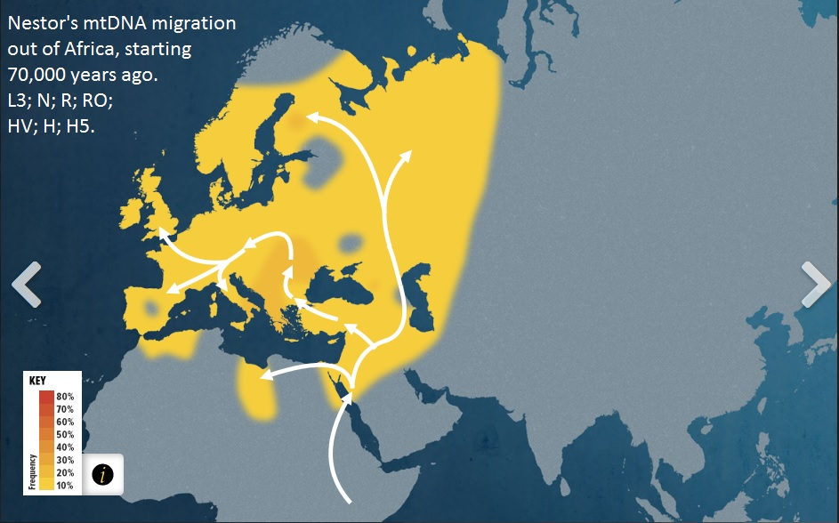
“The Genographic Project”

Slide 8
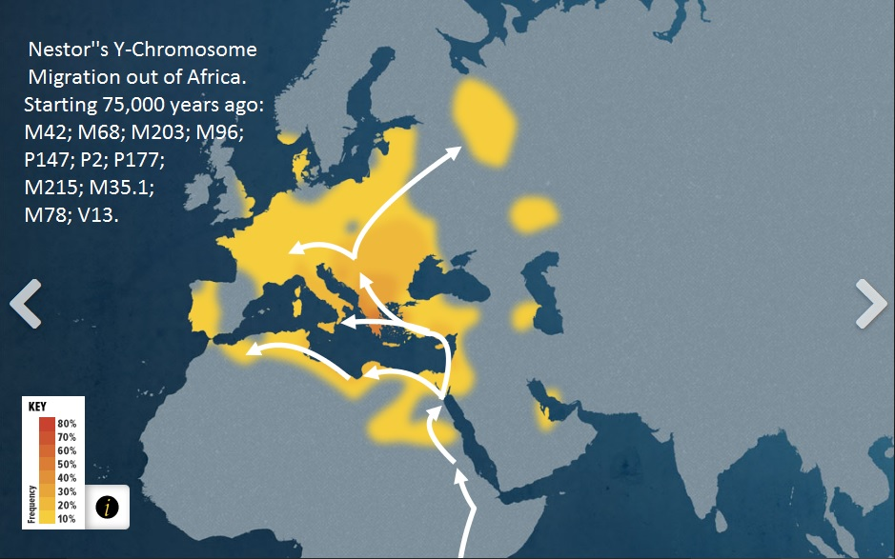
“The Genographic Project”

Slide 9
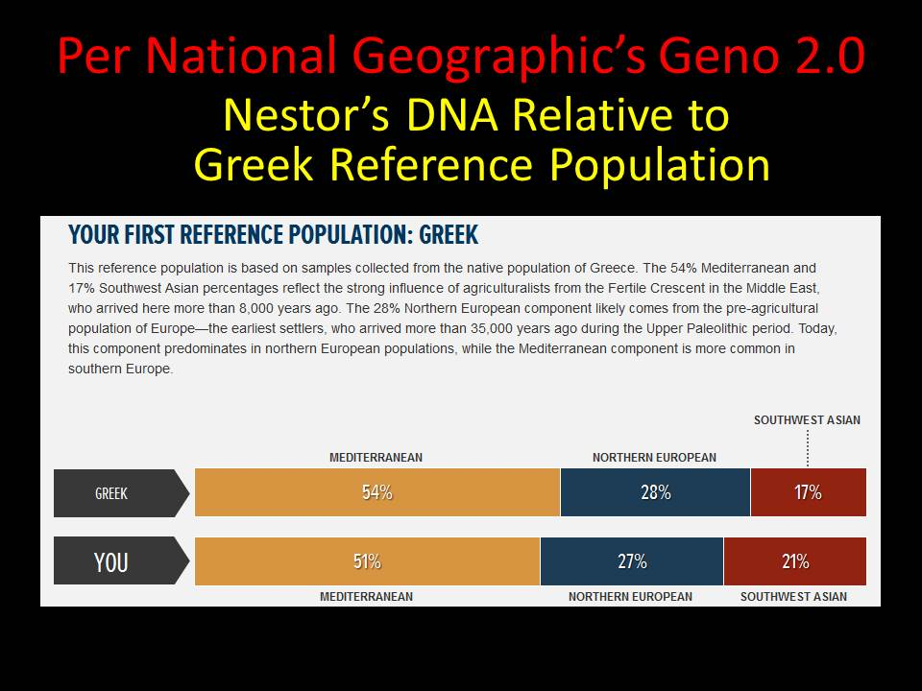
“The Genographic Project”

Slide 10
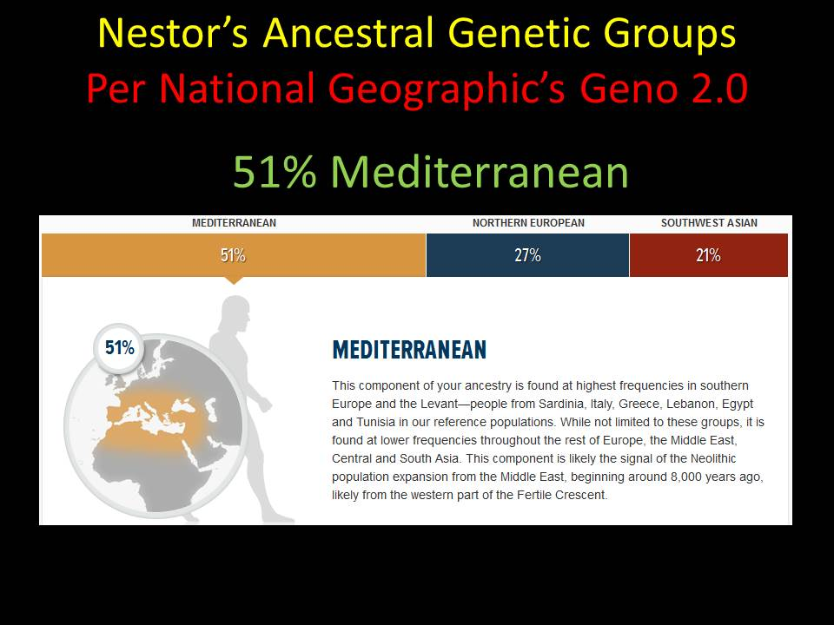
“The Genographic Project”

Slide 11
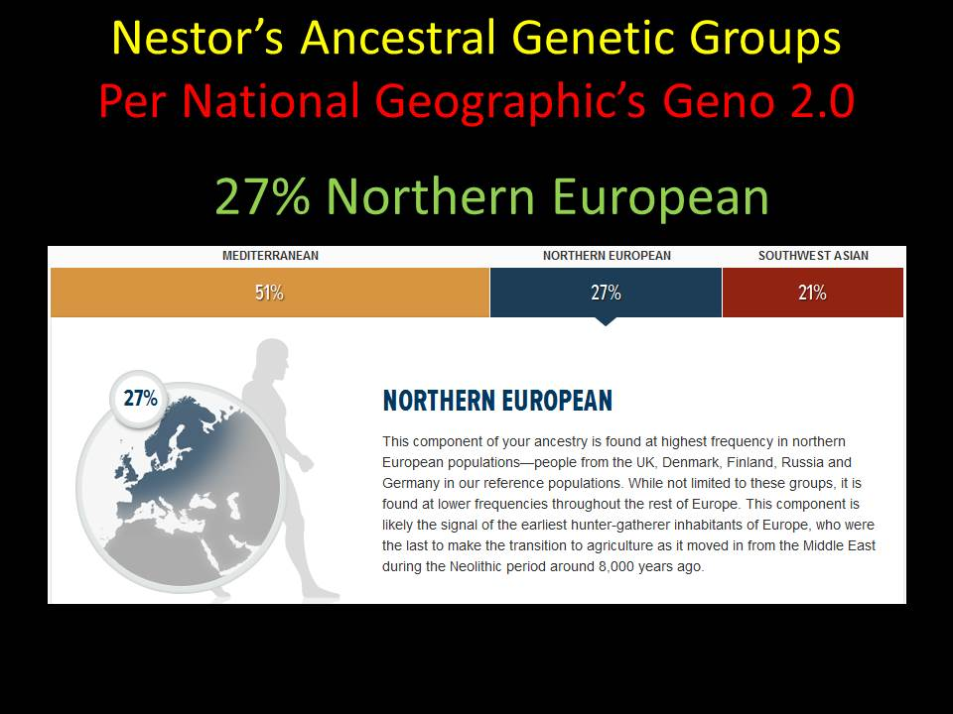
“The Genographic Project”

Slide 12
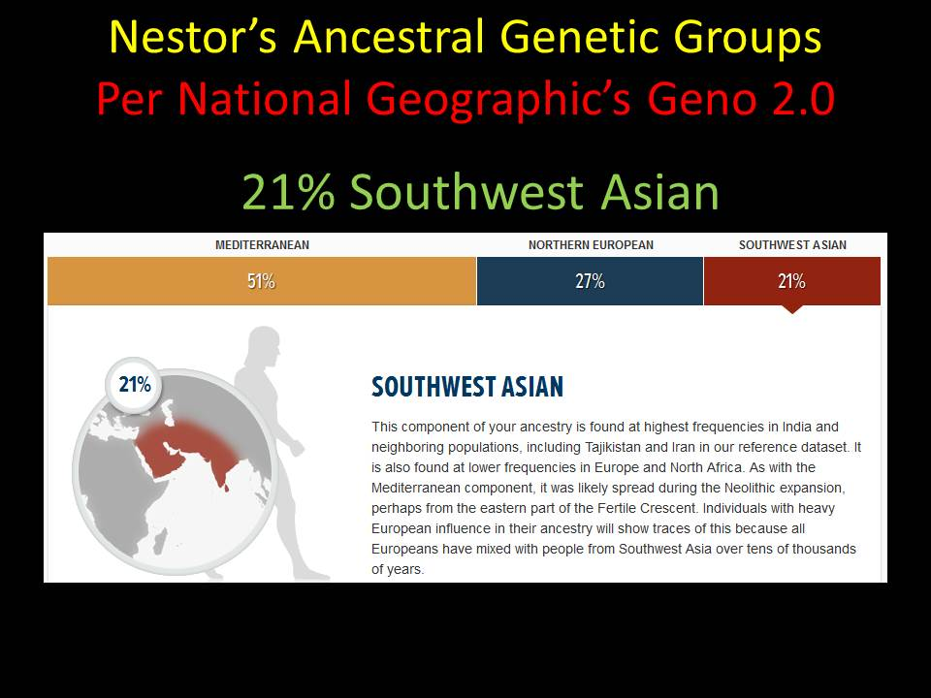
“The Genographic Project”

Slide 13
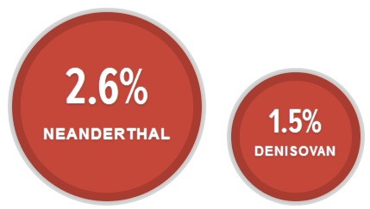
“The Genographic Project”

Slide 14
