Slide 1
Learning: Classical (Pavlovian) Conditioning

Slide 2
Associative Learning
http://en.wikipedia.org/wiki/Learning#Associative_learning
Associative Learning – a form of conditioning in which the organism learns the correlation between two stimuli (classical conditioning), or between a response and stimulus (operant conditioning).
Examples:
Classical (Pavlovian) Conditioning
Instrumental (Operant) Conditioning

Slide 3
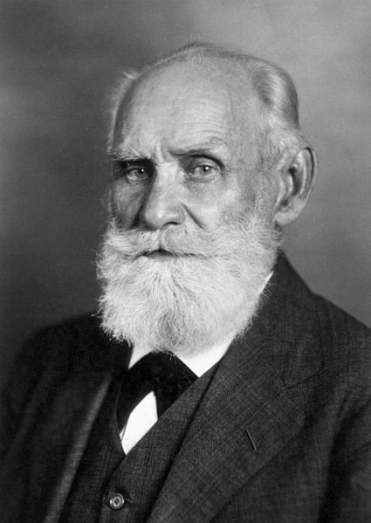
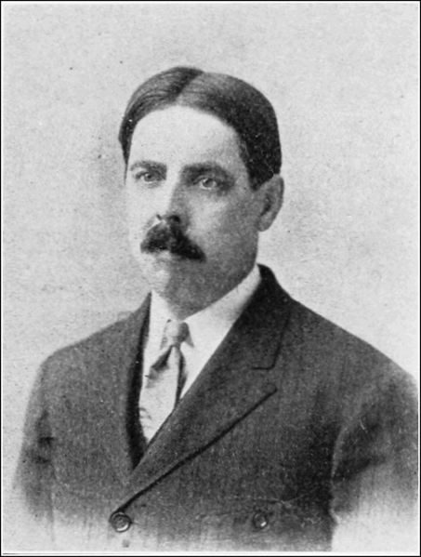
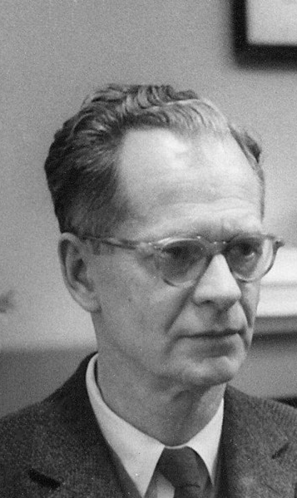

Some Synonyms
Mantra: Conditioning <---> Learning
Pavlovian <---> Classical
Instrumental <---> Operant
Ivan Pavlov
Russia: 1849-1936
Edward Thorndike
USA: 1874-1949
B.F. Skinner
USA: 1904-1990
http://en.wikipedia.org/wiki/File:Ivan_Pavlov_NLM3.jpg
Public Domain in the United States
http://en.wikipedia.org/wiki/File:B.F._Skinner_at_Harvard_circa_1950.jpg
http://en.wikipedia.org/wiki/File:PSM_V80_D211_Edward_Lee_Thorndike.png

Slide 4
Before Classical Conditioning
Unconditioned Stimulus (US)- a stimulus to which the organism responds without training.
Ex. Meat Powder
Unconditioned Response (UR) –an autonomic nervous system response to an untrained stimulus.
Ex. Saliva after Meat Powder Exposure

Slide 5
After Classical Conditioning
Conditioned Stimulus (CS) - a neutral stimulus to which the organism responds only after repeated pairing with the unconditioned stimulus.
Example: The Bell in Pavlov’s Classic Exp.
Conditioned Response (CR) –an autonomic nervous system response to the CS.
Salivation to the Bell in Pavlov’s Classic Exp.

Slide 6

Classical Conditioning
Strength of C.R.
http://commons.wikimedia.org/wiki/File:One_of_Pavlov%27s_dogs.jpg
# of CS / US pairings

Slide 7
Extinction
Extinction – The decrease in CR that occurs when the CS is repeatedly presented without the US.
Extinction
Strength of C.R.
# of CS / US pairings
CS Alone

Slide 8
Spontaneous Recovery
Spontaneous Recovery – The immediate return to pre-extinction CR levels after reinstating CS / US pairings.
Similar to “relapse” in Alcohol Recovery Programs
Extinction
Spontaneous Recovery
Strength of C.R.
# of CS / US pairings
CS Alone
# of CS / US pairings

Slide 9
Other Classical Conditioning Phenomena
https://en.wikipedia.org/wiki/Second-order_conditioning
Second-Order Conditioning – The phenomenon in which a conditioned response to a neutral stimulus increases after repeated pairing to a conditioned stimulus –which is followed by an unconditioned stimulus.
Phase 1
Pair a Bell (CS) to Meat Powder (US)
Phase 2
Pair a Light (2nd order CS) to the Bell (CS)
Light → Bell → Meat Powder
2nd order CS
(also called
“higher order” CS)
Conditioned Stimulus
Unconditioned Stimulus

Slide 10
Other Classical Conditioning Phenomena
Generalization – Occurs when a learned response to a stimulus transfers to a similar (yet different) stimulus.
Ex: Similar responses to a 440 Hz conditioned stimulus and a “new” 450 Hz stimulus.
Discrimination Learning – Occurs when a learned response to a stimulus does NOT transfer to a similar (yet different) stimulus.
Ex: A conditioned response occurs to a 440 Hz conditioned stimulus, but not to a “new” 450 Hz stimulus.
Generalization & Discrimination are opposite phenomena.

Slide 11

Other Classical Conditioning Phenomena
https://commons.wikimedia.org/wiki/File:BauW170B.jpg
https://www.youtube.com/watch?v=SESI19h4wDo

Slide 12
Contiguity vs Contingency
Contiguity – The phenomenon in which two stimuli occur near each other in time.
Contingency – The phenomenon in which the occurrence of one stimulus “reliably” (statistically) predicts the occurrence of a subsequent stimulus.
Mantra – Animals are sensitive to environmental contingencies (more so than to contiguities).

Slide 13
Classical Conditioning & Drug Use
At a biological level, the conditioned response (CR) acts as a preparatory reaction – in the presence of conditioned stimuli – to help the body maintain homeostasis.
Homeostasis – the tendency for a system (biological or otherwise) to operate in a relatively constant range.

Slide 14
Classical Conditioning & Drug Use
Tolerance – The reduced reaction to a drug after repeated use.
https://en.wikipedia.org/wiki/Drug_tolerance
Dependence – A condition “that develops from repeated drug administration, and which results in withdrawal upon cessation of drug use.”
https://en.wikipedia.org/wiki/Substance_dependence
Withdrawal – an ensemble of psychological and/or physiological symptoms that occurs upon cessation of drug use.
Symptoms might include irritability, anxiety, shaking, sweating, heart-rate changes, fatigue, nausea, dizziness, insomnia, headache, etc.
https://en.wikipedia.org/wiki/Drug_withdrawal

Slide 15
