Slide 1
Learning:
Latent & Observational Learning

Slide 2
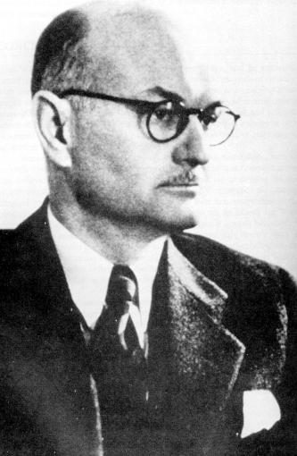
Latent Learning
http://en.wikipedia.org/wiki/Latent_learning
Latent Learning – Learning that occurs without observable changes in behavior.
Maze
Edward Tolman
1886-1959 USA
http://en.wikipedia.org/wiki/File:Tolman,_E.C._portrait.jpg

Slide 3
Cognitive Maps
Cognitive Map – an internal representation of an environment’s spatial arrangement.
Representation – a correspondence between the state of two systems, such that the state of one provides information about the other.
Information – the reduction of uncertainty.
Critical Thinking Question – Would Logical Positivists support or oppose theories that rely on cognitive maps? Explain your choice.

Slide 4
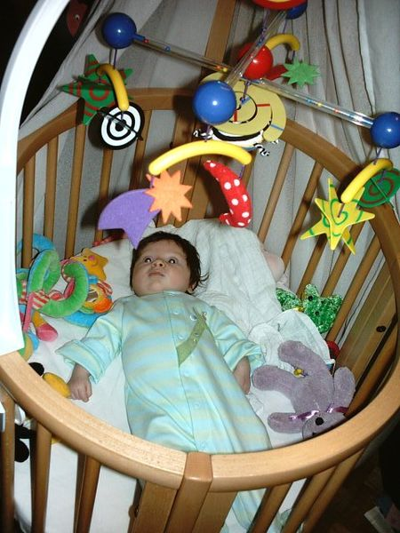
The Joy of Mastery
http://commons.wikimedia.org/wiki/File:Colourful_mobile.jpg
Classic Study - In your own words, explain “the baby-mobile experiment”.
Watson, J. S. (1967). Memory and 'contingency analysis' in infant learning. Merrill-Palmer Quarterly, 13, 55-76.
http://0-www.jstor.org.dewey2.library.denison.edu/stable/23082719

Slide 5
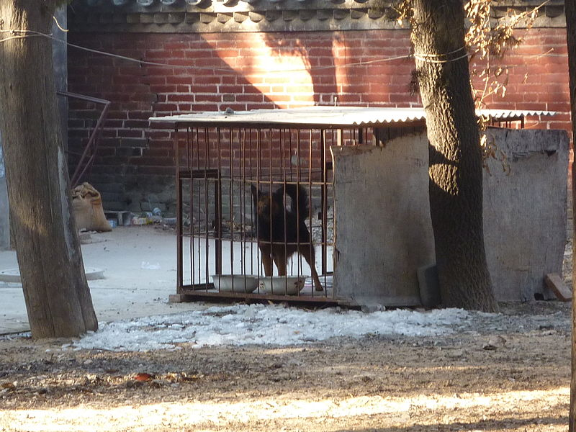
Learned Helplessness
http://en.wikipedia.org/wiki/Learned_helplessness
Learned Helplessness - “a mental state in which an organism forced to endure aversive stimuli…becomes unable or unwilling to avoid subsequent encounters with those stimuli, even if they are escapable, presumably because it has learned that it cannot control the situation”. http://en.wikipedia.org/wiki/Learned_helplessness

Slide 6
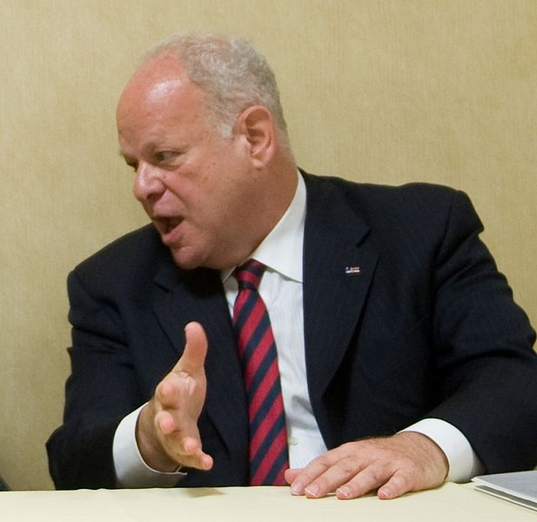
Learned Helplessness
http://en.wikipedia.org/wiki/Learned_helplessness
Critical Thinking Question – In your own words, explain how the concept of learned helplessness can be applied to college students struggling with difficult course material.
Dr. Martin Seligman (b. 1942)
University of Pennsylvania
http://en.wikipedia.org/wiki/File:Flickr_-_The_U.S._Army_-_Comprehensive_Soldiers_Fitness_%281%29cropped.jpg

Slide 7
Observational Learning
Social Learning Theory – “posits that learning is a cognitive process that takes place in a social context and can occur purely through observation or direct instruction, even in the absence of motor reproduction or direct reinforcement.”
http://en.wikipedia.org/wiki/Social_learning_theory

Slide 8
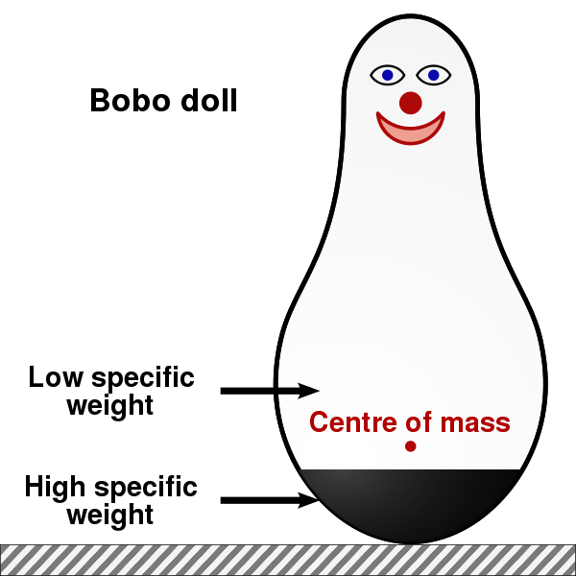
Evidence For Social Learning Theory
http://en.wikipedia.org/wiki/Bobo_doll_experiment
Classic Study – In your own words, explain Albert Bandura’s classic “Bobo Doll experiment” and why it’s important.
http://en.wikipedia.org/wiki/File:Bobo_doll-en.svg

Slide 9
