Slide 1
Learning: Neural Basis of Learning

Slide 2
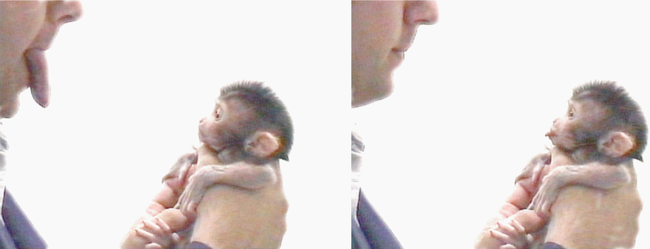
Mirror Neurons
http://en.wikipedia.org/wiki/Mirror_neuron
Mirror Neurons - a neuron that fires both when an animal acts and when the animal observes the same action performed by another.
http://en.wikipedia.org/wiki/File:Makak_neonatal_imitation.png

Slide 3
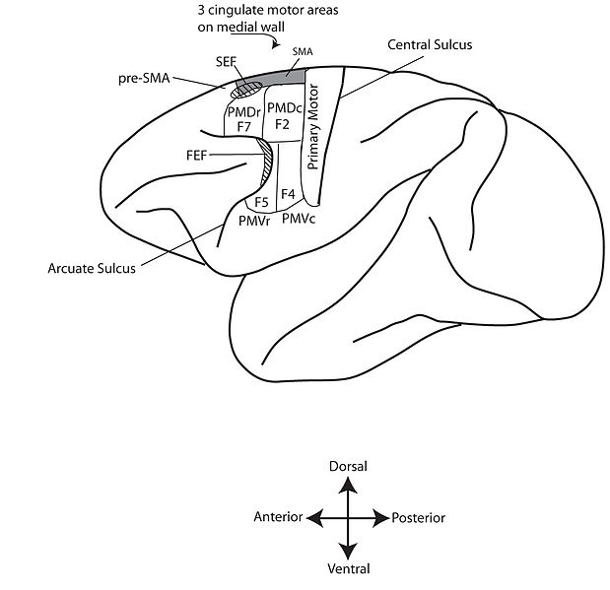
Mirror Neurons
http://en.wikipedia.org/wiki/File:Motor_Cortex_monkey.jpg
Mirror Neurons are located in the ventral pre-motor cortex of the frontal lobe.
In neuro-anatomy, the prefix “pre” means “anterior to”.

Slide 4
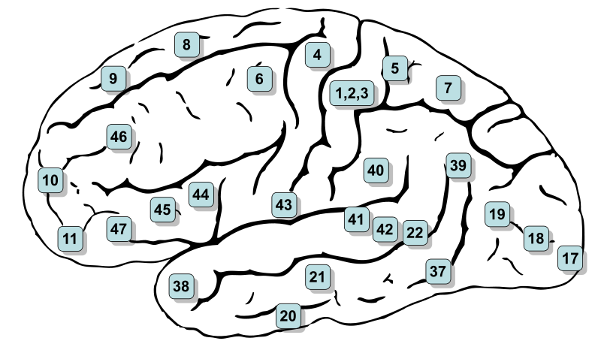
Mirror Neurons: Brodmann’s Area 6
http://en.wikipedia.org/wiki/File:Gray726-Brodman.svg
Brodmann’s
Area 17 =
Primary
Visual
Cortex
“V1”

Slide 5
Mirror Neurons
PubMed Abstract on Mirror Neurons: http://www.ncbi.nlm.nih.gov/pubmed/15217330
BrainFacts.org on Mirror Neurons: http://www.brainfacts.org/brain-basics/neuroanatomy/articles/2008/mirror-neurons/

Slide 6
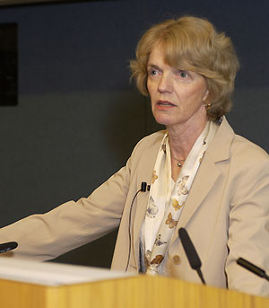
Mirror Neurons
http://en.wikipedia.org/wiki/Mirror_neuron
Mirror Neuron Demo
http://commons.wikimedia.org/wiki/File:Dynamic-Visuomotor-Transformation-Involved-with-Remote-Flying-of-a-Plane-Utilizes-the-%E2%80%98Mirror-pone.0033873.s001.ogv
Critics caution that an individual neuron (even a mirror neuron) cannot be responsible for registering the intentions of others.
Dr. Patricia Smith Churchland
Neurophilosopher
U of California, San Diego
Born 1943

Slide 7
Biological Constraints on Learning
http://en.wikipedia.org/wiki/Taste_aversion
Evidence indicates that animals are not purely “tabula rasa”….some pairings are more easily learned than others, suggesting an innate predisposition or “preparedness”.
Conditioned Taste Aversion –
A unique type of Pavlovian Conditioning
Occurs after a single pairing (e.g. that generates nausea)
Stimulus and illness can be separated by hours!
The pairings are specific
Ingested stimuli associate with nausea (not shock)
Lights and sounds associate with shock (not nausea)

Slide 8
Biological Constraints on Learning
Instrumental Conditioning exhibits biological constraints
As if certain operant responses “belong” to certain stimuli
Pigeons quickly learn to PECK a key for food or water.
Pigeons don’t quickly learn to PECK key to escape electric shock.
Pigeons quickly learn to FLAP wings to escape electric shock
Pigeons don’t quickly learn to FLAP wings for food / water.
These findings contradict “strong” tabula rasa positions

Slide 9
Generalizability Across Species
The basic principles of classical and operant conditioning generalize across diverse animal species because
All animals share a genetic ancestry
And a history that “starts” with the Big Bang
All animals share evolutionary needs (4 F’s)
Feeding
Fleeing
Fighting
Reproduction

Slide 10
Plasticity
Here’s an oldie but goodie
☺
The nervous system is modifiable:
Modifications in how much neurotransmitter a presynaptic neuron releases
Modifications in new connections by growing new dendritic spines
Modifications in neuron sensitivity to neurotransmitters

Slide 11
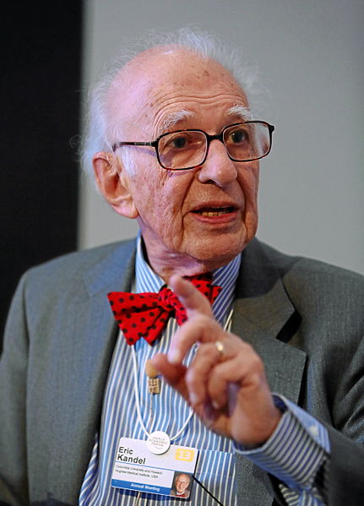
Neural Basis of Learning
http://en.wikipedia.org/wiki/File:Eric_Kandel_World_Economic_Forum_2013.jpg
Eric Kandel (Columbia University) earned a Nobel Prize (2000)
for research on Long Term Potentiation…

Slide 12
Long Term Potentiation
Long Term Potentiation (LTP) – An enduring (24 hours….to a lifetime) increase in a post-synaptic neuron’s responsiveness to specific inputs, cause by repeated stimulation
LTP is considered the cellular / molecular basis of learning & memory
LTP Video
http://www.youtube.com/watch?v=vso9jgfpI_c

Slide 13
Hebb’s Rule
Donald Hebb (1904 – 1985)
Canadian Psychologist, McGill University
Neurons that fire together, “wire” together

Slide 14
