Slide 1
Learning:
Non-Associative
Learning

Slide 2
Learning
Learning – A relatively permanent change in performance potential, caused by certain kinds of experiences.

Slide 3
Learning
Critical Thinking Question – Why does the definition above stress performance potential, rather than simply performance?
Critical Thinking Question – Would you consider dark-adaptation, which occurs when you sit in a dark movie theater, to be a form of learning? Why or Why Not?

Slide 4
Learning
Learning is not directly observed by the senses, but instead must be inferred from the behavior of organisms.
  We wouldn’t say, “Draw me a picture (or play me the sound) of learning”.
  Note: Gravity is also inferred rather than directly observed by the senses.
    We can test falsifiable theories of gravity by experiments on the behavior or objects.
    We can test falsifiable theories of learning by experiments on the behavior or organisms.

Slide 5
Non-Associative Learning
http://en.wikipedia.org/wiki/Learning#Non-associative_learning
Non-Associative Learning – “a relatively permanent change in the strength of the response to a single stimulus caused by repeated exposure to that stimulus. Changes due to such factors as sensory adaptation, fatigue, or injury do not qualify as non-associative learning.”
Examples:
  Habituation (Desensitization)
  Sensitization

Slide 6
Habituation
Habituation - “a form of (non-associative) learning in which an organism decreases or ceases to respond to a stimulus after repeated presentations”. http://en.wikipedia.org/wiki/Habituation
  Also called desensitization
    Habituation and desensitization are distinct from sensory adaptation, which is a temporarily reduced ability to detect stimuli.
Potential Pop Quiz Question – Provide a your own novel example of habituation from everyday life. Explain your choice.

Slide 7

Habituation
http://commons.wikimedia.org/wiki/File:Kabul_City_Traffic.jpg
Potential Pop Quiz Question – In your own words, explain why habituation might be evolutionarily adaptive.

Slide 8
Sensitization
http://en.wikipedia.org/wiki/Sensitisation
Sensitization – “a non-associative learning process in which repeated administrations of a stimulus result in the progressive amplification of a response”.
Example: Fast-food workers become sensitized to the call for “Large Fry”, amidst the buzz of task-irrelevant auditory stimulation.

Slide 9
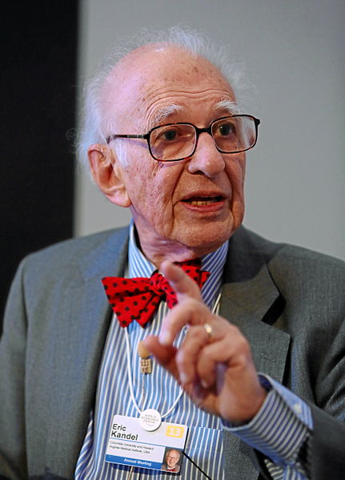
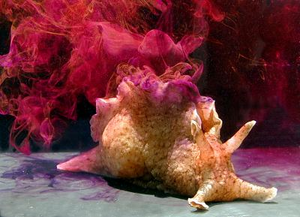
Sensitization
http://en.wikipedia.org/wiki/File:Eric_Kandel_World_Economic_Forum_2013.jpg
http://en.wikipedia.org/wiki/File:Aplysia_californica.jpg
Eric Kandel (Columbia University) earned a Nobel Prize (2000)
for research on the physiological basis of sensitization
(and memory), in Aplysia Californica (“Sea Slugs”).

Slide 10
