Slide 1
Memory:
Memory Failures
&
Improving Memory

Slide 2
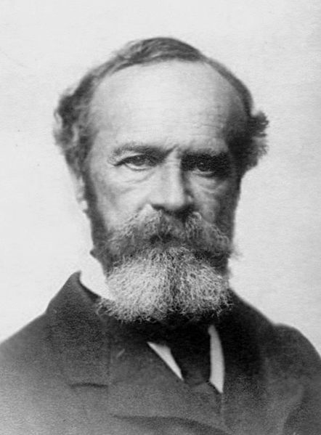
Memory Failures
http://en.wikipedia.org/wiki/File:Wm_james.jpg
Partial Retrieval
Tip of the Tongue Phenomena – a retrieval failure in which one can recall features of the target item, such as the first letter, or rhyming words.
William James described the TOT phenomena
- but not by that name - in the Principles of Psychology (1890).

Slide 3
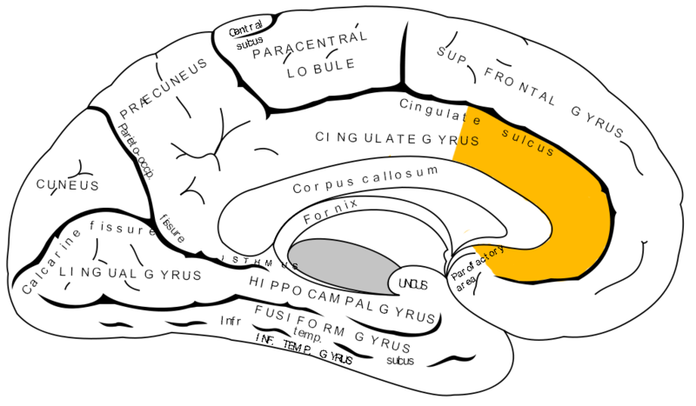
Tip of the Tongue Phenomena
http://en.wikipedia.org/wiki/File:Gray727_anterior_cingulate_cortex.png
“The anterior cingulate cortex shows increased activation in TOT states.”
http://en.wikipedia.org/wiki/Tip_of_the_tongue
PMIDs: 15670690, 19642890, 11576194
https://www.youtube.com/watch?v=WkdIZK4F9iE

Slide 4
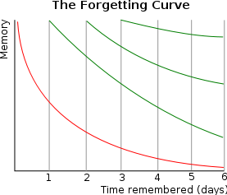
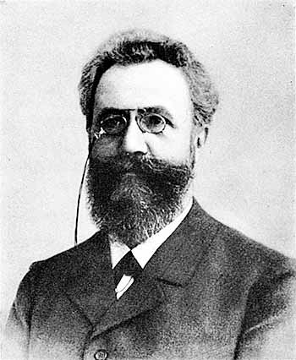
Forgetting
Where R is memory retention, S is the relative strength of memory, and t is time.
“e” is Euler’s Number (2.718281824…)
http://en.wikipedia.org/wiki/Forgetting_curve
https://en.wikipedia.org/wiki/E_(mathematical_constant)
http://en.wikipedia.org/wiki/File:ForgettingCurve.svg
http://en.wikipedia.org/wiki/Hermann_Ebbinghaus
Hermann Ebbinghaus
Germany 1850-1909

Slide 5
Forgetting
Two Factors That Influence Forgetting
Retention Interval – Time between learning and retrieval
New Learning– recently acquired information disrupts memory of older information.
Note: These two factors tend to be correlated.

Slide 6
Memory Intrusions
http://en.wikipedia.org/wiki/Interference_theory
Proactive Interference - the phenomenon that occurs when previously learned information impedes the recall of newly learned information.
The old disrupts the new
Retroactive Interference - the phenomenon that occurs when newly learned information impedes the recall of previously learned information.
The new disrupts the old

Slide 7
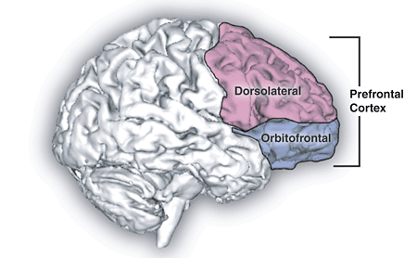
Memory Intrusions
http://en.wikipedia.org/wiki/File:Prefrontal_cortex.png
fMRI evidence suggests the prefrontal cortex helps to resolve (overcome) proactive interference.
PMID: 17904389

Slide 8
Memory Intrusions
Anterograde Amnesia – A memory deficit in which the patient is unable to form memories of information acquired after brain trauma.
Retrograde Amnesia – A memory deficit in which the patient loses information acquired before the brain trauma.

Slide 9


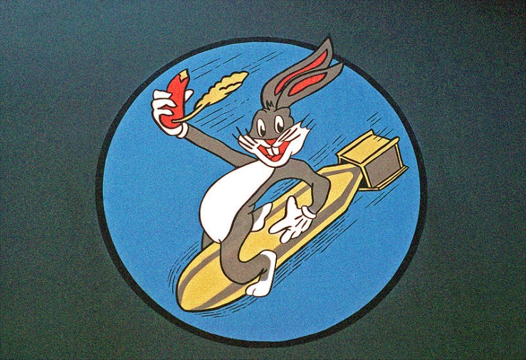
Memory Intrusions
http://en.wikipedia.org/wiki/Misinformation_effect
http://en.wikipedia.org/wiki/File:Elizabeth_Loftus-TAM_9-July_2011.JPG
Misinformation Effect – the phenomenon in which memory becomes less accurate because of post event information.
Dr. Elizabeth Loftus
Memory Researcher
Born 1944
http://en.wikipedia.org/wiki/File:DisneylandCastle.JPG
http://commons.wikimedia.org/wiki/File:FB-111_Bugs_Bunny_Nose_Art.jpeg

Slide 10
Memory Intrusions
Schemas – Organized bits of knowledge.
Let’s make that a mantra.
Schemas help organize complex information, but can also cause memory errors.
Deese–Roediger–McDermott (DRM) - paradigm is a procedure in cognitive psychology used to study false memory in humans, via a “lure” i.e., a semantically (thematically) related distractor item.

Slide 11
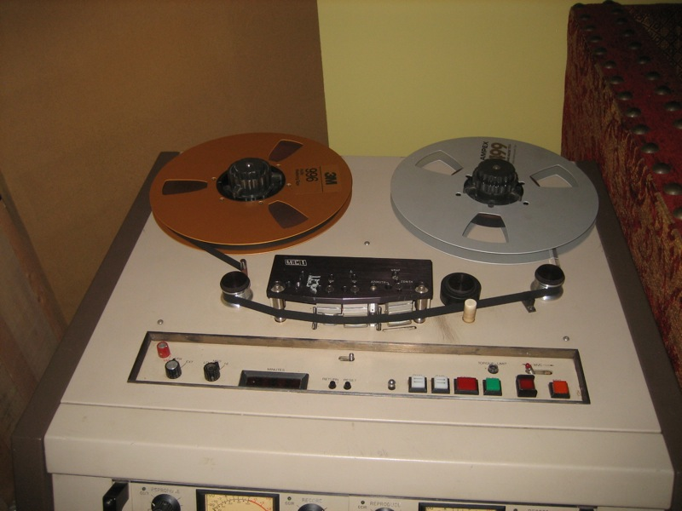
Memory Intrusions
http://commons.wikimedia.org/wiki/File:MCI_Tape_Recorder_%28Greenhouse_Studio%29.jpg
Memory is NOT like a tape recorder

Slide 12
Memory Intrusions
http://en.wikipedia.org/wiki/File:TheCat.png
Mantra:
Memory is Constructive
Mantra:
Memory is “Top Down”

Slide 13
Top-Down vs Bottom-Up
Here’s an oldie but goodie
☺
Top-Down Process –
“Knowledge Driven”
Requires information beyond the stimulus
Bottom-Up
“Stimulus Driven”
Relies entirely on the neural response to stimulation
Demo: ABC versus 12 13 14

Slide 14
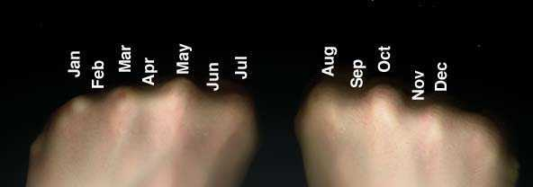
Improving Memory
http://en.wikipedia.org/wiki/File:Knucklemnemonic.jpg
Mnemonics - any learning technique that aids information retention.
Method of Loci
Rhyming Schemes
Active Mental Imagery

Slide 15
Improving Retrieval
Encoding Specificity – The principle that states memory will be most effective when the retrieval and acquisition contexts are similar.
Example: A psychology professor may provide hints (i.e., retrieval cues) to an answer by reminding students of the context in which a memory was acquired.
This is the process of “context reinstatement”

Slide 16
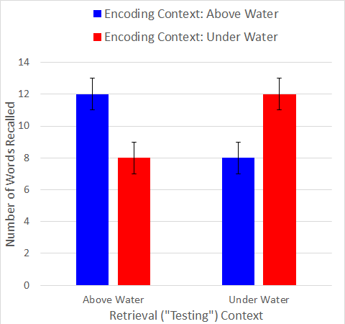
Improving Retrieval
“The Diving Study”
CONTEXT-DEPENDENT MEMORY IN TWO NATURAL ENVIRONMENTS: ON LAND AND UNDERWATER
Godden & Baddelley, 1975, British Journal of Psychology

Slide 17
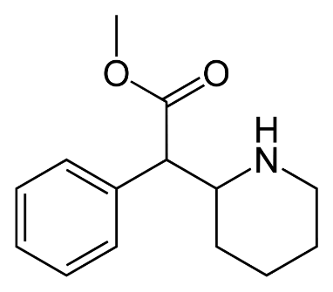
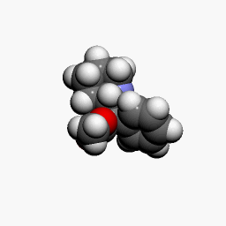
Discussion Topics
http://en.wikipedia.org/wiki/File:Methylphenidate3Dan.gif
Methylphenidate & Cognitive Enhancing Drugs
https://en.wikipedia.org/wiki/Methylphenidate#Enhancing_performance
Drug Induced Amnesia
Holmes, E. A., Sandberg, A., & Iyadurai, L. (2010). Erasing trauma memories. The British Journal of Psychiatry, 197(5), 414-415.
http://bjp.rcpsych.org/content/197/5/414.3.long
http://en.wikipedia.org/wiki/File:Methylphenidate-2D-skeletal.svg

Slide 18
