Slide 1
Memory
Memory Processes
&
3 Stage Model

Slide 2
Memory: Motivation / Definition
“Memory is the glue that binds our mental life together.”
      Eric Kandel https://www.youtube.com/watch?v=ZKg79cNCVzw
Memory – Differential responding to previously presented stimuli.

Slide 3
Memory Processes
Three Central Memory Processes
  Encoding (or Acquisition)
    Relies heavily on Sensation & Perception
    Environmental stimulation must be “transduced” into action potentials in the nervous system.
    Any stimulus that is not encoded cannot be stored
  Storage
    Any item that is not stored cannot be retrieved
  Retrieval

Slide 4
Memory Processes
Encoding (or Acquisition) – The process of converting sensory information into a form that we can report.
Or, the process of gaining new information.
    Mantra – Information is the reduction of uncertainty.
  Intentional Learning – deliberate effort to acquire knowledge for later use.
  Incidental Learning – the acquisition of knowledge that occurs without deliberation or effort.

Slide 5
Memory Processes
Storage – “the creation of a permanent record of the encoded information” http://en.wikipedia.org/wiki/Memory#Physiology
  Consolidation – the “solidification” of new information as it transfers from short to long term memory.
    Consolidation (but not storage) frequently occurs via activity in the hippocampus…
    Hippocampus Etymology - From the Greek Hippos (horse) Kampos (sea monster) http://en.wikipedia.org/wiki/Hippocampus

Slide 6
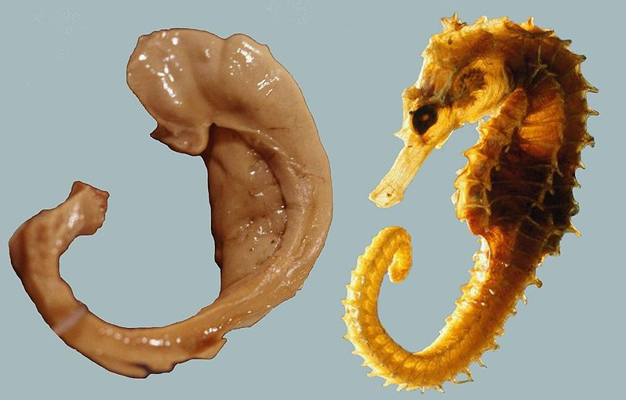
Hippocampus
http://en.wikipedia.org/wiki/File:Hippocampus_and_seahorse_cropped.JPG
Named by Venetian anatomist Julius Caesar Aranzi (1587)

Slide 7
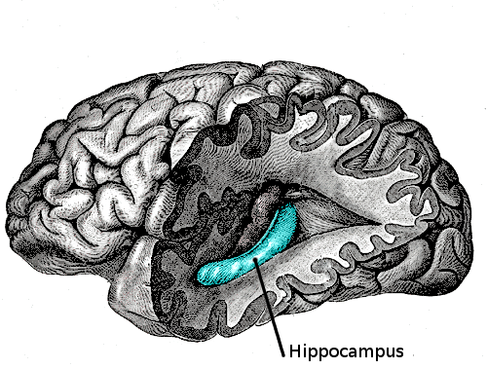
Hippocampus
http://en.wikipedia.org/wiki/File:Gray739-emphasizing-hippocampus.png

Slide 8
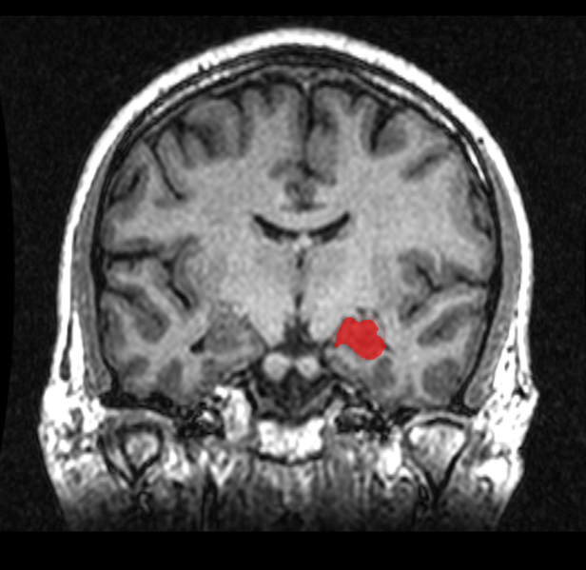
Hippocampus
http://en.wikipedia.org/wiki/File:MRI_Location_Hippocampus_up..png

Slide 9
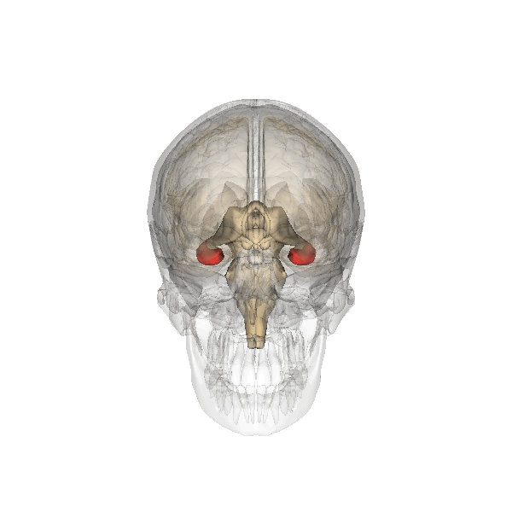
Hippocampus
http://en.wikipedia.org/wiki/File:Hippocampus.gif

Slide 10
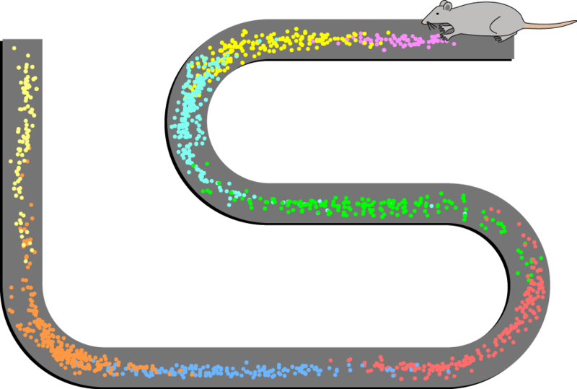
Hippocampus
http://en.wikipedia.org/wiki/File:Place_Cell_Spiking_Activity_Example.png

Slide 11
Figure Caption
http://en.wikipedia.org/wiki/File:Place_Cell_Spiking_Activity_Example.png
“Spatial firing patterns of 8 place cells recorded from the CA1 layer of a rat. The rat ran back and forth along an elevated track, stopping at each end to eat a small food reward. Dots indicate positions where action potentials were recorded, with color indicating which neuron emitted that action potential.”
Note: You will frequently see “CA1”, “CA2”, “CA3” to refer to specific subsections of the Hippocampus’ cornu ammonis (CA)

Slide 12
Memory Processes
Retrieval – The use of stored information.
  Recall – A type of retrieval that requires information about a previously presented stimulus that is not currently in the environment.
  Recognition– A type of retrieval that requires judging a stimulus that is physically present in the environment.

Slide 13
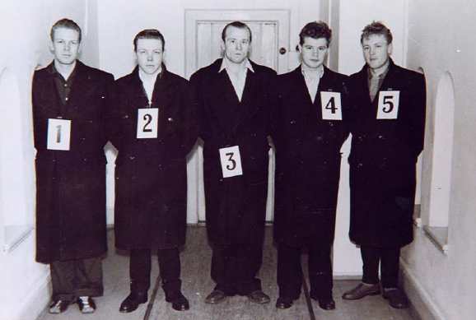
Recognition Example
https://commons.wikimedia.org/wiki/File:Oppstilling-2.jpg
Police Lineup

Slide 14
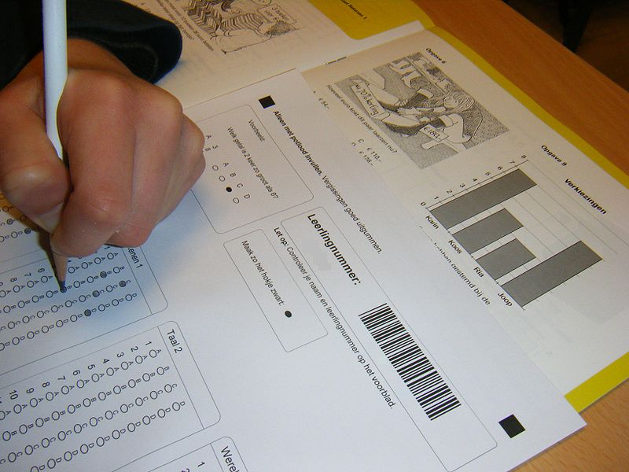
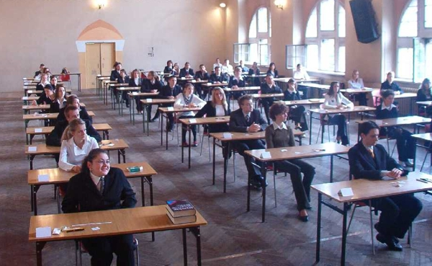
Multiple Choice Tests Rely on Recognition
Discussion Question - What are the costs & benefits of
colleges & universities “going Test Optional”
i.e., not requiring applicants to submit standardized test scores?
http://en.wikipedia.org/wiki/File:Cito_Eindtoets_Basisonderwijs.JPG
http://en.wikipedia.org/wiki/File:Matura2005_ILOSzczecin.jpg

Slide 15

Three-Stage Model of Memory
http://en.wikipedia.org/wiki/File:Multistore_model.png

Slide 16
Sensory Memory
Sensory Memory – “holds sensory information for a few seconds or less after an item is perceived.” http://en.wikipedia.org/wiki/Memory#Sensory_memory
  Iconic Memory
    fast decaying store of visual information
  Echoic Memory
    fast decaying store of auditory information
  Haptic Memory
    fast decaying store of tactile (“touch”) information

Slide 17
Short Term Memory
Short Term (Working) Memory – a type of memory that operates in the seconds to minutes time scale, with a limited capacity.
Miller’s Magic Number – The alleged capacity of short term memory (STM) is approximately 7 items + 2.

Slide 18
Short Term Memory Phenomena
  Chunking – The process of organizing (“recoding”) information to-be- remembered by grouping / combining items into larger units.
  Mantra: Organization is a key to memory!
    Experts often have the same memory capacity as novices, but organize information differently.
  Maintenance (Rote) Rehearsal – The act of repeating (silently or aloud) information to-be-remembered.

Slide 19
Long Term Memory
Long Term Memory (LTM) – a type of memory that operates on the time scale of minutes to years, with a comparatively large capacity.
Analogy:
  STM → A book that you hold on your lap now
    Or, the individual file currently open on your computer
  LTM → The entire library
    Or, all the files on your computer drive

Slide 20
Levels of Processing
Levels of Processing – An approach to the study of memory that emphasizes how memory depends on the qualities of the tasks one performs.
  Shallow Processing – Tasks that require only sensory level information
  Deep Processing – Tasks that require semantic information, i.e., knowledge of what items mean and/or relate to one another.

Slide 21
Primacy & Recency Effects in Recall
Primacy Effect – the phenomenon in which items presented earliest in a sequence are recalled more frequently than those presented in the middle.
Recency Effect – the phenomenon in which items presented near the end of a sequence are recalled more frequently than those presented in the middle.

Slide 22
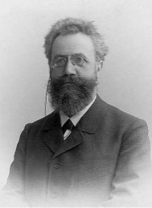
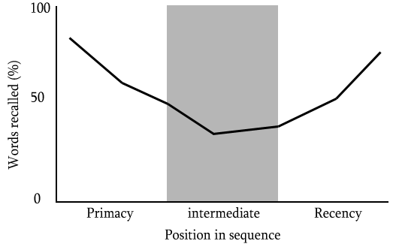

Serial Position Effect
Hermann Ebbinghaus
http://en.wikipedia.org/wiki/File:Serial_position.png
https://commons.wikimedia.org/wiki/File:Ebbinghaus2.jpg

Slide 23
Serial Position Effect
The recency effect can be disrupted with an interference task, e.g., testing recall after requiring participants to count backwards from 100, by 7’s.
  This disruption demonstrates that the recency effect relies on retrieval from working memory.
  The interference task does not similarly disrupt primacy effect, suggesting that distinct neural events govern the recency and primacy effects.

Slide 24
Serial Position Effect
The primacy effect can be enhanced or reduced, respectively, by slowing or speeding the stimulus presentation.
  Slowing the presentation rate allows more time for rote rehearsal and long term storage.
  Slowing or speeding the presentation rate has no effect on the recency effect, suggesting that distinct neural events govern the recency and primacy effects.

Slide 25
Dissociations
Dissociation – occurs when one behavior (“A”) can be disrupted without altering a separate behavior (“B”), suggesting at least some independence between the neural events governing the two behaviors.
Double Dissociation – occurs when one behavior (“A”) can be disrupted without altering a separate behavior (“B”) –and vice versa – suggesting considerable independence between the neural events governing the two behaviors.

Slide 26
