Slide 1
Memory:
Varieties
of
Memory

Slide 2
Varieties of Memory
Explicit memory – the intentional retrieval of prior information or experiences. http://en.wikipedia.org/wiki/Explicit_memory
Implicit memory – the phenomenon in which task performance is altered by past experiences without conscious awareness. http://en.wikipedia.org/wiki/Implicit_memory
Critical Thinking Question– Would logical positivists accept or reject the above definitions? Explain your choice.

Slide 3
Varieties of Memory
Some researchers prefer to use the terms…
  Declarative Memory (for Explicit Memory)
    Operationalized as the ability to correctly report (“declare”) how or when the memory was acquired.
      Such reports can be independently confirmed or disconfirmed.
        No need for mentalistic (non-empircal) constructs like “awareness” or “consciousness” or “intentionality”
  Non-Declarative Memory (for Implicit Memory)
    Operationalized as the inability to correctly report (“declare”) how or when the memory was acquired.
      Such reports can be independently confirmed or disconfirmed.
        No need for mentalistic (non-empircal) constructs like “awareness” or “consciousness” or “intentionality”

Slide 4
Explicit (Declarative) Memory
Episodic Memory – the retrieval “of autobiographical events (times, places, associated emotions, and other contextual who, what, when, where, why knowledge) that can be explicitly stated”.
    http://en.wikipedia.org/wiki/Episodic_memory

Slide 5
Explicit (Declarative) Memory
Semantic Memory – the retrieval of meanings, concepts, categories, or other abstractions. http://en.wikipedia.org/wiki/Semantic_memory
Most mantras and potential pop quiz questions in this course require semantic memory.
  Ex. “Estimate a p-value for this graph.”
    To answer this, one must recall what a p-value means, what its range is, and how those concepts match information in the graph.

Slide 6
Implicit (Non-declarative) Memory
Procedural memory – the type of memory that guides action.
  Pertains both to motor and cognitive skills
    Examples
      Riding a bike
      Singing
      Musical Instrument Playing
      Reading

Slide 7
Implicit (Non-declarative) Memory
Research Question – In your own words, explain how the study of patient H.M. established a dissociation between the neural events mediating procedural and declarative memory.
Patient H.M. - http://en.wikipedia.org/wiki/Henry_Molaison
H.M. Brain Slice Video http://thebrainobservatory.ucsd.edu/hm_live.php

Slide 8
Implicit (Non-Declarative) Memory
http://en.wikipedia.org/wiki/Priming_(psychology)
Priming - an implicit memory effect in which exposure to a stimulus influences a response to a later stimulus.
Example
  Exposure to the word “T H I S”
  Increases frequency of “THIS” when prompted with “T H _ _”.

Slide 9

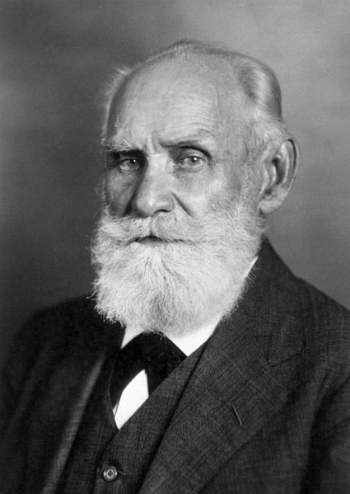

Implicit (Non-Declarative) Memory
Classical Conditioning
Pavlovian <---> Classical
http://commons.wikimedia.org/wiki/File:One_of_Pavlov%27s_dogs.jpg
Strength of C.R.
Ivan Pavlov
Russia: 1849-1936
http://en.wikipedia.org/wiki/File:Ivan_Pavlov_NLM3.jpg
Public Domain in the United States
# of CS / US pairings

Slide 10
