Slide 1
Reliability
&
Validity

Slide 2
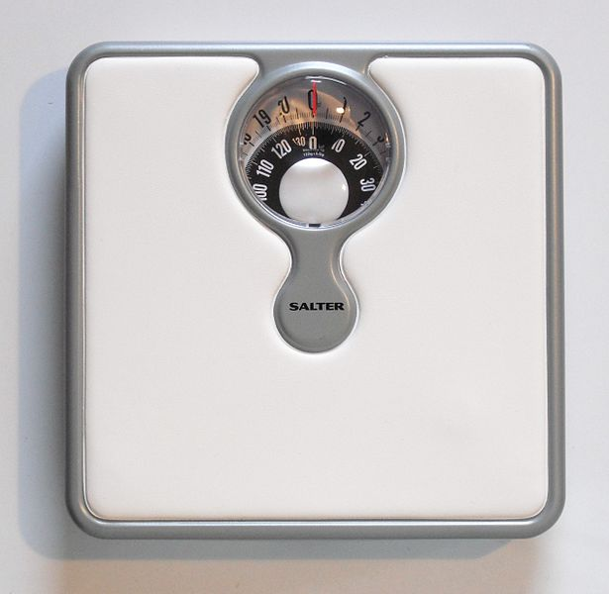
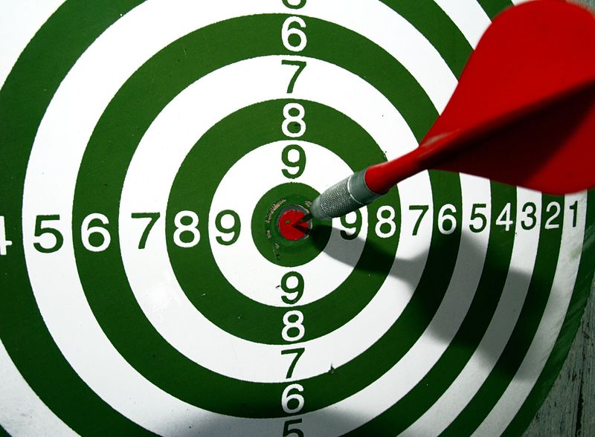
Reliability
https://commons.wikimedia.org/wiki/File:Bullseye_dart.JPG
https://commons.wikimedia.org/wiki/File:SalterBathroomScales.JPG
Reliability – The repeatability of a measure. The consistency with which a measurement is made.

Slide 3

Internal Validity
https://en.wikipedia.org/wiki/Polo#/media/File:Varsity_Polo_2013.jpg
Internal Validity – The extent to which researchers measure what they claim to be measuring.

Slide 4
External Validity
External Validity – The generalizability of a finding to novel conditions…
  Stimuli
  Tasks
  Situations
  Environments
  Populations

Slide 5

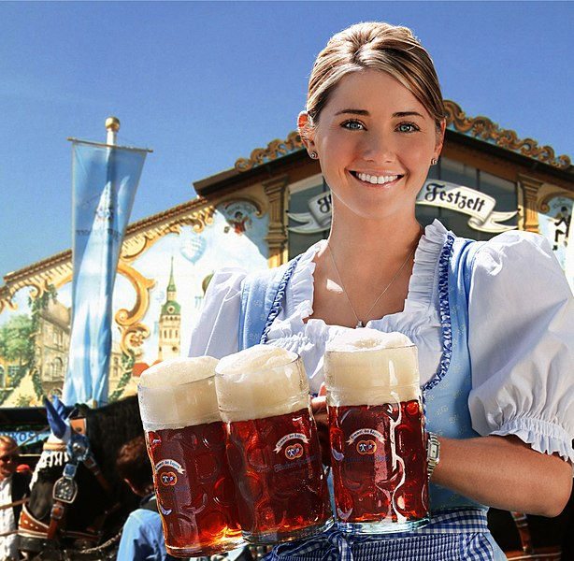

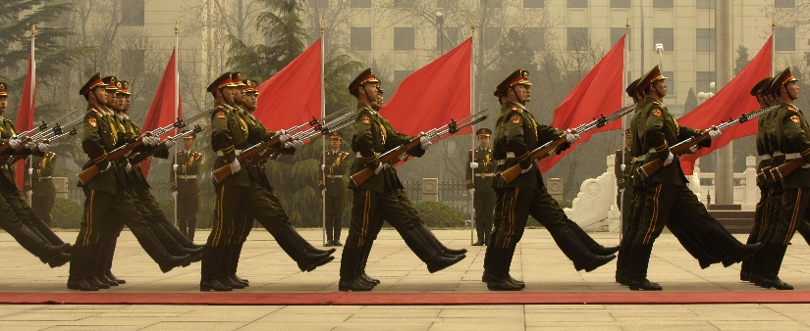
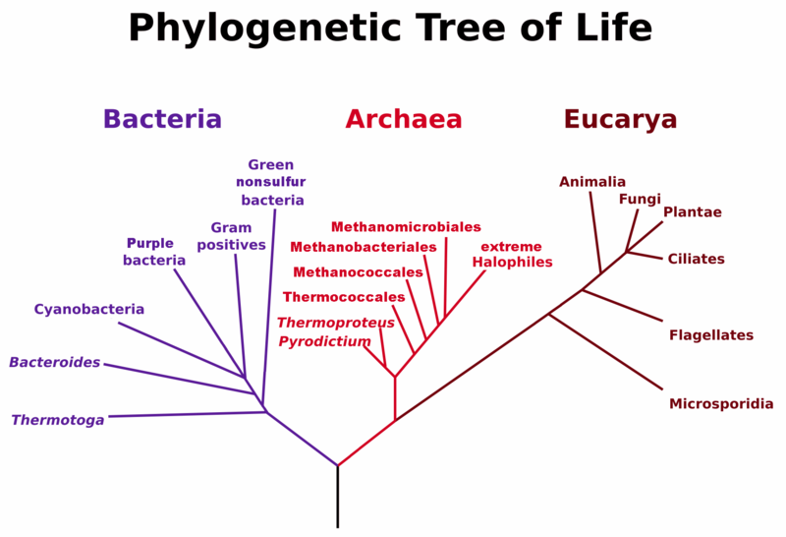
External Validity
https://en.wikipedia.org/wiki/Culture#/media/File:Chinese_honor_guard_in_column_070322-F-0193C-014.JPEG
https://commons.wikimedia.org/wiki/File:PhylogeneticTree,_Woese_1990.PNG
https://commons.wikimedia.org/wiki/File:Gobustan_ancient_Azerbaycan_full.jpg
https://commons.wikimedia.org/wiki/File:Hacker-Pschorr_Oktoberfest_Girl_Remix.jpg
https://commons.wikimedia.org/wiki/File:Sri_Mariamman_Temple_Singapore_3_amk.jpg

Slide 6
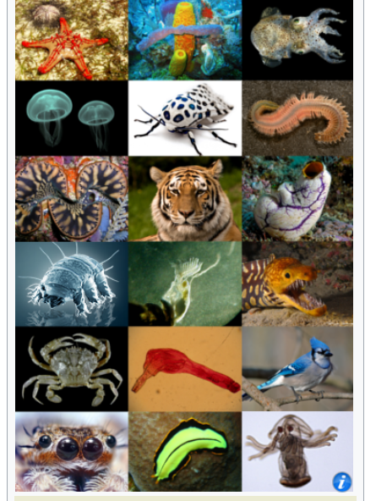
External Validity
https://en.wikipedia.org/wiki/Animal

Slide 7
