Slide 1
Research
Ethics

Slide 2
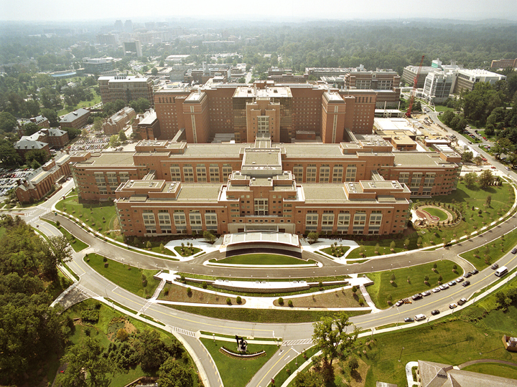

Research Ethics
https://commons.wikimedia.org/wiki/File:NIH_Clinical_Research_Center_aerial.jpg
National Institutes of Health Bethesda, Maryland Campus
https://commons.wikimedia.org/wiki/File:NIH_Master_Logo_Vertical_2Color.png

Slide 3
Research Ethics
Before conducting a Psychological study, approval must be earned from an ethics board,
Institutional Review Board (IRB)
Human Participants
Institutional Animal Care & Use Committee (IACUC)
Non-human Animal Participants
Human participants must provide informed consent, and must be debriefed.

Slide 4
Research Ethics
The IRB ensures
Physical and emotional well-being
Privacy – anonymity or confidentiality
Dignity
The opportunity to stop at any time w/o penalty
The IRB considers “minimal risk”
Are the risks in the experiment different from those of everyday life?

Slide 5
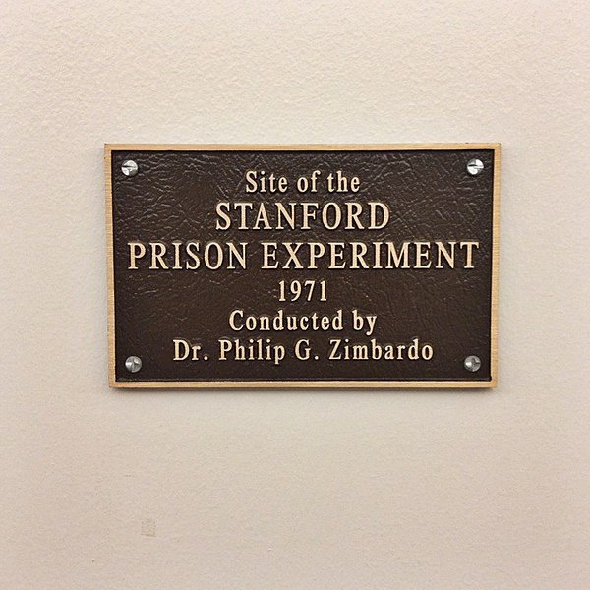

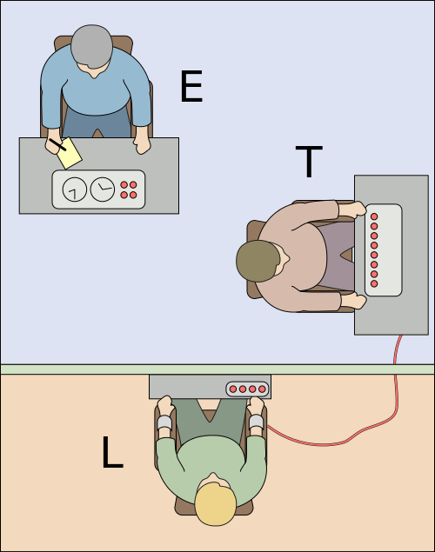
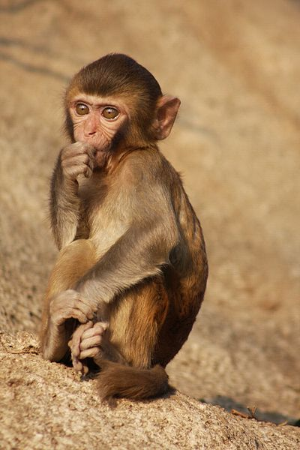
Research Ethics
https://commons.wikimedia.org/wiki/File:Plaque_Dedicated_to_the_Location_of_the_Stanford_Prison_Experiment.jpg
https://commons.wikimedia.org/wiki/File:Rhesus_Macaque_(Macaca_mulatta)_(5780783616).jpg
https://commons.wikimedia.org/wiki/File:Milgram_experiment_v2.svg
https://en.wikipedia.org/wiki/Milgram_experiment#/media/File:Milgram_Experiment_advertising.png

Slide 6
