Slide 1
Science
&
Hypotheses

Slide 2
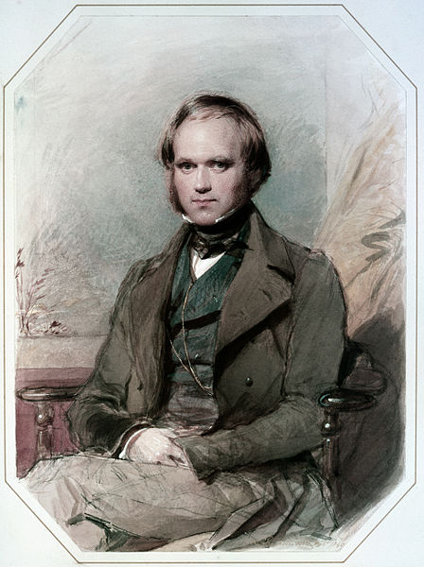
What is Science?
https://commons.wikimedia.org/wiki/File:Charles_Darwin_by_G._Richmond.jpg
Some Criteria That Guide Science
1. Falsifiability - Is the claim testable?
2. Replicability – Can a test be re-done ‘at will’?
3. Parsimony – Are there unnecessary or unnatural components?
Occam’s Razor - All else equal, the simplest explanation is preferred. https://en.wikipedia.org/wiki/Occam%27s_razor

Slide 3
Hypotheses
Hypothesis – A testable and tentative explanation for a phenomenon.
Science does NOT prove hypotheses.
“Prove” is ‘too strong’
Please remove “prove” from your vocabulary.
Science either rejects (disconfirms) or fails to reject a hypothesis.

Slide 4
Science is Rigorous!
Scientific conclusions demand evidence
Strong claims demand strong evidence
Scientists seek to challenge their own hypotheses
Scientists must allow others the chance to evaluate / replicate / reinterpret their findings (using the scientific method)
Scientific conclusions typically rely on multiple “converging” studies (diverse methods yielding similar conclusions).

Slide 5
Science is Practical!
Science can inform …
Parenting
Teaching
Athletics
Art
Medicine
Civic activities
Politics
Everyday life!

Slide 6
