Slide 1
Sensation:
Origins of
Our
Knowledge

Slide 2
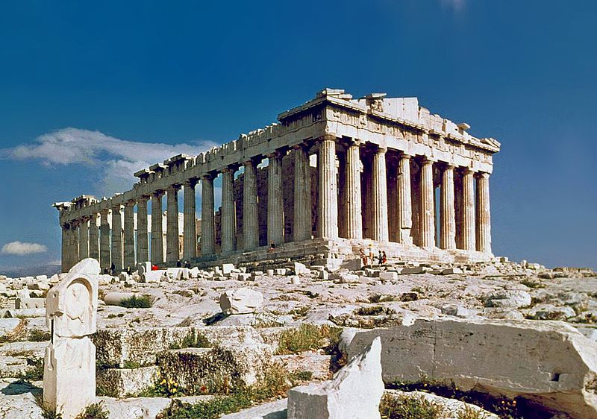
Origins of Knowledge
http://en.wikipedia.org/wiki/File:The_Parthenon_in_Athens.jpg
http://en.wikipedia.org/wiki/Parthenon
Psychology’s early roots begin with ancient Greek philosophers, who considered how knowledge originates.
Parthenon
Athens, Greece
Constructed
447-438 BCE

Slide 3
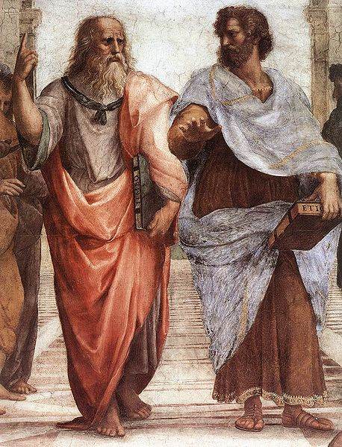
Origins of Knowledge
http://commons.wikimedia.org/wiki/File:Sanzio_01_Plato_Aristotle.jpg
Epistemology – a branch of philosophy addressing the nature of knowledge.
  What is the nature of our knowledge?
  How do we know what we know?
  How is knowledge acquired?
“The School of Athens”
By Italian Renaissance Artist Raphael
Painted Between 1509-1510
(Left, Plato points up toward “ideas”;
Right, Aristotle points toward the real world.)
http://en.wikipedia.org/wiki/The_School_of_Athens

Slide 4
Origins of Knowledge
Questions about the origin of knowledge led to the study of Sensation.
Sensation – The psychological experience that arises from stimulation of the senses (vision, hearing, touch, taste, smell)
Our study of sensation will build on our earlier discussions of the environment (big history), evolution, and the nervous system.

Slide 5
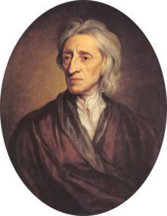
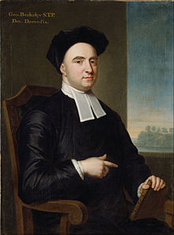
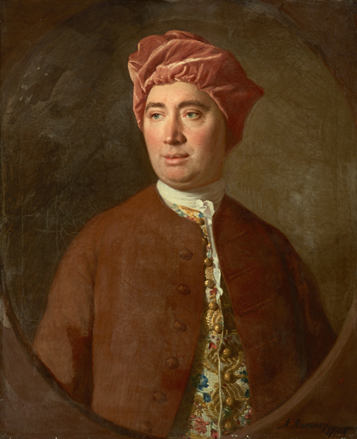
Origins of Knowledge
http://www.thefreedictionary.com/British+Empiricists
Empiricism - The view that experience, especially of the senses, is the only source of knowledge.
We begin life as “tabula rasa”…blank slates
British Empiricist: John Locke
1632-1701
http://en.wikipedia.org/wiki/John_Locke
British Empiricist: George Berkeley
1685-1753
http://en.wikipedia.org/wiki/George_Berkeley
British Empiricist: David Hume
1711-1776
http://en.wikipedia.org/wiki/George_Berkeley

Slide 6
Origins of Knowledge
Stimulus – any form of environmental energy. Could be visual, auditory, tactile, chemical (gas, liquid or solid)
Mantra:
  The word “stimulus” is singular;
  The word “stimuli” is plural!
    Examples:
      The stimulus is important.
      The stimuli are important.

Slide 7
Origins of Knowledge
Distal Stimulus – Energy in the environment that stimulates the senses.
Proximal Stimulus – The nervous system’s response to energy from the environment.
Potential Pop Quiz Item – Generate three novel examples of distal stimuli, and their corresponding proximal stimuli.

Slide 8
