Slide 1
Sensation: Psychophysics

Slide 2
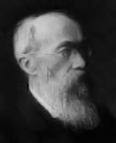
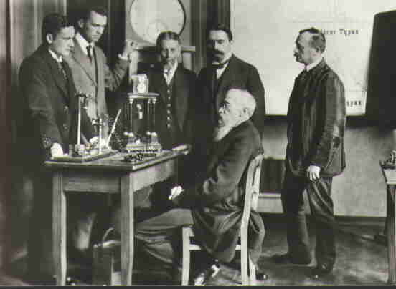
Modern Psychology Begins!
http://en.wikipedia.org/wiki/Wilhelm_Wundt
“Founder” of Modern Psychology
Wilhelm Wundt
1832-1920
http://en.wikipedia.org/wiki/Wilhelm_Wundt
Historical Note:
In December of 1831,
Charles Darwin sailed to the Galapagos Islands on the HMS Beagle. Wundt was born the following year.
University of Leipzig
Laboratory for Psychological Research
Established 1879
http://commons.wikimedia.org/wiki/File:Wundt-research-group.jpg

Slide 3
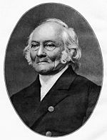
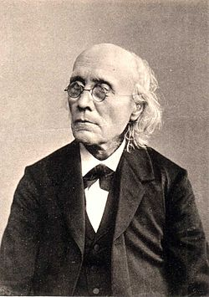

Psychophysics
Psychophysics – The science of establishing quantitative relationships between physical stimulation and psychological events.
Psychophysicist: Ernst Weber
1795-1878
http://en.wikipedia.org/wiki/Ernst_Heinrich_Weber
Psychophysicist: Gustav Fechner
1801-1887
http://en.wikipedia.org/wiki/Gustav_Theodor_Fechner
Psychophysicist: Nestor Matthews
See Your Intellectual Family Tree
http://personal.denison.edu/~matthewsn/academicFamilyTree.html

Slide 4
Psychophysics
Mathematical Function – a rule for turning one number into another number.
Ex. Y= mX + b
Psychophysical Function – a rule for turning one number (a quantified stimulus) into a another number (a quantified psychological response).
Ex. Psychological response = 3 x physical stimulus + 2
Psychophysical functions can be graphed…

Slide 5
Psychophysics
http://en.wikipedia.org/wiki/Psychophysics
Psycho
Physics

Slide 6
Psychophysics
http://en.wikipedia.org/wiki/Psychophysics
Text for graph:
In this graph,
(psychological experience)
is plotted as a function of
(physical stimulation)
Psycho
Physics

Slide 7
Psychophysics
http://en.wikipedia.org/wiki/Psychophysics
Text for graph:
In this graph,
perceived length
is plotted as a function of
physical length.
Perceived Length
Physical Length

Slide 8
Psychophysics
http://en.wikipedia.org/wiki/Psychophysics
Expansive Non-Linearity:
Ex: Response to Electric Shock
Linearity:
Ex: Response to Visual Size
Sensation
Compressive Non-Linearity:
Ex: Response to Lights or Sounds
Physical Stimulation

Slide 9
Psychophysics
http://en.wikipedia.org/wiki/Psychophysics
Text for graph:
In this graph,
favorability rating
is plotted as a function of
sugar concentration.
Favorability Rating
Sugar Concentration

Slide 10
Psychophysical Thresholds
Sensitivity – Responsiveness to stimulation.
Systems / organisms with low sensitivity exhibit little or no response to stimulation.
Shallow slope on sensitivity-by-stimulation plot
Systems / organisms with high sensitivity exhibit a strong response to stimulation.
Steep slope on sensitivity-by-stimulation plot
Threshold – The smallest stimulus quantity required for a desired response level.
75% correct-threshold is the stimulus strength to which a participant responds correctly on three-quarters of trials.
Mantra: Sensitivity and Thresholds are inversely related
High thresholds → low sensitivity, and vice versa.

Slide 11
Psychophysical Thresholds
Historical / Etymological Note:
The German word “limen” refers to a threshold
http://en.wikipedia.org/wiki/Limen
The word “sub-limenal” refers to stimulation that is just beneath detectability, i.e.,
This is the origin of the commonly used word “subliminal”, as in, “subliminal messages”.
That word has its roots in Psychophysics!
http://en.wikipedia.org/wiki/Subliminal_stimuli

Slide 12
Psychophysical Thresholds
Two Frequently Used Types of Thresholds
Absolute Detection
The smallest stimulus quantity that a system/organism can reliably report relative to no stimulation at all.
Typically, the experimenter asks the participant whether a given stimulus is Present or Absent
This is sometimes called a Yes/No experiment
Difference Threshold
The smallest discrepancy between two stimulus quantities that a system/organism can reliably report.
This is often called the Just Noticeable Difference or JND
Typically, the experimenter asks the participant to report whether two stimuli are the Same or Different

Slide 13
Weber’s Law
http://en.wikipedia.org/wiki/Weber%E2%80%93Fechner_law
Weber’s Law – The JND is proportional to stimulus magnitude.
Think of Weber’s law as multiplicative
Examples: Perhaps we can reliably distinguish…
A 5% change in size or spatial distance
or a 10% change in stimulus speed
or A 15% change in stimulus duration
Note: Fechner offered a variation on this, which states that the JND is proportional to the logarithm of the stimulus magnitude.

Slide 14
Signal Detection Theory
http://en.wikipedia.org/wiki/Detection_theory
Signal Detection Theory – A procedure for determining the sensitivity of a system, independent of the system’s response biases.
Response Bias – The inclination to favor one behavioral option over another.

Slide 15
Signal Detection Theory Stimulus-Response Matrix
http://en.wikipedia.org/wiki/Detection_theory
Correct
Rejection
False
Alarm
N
False Positive
Type 1 Error
Stimulus Present?
Y
Miss
Hit
False Negative
Type 2 Error
N
Y
Response

Slide 16


