Slide 1
Sensation:
Some Neural
Principles

Slide 2
Sensory Codes
Code – A set of rules that provide information.
  Information - The reduction of uncertainty.
Sensory Code – A set of rules that provide information (reduce uncertainty) about the environment via “detectors” (sensors).

Slide 3
Sensory Codes
Rate Code – A sensory rule by which stronger stimuli generate more action potentials per unit time.
  “strong” stimuli -> hire firing rate
Time Code – A sensory rule by which stimuli generate unique patterns or “rhythms” of action potentials.

Slide 4
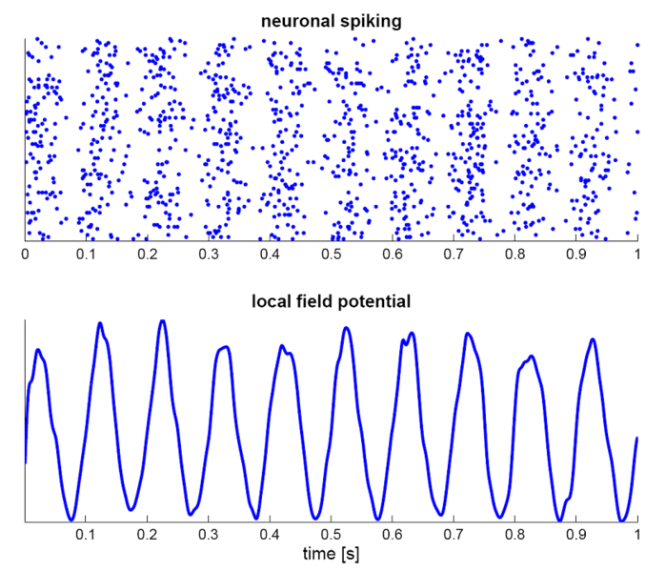
Sensory Codes
https://en.wikipedia.org/wiki/Neural_oscillation

Slide 5
Sensory Adaptation
http://en.wikipedia.org/wiki/Neural_adaptation
Sensory (Neural) adaptation – the reduction in the nervous system’s response to a repeated stimulus.
Sensory adaptation experiments often generate psychological aftereffects.
    Example:
      Time 1: Place hand in room temperature water.
      Time 2: Adapt to (place hand in) hot water.
      Time 3: Place hand in room temperature water, which now feels cold.

Slide 6
Neural Receptive Fields
Sensory neurons have Receptive Fields – the range of stimuli to which the neuron responds.
Example: Some neurons in your occipital lobe respond to the center of your retina (the proximal stimulus), others respond to only to either the nasal-retina or temporal-retina.

Slide 7
Lateral Inhibition
http://en.wikipedia.org/wiki/Lateral_inhibition
Lateral Inhibition – The ability of an active neuron to reduce the firing rates of neighboring neurons.
Center Surround Antagonism – a form of lateral inhibition in which concentric regions of a receptive field have competitive interactions.
  Example: Some neural receptive fields have
  “on” centers and “off” surrounds…

Slide 8
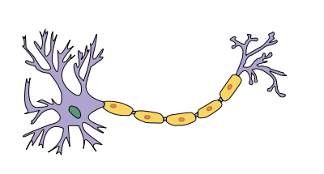
“On-Center” Ganglion Cell
Neuron
Receptive Field
-
-
-
-
+
-
+
+
-
+
+
+
+
+
-
+
+
-
-
-
-
-
-
-
Responds maximally to light increments in the center,
and light decrements in the surround.

Slide 9
Receptive Field
“On-Center” Cells Love Stimuli like this.
-
-
-
-
+
-
+
+
-
+
+
+
+
+
-
+
+
-
-
-
-
-
-
-

Slide 10
Receptive Field
“On-Center” Cells Hate Stimuli like this.
-
-
-
-
+
-
+
+
-
+
+
+
+
+
-
+
+
-
-
-
-
-
-
-

Slide 11
Receptive Field
“Off-Center” Ganglion Cell
+
+
+
+
+
-
-
-
-
-
-
-
-
-
-
+
+
+
Responds maximally to light decrements in the center,
and light increments in the surround.

Slide 12
Receptive Field
“Off-Center” Cells Love Stimuli like this.
+
+
+
+
-
-
+
-
-
+
-
-
-
-
-
-
-
-
-
+
-
+
+
+

Slide 13
Receptive Field
“Off-Center” Cells Hate Stimuli like this.
+
+
+
+
-
-
+
-
-
+
-
-
-
-
-
-
-
-
-
+
-
+
+
+

Slide 14
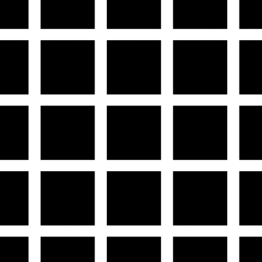
Center Surround Antagonism
http://en.wikipedia.org/wiki/File:HermannGrid.gif
The Hermann grid illusion

Slide 15
