Slide 1
Statistics
&
Sampling

Slide 2
Descriptive Statistics
Descriptive Statistics – Numbers that characterize the central tendency and dispersion of a data set.
  Central Tendency
    Means, Medians, Modes
  Dispersion
    Standard Deviation – The average extent to which a score departs from the mean

Slide 3
Inferential Statistics
Inferential Statistics – The process of using samples to draw conclusions (“inferences”) about populations.
Statistical Significance – An effect (i.e., a trend or a difference-score) that is unlikely to occur just by chance.
  Researchers often use the “5% rule”; Outcomes that could occur by chance with a probability less than 5% (p<0.05) are deemed “statistically significant”.

Slide 4
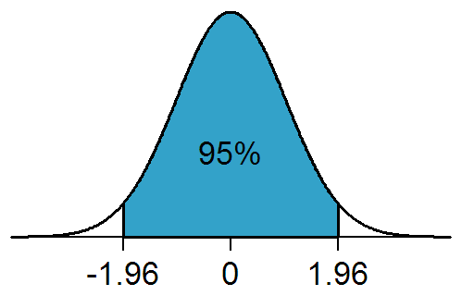
Inferential Statistics
https://en.wikipedia.org/wiki/Statistical_significance#/media/File:NormalDist1.96.png
Wiki on Statistical Significance https://en.wikipedia.org/wiki/Statistical_significance

Slide 5
Inferential Statistics
Type 1 Error – False Positive (“False Alarm”)
  Alpha Level = Probability of a Type 1 error
Type 2 Error – False Negative (“Miss”)
  Beta Level = Probability of a Type 2 error

Slide 6
Populations vs Samples
Population – Every member in a group of interest.
    Example: All College Students
Sample – A sub-set of a population.
    Example: Denison Psychology Students

Slide 7
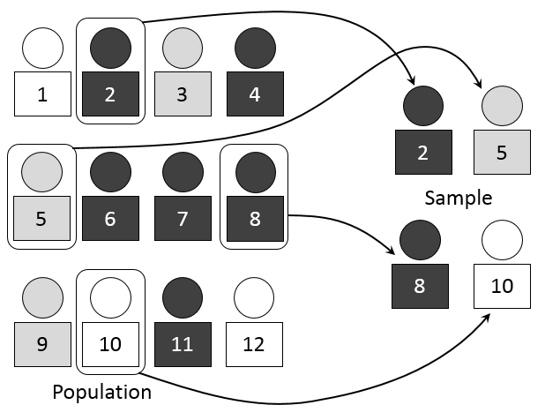
Populations vs Samples
https://commons.wikimedia.org/wiki/File:Simple_random_sampling.PNG
Simple Random Sampling

Slide 8
Sampling Techniques
Random Sampling – A technique for selecting a subset of a population; each member of the population has an equal chance of being selected.
  Random Sampling is preferred
Convenience Sampling – A technique for selecting a subset of a population; members are selected based on practical matters, like availability.

Slide 9
