Slide 1
The Facts of Light

Slide 2
“The Facts Of Light”
Light is electromagnetic (“EM”) radiation.
Light has both wave-like and particle-like properties.
Let’s consider some different types of waves….

Slide 3
Part 1: “The Facts Of Light”
Let’s “Do the Wave”!
Stadium-Style = Transverse Wave
Transverse Wave - A wave in which oscillations are perpendicular to the direction the wave travels.
Electromagnetic energy is a transverse wave.

Slide 4
“The Facts Of Light”
Let’s “Do the (other) Wave”!
Geek-Style = Longitudinal Wave
Longitudinal Wave - A wave in which oscillations are parallel to the direction the wave travels.
Acoustic energy is a longitudinal wave.

Slide 5
“The Facts Of Light”
Let’s consider the particle-like properties of light.
The smallest (particle or) unit of light is the photon.
Not all photons are equal!

Slide 6
“The Facts Of Light”
Some photons oscillate at relatively high rates. These are said to be of high energy.
High energy photons travel a short distance over the course of each oscillation, so they have short wavelengths.
Short-wave (i.e., high energy) light typically appears blue-ish to most humans.

Slide 7
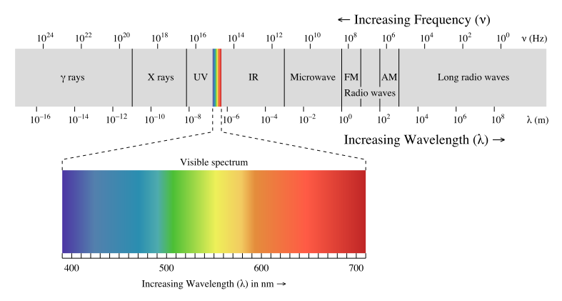
“The Facts Of Light”
https://commons.wikimedia.org/wiki/File:EM_spectrum.svg

Slide 8
“The Facts Of Light”
Some photons oscillate at relatively low rates. These are said to be of low energy.
Low energy photons travel a long distance over the course of each oscillation, so they have long wavelengths.
Long-wave (i.e., low energy) light typically appears red-ish to most humans.

Slide 9
“The Facts Of Light”
“The rays are NOT colored.”
Sir Isaac Newton

Slide 10
“The Facts Of Light”
“The red’s in the head.”
Billy Wooten

Slide 11
“The Facts Of Light”
What are the evolutionary advantages of being sensitive to electromagnetic energy (versus, say, acoustic energy)?
Electromagnetic energy travels quickly, thereby conveying (almost) immediate information about distant objects, food, predators, potential mates, etc..
Electromagnetic energy tends to move in straight lines, thereby preserving information about the shape of objects, food, predators, potential mates, etc..

Slide 12
“The Facts Of Light”
What are the evolutionary advantages of being sensitive to 400-700 nanometer wavelengths?
400-700 nanometer light is “bouncy”.
Unlike longer-wave energy, which passes through many opaque objects, 400-700 nanometer light can be reflected (‘bounced’) off of objects, making them visible. 400-700 nanometer light a better messenger.
On our planet, 400-700 nm light is plentiful. By contrast, shorter-wave energy tends to be absorbed by our atmosphere (i.e., by oxygen and nitrogen), and is less plentiful.

Slide 13
“The Facts Of Light”
Summary of evolutionary advantages to using light as the “messenger”.
Plenty fast.
Plenty straight.
Plenty bouncy.
And just-plain-old, PLENTY!

Slide 14


