Slide 1
Vision & Hearing

Slide 2
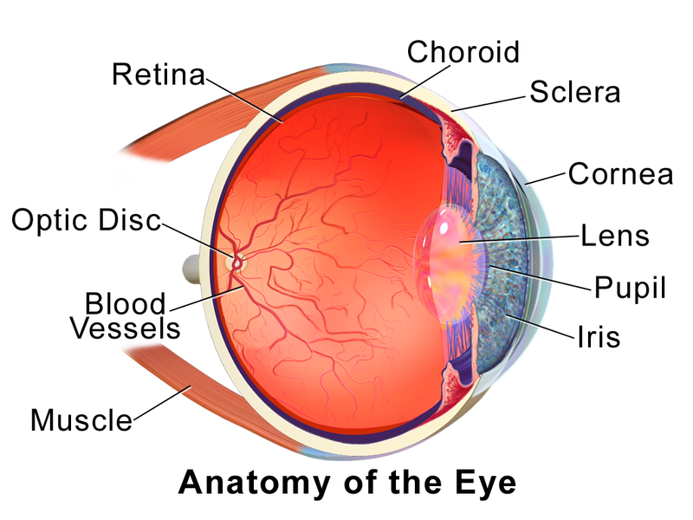
The Eye & Physiological Optics
http://en.wikipedia.org/wiki/File:Blausen_0388_EyeAnatomy_01.png
The eye is said
to have two
optical components:
The Cornea
&
The Lens

Slide 3
The Eye & Physiological Optics
Image formation on the retina depends on the cornea.
The cornea refracts (or “bends”) light. That is, it changes the direction of light entering the eye.
Because the cornea is convex, it makes incoming light rays converge to a focal point.
The refractive power of the cornea, or any other optical device, is measured in diopters (40 for the cornea).

Slide 4
The Eye & Physiological Optics
Diopter = 1 / focal length in meters
Focal length is the distance from the
optical device, to the focal point.
Focal Point
Focal Length

Slide 5
The Eye & Physiological Optics
Image formation on the retina also depends on the crystalline lens.
Unlike the cornea, the crystalline lens can change shape, providing additional optical power of 10 to 30 diopters. This variability in the lens’ shape is called accommodation.
Together, the cornea and the lens provide refraction ranging from 50 and 70 diopters --at least in healthy, young eyes.

Slide 6
The Eye & Physiological Optics
Myopic
Near-sighted
The eye ball is “too long”, given the refraction.
Retina
Can be corrected with a concave “-” lens.

Slide 7
The Eye & Physiological Optics
Hyperopic
Far-sighted
The eye ball is “too short”, given the refraction.
Retina
Can be corrected with a convex “+” lens.

Slide 8
The Eye & Physiological Optics
Presbyopic
“Old Sight”
Caused by sclerosis (hardening) of crystalline lens,
i.e., reduced refraction.
Corrected with bifocals
Reading is corrected with a strong convex lens.
Distance can be corrected with a weaker convex lens.

Slide 9
The Eye & Physiological Optics
The “blind spot” is a perceptual phenomenon that arises from the optic disc (an anatomical structure on the nasal side of each retina).

Slide 10
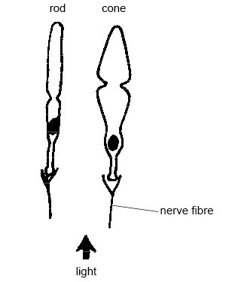
Photoreceptors
http://commons.wikimedia.org/wiki/File:Anatomy_and_physiology_of_animals_A_rod_and_cone_from_the_retina.jpg
Cones provide color vision. Rods don’t.
http://en.wikipedia.org/wiki/Photoreceptor_cell

Slide 11
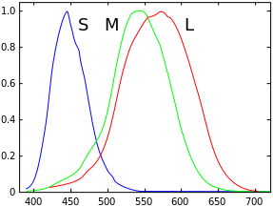
Photoreceptors: Cones
https://commons.wikimedia.org/wiki/File:Cones_SMJ2_E.svg
Relative Sensitivity
Wavelength of Light (in Nanometers)

Slide 12
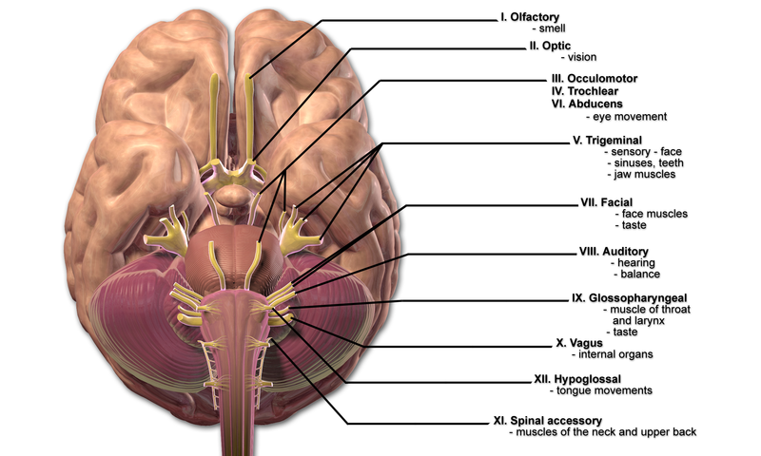
Cranial Nerves
http://commons.wikimedia.org/wiki/File:Blausen_0284_CranialNerves.png

Slide 13
Optic Inversion
“Left goes to right”
The left visual field projects to the right side of each retina.
“Right goes to left”
The right visual field projects to the left side of each retina.
“Top goes to bottom”

Slide 14
Optic Inversion
“Top goes to bottom”
The upper visual field projects to the lower portion of each retina.
“Bottom goes to top”
The lower visual field projects to the upper portion of each retina.
“Top goes to bottom”

Slide 15
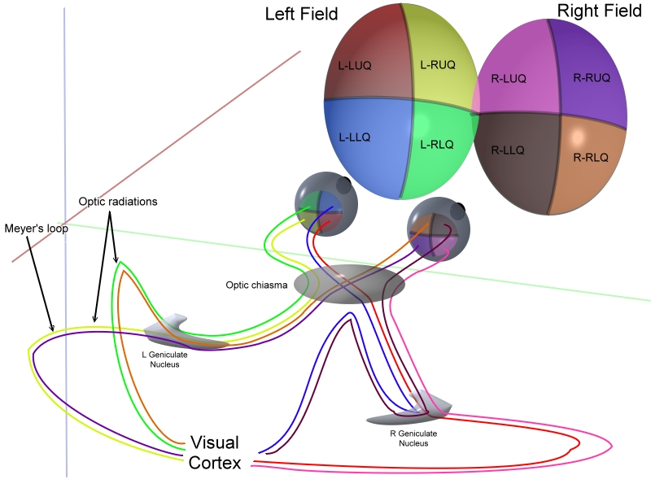
http://en.wikipedia.org/wiki/File:ERP_-_optic_cabling.jpg
LGN Projections

Slide 16
Hearing

Slide 17
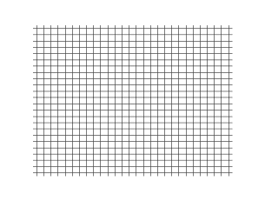
Longitudinal Wave
http://en.wikipedia.org/wiki/File:Onde_compression_impulsion_1d_30_petit.gif

Slide 18
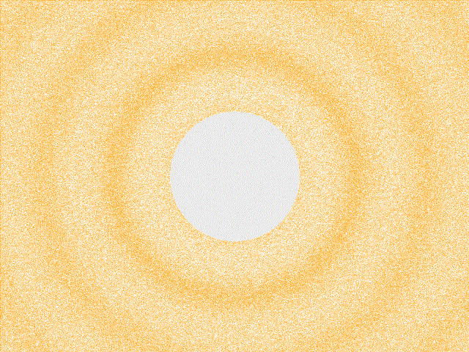
Sound Waves
http://en.wikipedia.org/wiki/File:Spherical_pressure_waves.gif

Slide 19
The Stimulus for Hearing
Loudness – the psychological correlate of acoustic intensity.
Measured in Decibels
Pitch – The psychological correlate of frequency
Measured in Hz (cycles per second)

Slide 20
Sound Localization
Interaural Intensity Differences
Acoustic energy is greater at the ear nearest to the distal stimulus.
Interaural Time Differences
Acoustic energy arrives first at the ear nearest to the distal stimulus.

Slide 21
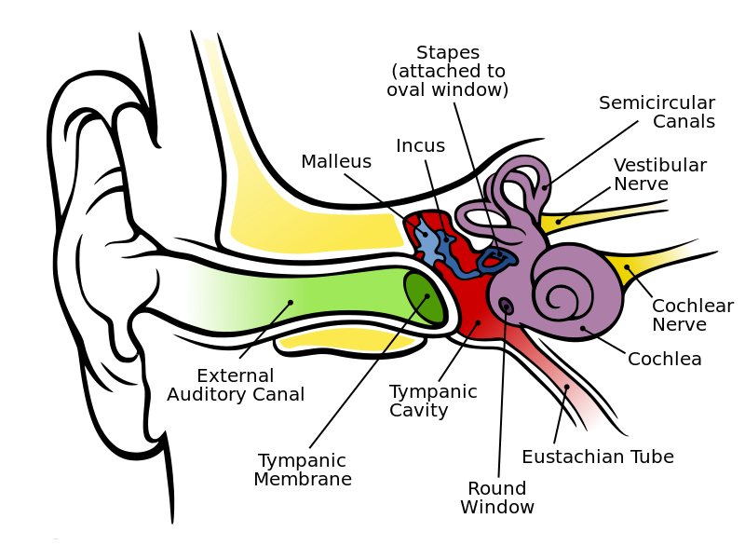
The Human Ear
http://en.wikipedia.org/wiki/File:Anatomy_of_the_Human_Ear.svg

Slide 22
Cranial Nerves
http://commons.wikimedia.org/wiki/File:Blausen_0284_CranialNerves.png

Slide 23


