Slide 1
Why
Psychology Matters
To
College Students
Learning Styles

Slide 2
Learning Styles
Learning Styles – An approach for explaining individual differences in learning.
  Examples:
    Visual Learners
    Auditory Learners
    Kinesthetic Learners
Meshing Hypothesis – Learning is best when information is presented in a manner that matches (“meshes with”) the student’s learning style.

Slide 3
Research on Learning Styles
Learning Styles: Concepts and Evidence.
Pashler, McDaniel, Rohrer & Bjork, 2014.
Psychological Science in the Public Interest. https://www.ncbi.nlm.nih.gov/pubmed/26162104
What they did
  Meta-Analyses – An analysis of other analyses (e.g., prior research)
  Established Criteria for Evaluation
    1. Group students by their alleged learning style (A vs V)
    2. Randomly assign students to audio versus visual presentations
    3. Have all students complete the same comprehension test
    4. Test the Learning-Style by Presentation-Format Interaction

Slide 4
Interaction Effects
Dependent Variable(s)
  Comprehension (test score)
Independent Variable(s)
  Information Presentation Format (auditory vs visual)
  Student’s Learning Style (auditory vs visual)
Interaction Effect – Occurs when the influence of one independent variable changes across the levels of a different independent variable.
  Example:
    Auditory Presentations → Auditory Learners > Visual Learners
    Visual Presentations → Visual Learners > Auditory Learners

Slide 5
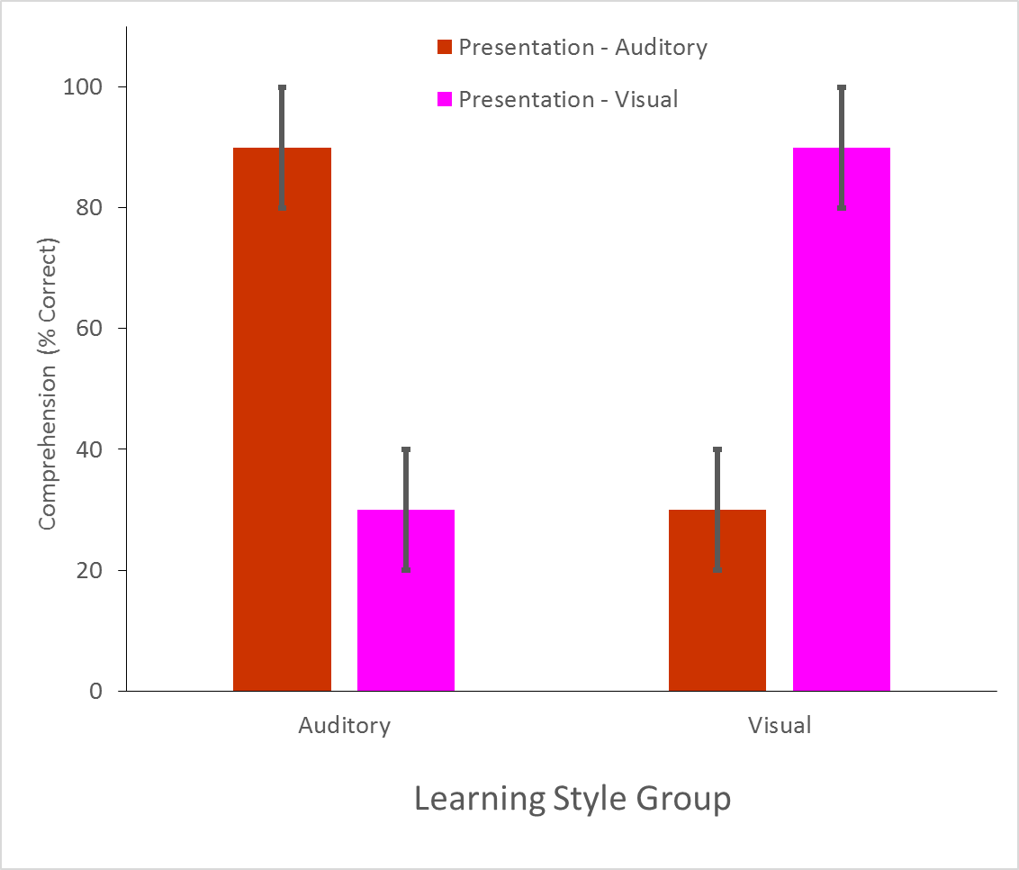
Learning Styles Prediction

Slide 6
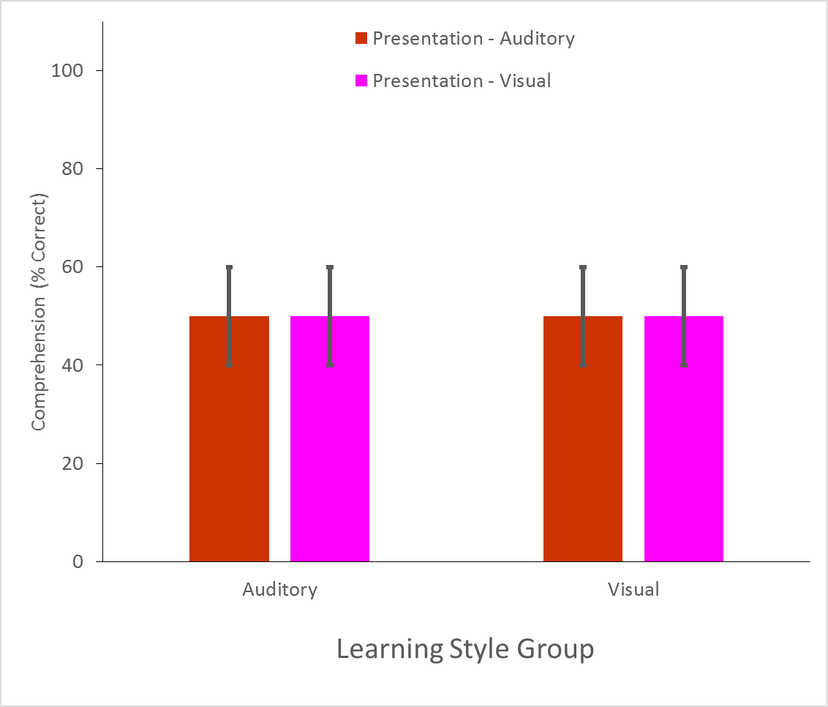
Learning Styles Disconfirmation

Slide 7
Research on Learning Styles
Learning Styles: Concepts and Evidence.
Pashler, McDaniel, Rohrer & Bjork, 2014.
Psychological Science in the Public Interest. https://www.ncbi.nlm.nih.gov/pubmed/26162104
  What they found
    Many studies investigated Learning Styles
    However, very few studies were conducted with an appropriate (2x2) design
    The few studies with an appropriate design disconfirmed the LS prediction
    Subsequent research also disconfirms the LS prediction
      Matching learning style to instructional method: Effects on Comprehension
      Rogowsky, Calhoun & Tallal (2015). Journal of Educational Psychology
      https://www.apa.org/pubs/journals/features/edu-a0037478.pdf
  Why it matters
    Applied Research – Evidence does NOT support learning styles.
    Basic Research – How does learning work?

Slide 8
