Slide 1
Why
Psychology Matters
To
College Students
To Learn, Retrieve!

Slide 2

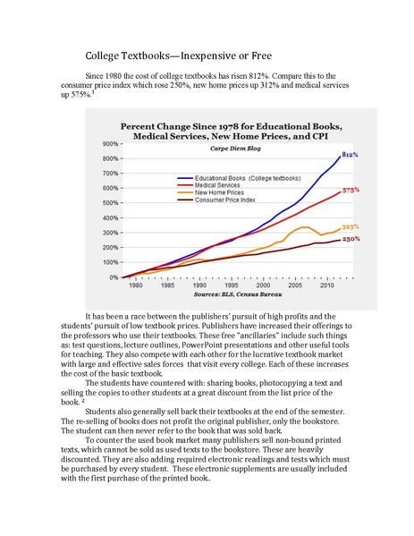
Meta-Cognition
Meta-Cognition → Thinking about thinking
  Common Meta-Cognitive Errors
    “I’m good at multi-tasking”
    “Re-reading the text is a good learning strategy”
    “Learning should be easy”
https://commons.wikimedia.org/wiki/File:College_Textbooks_--Free_and_Inexpensive.pdf
https://commons.wikimedia.org/w/index.php?title=Special:Search&limit=100&offset=20&profile=default&search=multitasking&searchToken=f2gbwii3fkadx2nvu8d59b30m#/media/File:%E8%86%9D%E3%81%ABPC_%E5%8F%B3%E6%89%8B%E3%81%AB%E3%82%AC%E3%83%A9%E3%82%B1%E3%83%BC_2011_(5861970938).jpg

Slide 3
“ Learning Is Effortful! ”
Desirable Difficulties

Slide 4
“ To Learn, Retrieve! ”
Retrieve→ To recall from memory
To Learn, Retrieve...Space…& INTER-LEAVE!
Retrieval Practice (Testing) Improves Learning.

Slide 5
Sleep & Learning
Learning - [12 hour interval] - Learning - Sleep
  Same Day
Learning - Sleep within 12 hour interval - Learning
  Sleep between learning
Sleeping between learning sessions improves long-term retention!
    Mazza et al., (2016). Relearn Faster and Retain Longer. Psychological Science. https://www.ncbi.nlm.nih.gov/pubmed/?term=27530500

Slide 6
