Slide 1
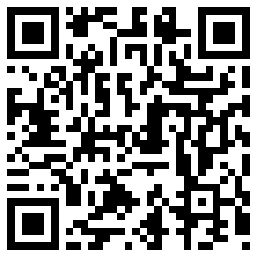
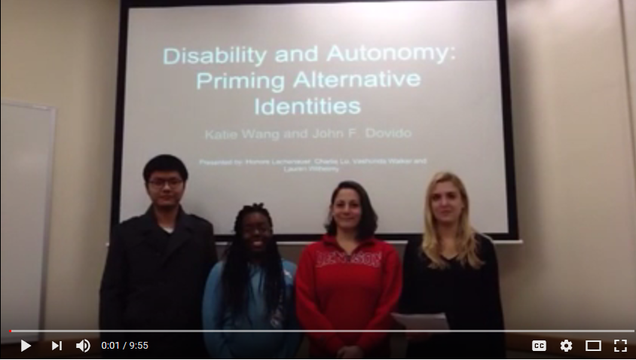
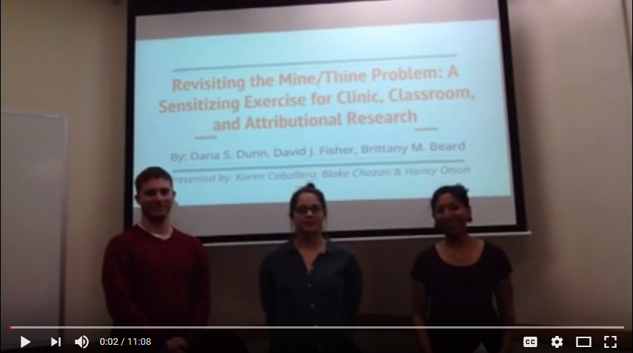
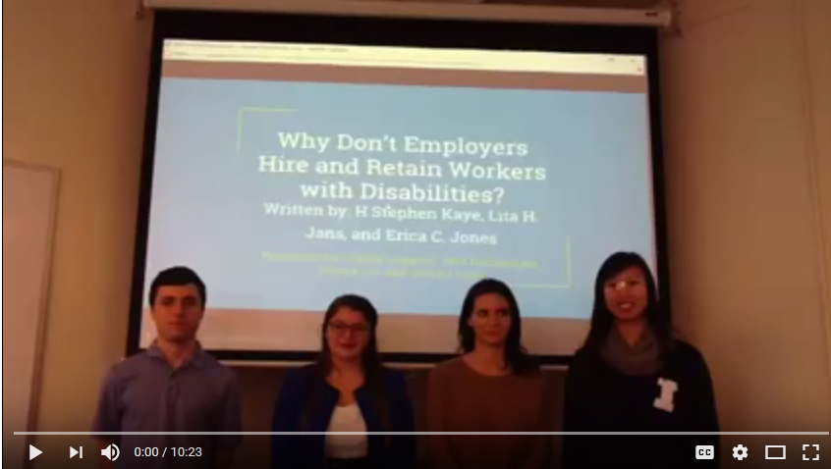
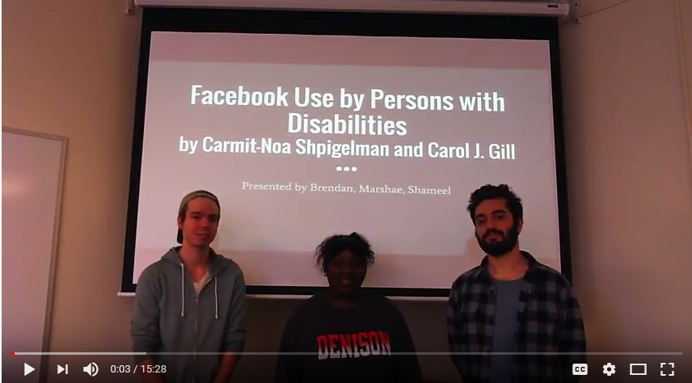
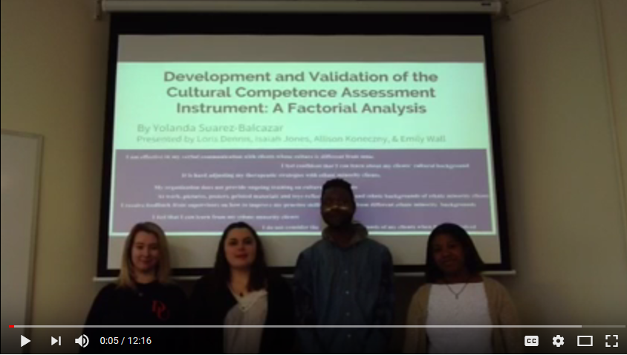
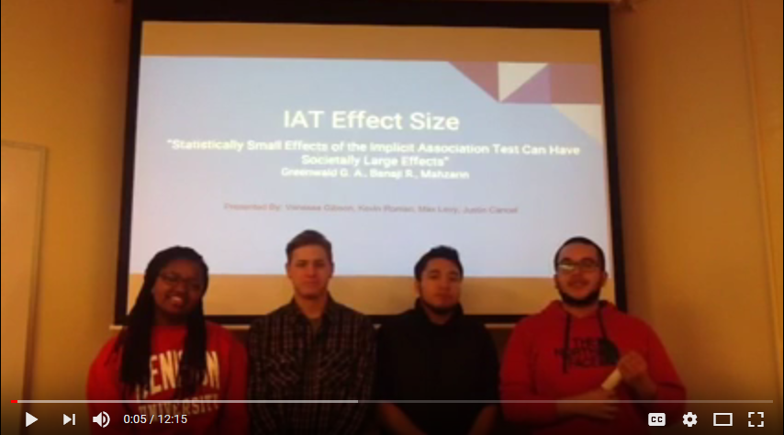
Disability, Power & Justice:
Student-Generated Videos
Nestor Matthews, Department of Psychology, Denison University
Poster: http://personal.denison.edu/~matthewsn/ballstatediversity2017.html
Home Page: http://personal.denison.edu/~matthewsn/
Disability & Autonomy
Revisiting the
Mine / Thine Problem
Why Don't Employers Hire and
Retain Workers with Disabilities?
Facebook Use by
Persons with Disabilities
Cultural Competence
Assessment Instrument
IAT Effect Size

