Slide 1
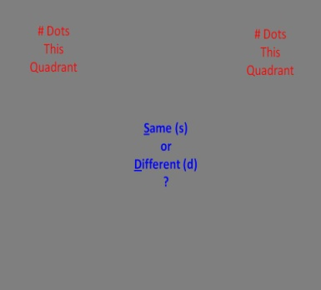
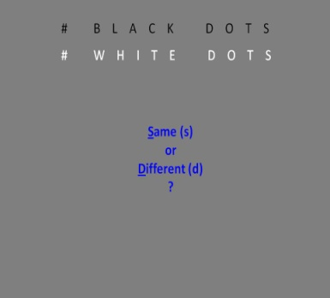
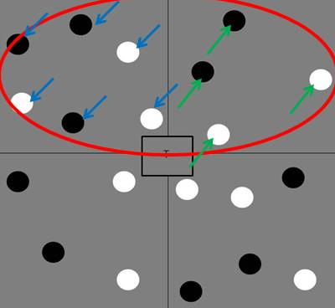
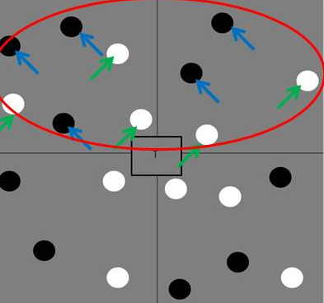
Visual Hemifields and Perceptual Grouping
Sarah Theobald & Nestor Matthews
Department of Psychology, Denison University, Granville OH 43023 USA
Introduction
Method
Discussion
The human brain is constantly being presented with complex visual information from all locations. As the retina receives information from either the left or right visual field, or hemifield, the information is processed predominately in the contralateral hemisphere. The brain’s ability to integrate visual information in the cortex allows for a perceptually unified experience when receiving visual information from all locations. However, not all lateralities are “created equal”.
Previous researchers have found that manipulation of attention between unilaterally presented stimuli (presented in only one hemifield) and bilaterally presented stimuli (presented in both hemifields) affects discriminability. Whether unilateral or bilateral presentation is superior is determined by the task.
A unilateral advantage is seen when images can be preattentively grouped, with easily detectable changes in stimuli (Butcher & Cavanagh, 2005). Unilateral superiority of visual attention has been observed on tasks involving illusory contours (Pillow & Rubin, 2002) and detection of motion paths (Butcher & Cavanagh, 2005). On the other hand, when tasks require a higher attentional demand, a bilateral advantage is observed (Alvarez & Cavanagh, 2005). For example, detecting targets among distractors, (Matthews & Kelly, 2009; Reardon, Kelly, & Matthews, 2009) and in a preliminary study, the numerosity of stimuli (Delvenne et al., 2009), present a bilateral advantage.
In this study, we investigated how visual attention, determined by perceptual grouping requirements, affects our perception of visual stimuli presented bilaterally and unilaterally. These perceptual grouping requirements were similarity, grouped by color, and proximity, grouped by quadrants. By solely manipulating attention and holding the stimulus constant, we hoped to probe laterality and grouping anisotropies in the brain.
Instructions
Stimuli with Markers
Series of Questions
Proximity
Similarity
Proximity
Similarity
In this study, we held retinal stimulation constant while we manipulated attention in two ways. First, we manipulated spatial attention by requiring participants to select one lateral hemifield while ignoring the other. Second, we manipulated grouping by requiring participants to select either proximal or similarly colored dots. For any given stimulus, we asked eight different numerosity questions: four sub-lateralities (bilateral; top vs. bottom: unilateral; left vs. right) by two grouping conditions (proximity vs. similarity).
While stimuli remained constant across all conditions, visual performance depended on the attentional grouping task. The switch in the attentional grouping task changed the isotropy in the neural events that set the limit on performance. In the unilateral case, the change from proximity to similarity grouping created an anisotropy. Conversely, in the bilateral case, the change from proximity to similarity grouping removed an anisotropy. A well known anisotropy in the early visual pathway is that there is “more cortex devoted to lower than to upper fields” (Van Essen, Newsome, & Maunsell, 1984 (p429)). This anisotropy appears to precede the neural events that limited performance on our bilateral similarity task.
What letter appeared
in the center of the screen?
2. Was the number of dots same or different?
Participants responded to 480 trials
Stimuli flashed for 200ms
After each slide, participants were prompted for the center letter and to respond whether the dots were the same or different in number according to which grouping variable and which two quadrants they were instructed to attend
After each response, participants were notified whether their response was correct or incorrect
Participants: 20 Denison University undergraduates
Within Subjects design
Independent Variables: 4 (Laterality) x 2 (Grouping)
  Laterality: Bilateral (Top vs. Bottom)
  Unilateral (Left vs. Right)
  Grouping: Proximity vs. Similarity
Dependent Variable: dPrime
  Hits: “Different” response when number of dots differed
  False Alarms: “Different” response when number of dots was the same
*
Results
References
Alvarez, G. & Cavanagh, P., (2005). Independent resources for attentional tracking in the left and right visual hemifields. Psychological Science, 16(8), 637-643.
Butcher, S. J., & Cavanagh, P. (2005). Within-field advantage for detecting matched motion paths. Vision Sciences Society, 267 (abstract).
Delvenne, J.F., Castronovo, J., Demeyere, N., & Humphreys, G. (2009). Enumerating visual items within and across hemifields. Vision Sciences Society, 63.406, (abstract).
Kelly, J.G., & Matthews, N. (2009). Bilateral Attentional Advantage in Gabor Detection. Vision Sciences Society Abstracts, 2009, Poster # 63.405, Abstract # 1095
Pillow, J., & Rubin, N., (2002). Perceptual Completion across the Vertical Meridian and the Role of Early Visual Cortex. Neuron, 33, 805-813.
Reardon, K. M., Kelly, J. G., & Matthews, N. (2009). Bilateral attentional advantage on elementary visual tasks. Vision Research, 49 (7), 691-701
Van Essen, D.C., Newsome, W.T., & Maunsell, J.H. (1984). The visual field representation in striate cortex of the macaque monkey: asymmetries, anisotropies, and individual variability. Vision Research, 24 (5), 429-448 (abstract).
*
*
Unilateral (Proximity > Similarity):
F (3, 19) = 5.21, p = .034, η²= .215, power=.581
Bilateral (Proximity > Similarity):
F (3, 19) = 6.157, p = .023, η²= .245, power=.653
Unilateral – Proximity (Left vs. Right):
t(19)=0.587, p=.564, η²=.018, power=.086 n.s.
Unilateral – Similarity (Left vs. Right):
t(19)=3.021, p=.007, η²=.324, power=.817
Bilateral – Proximity (Top vs. Bottom):
t(19)=4.325, p<.001, η²=.496 , power=.984
Bilateral – Similarity (Top vs. Bottom):
t(19)=0.365, p=0.719, η²=.007 , power=.064 n.s.
Acknowledgements
This project was supported by an Anderson Summer Research Award from Denison University.
http://denison.edu/~matthewsn/groupingmglur2010

