Slide 1


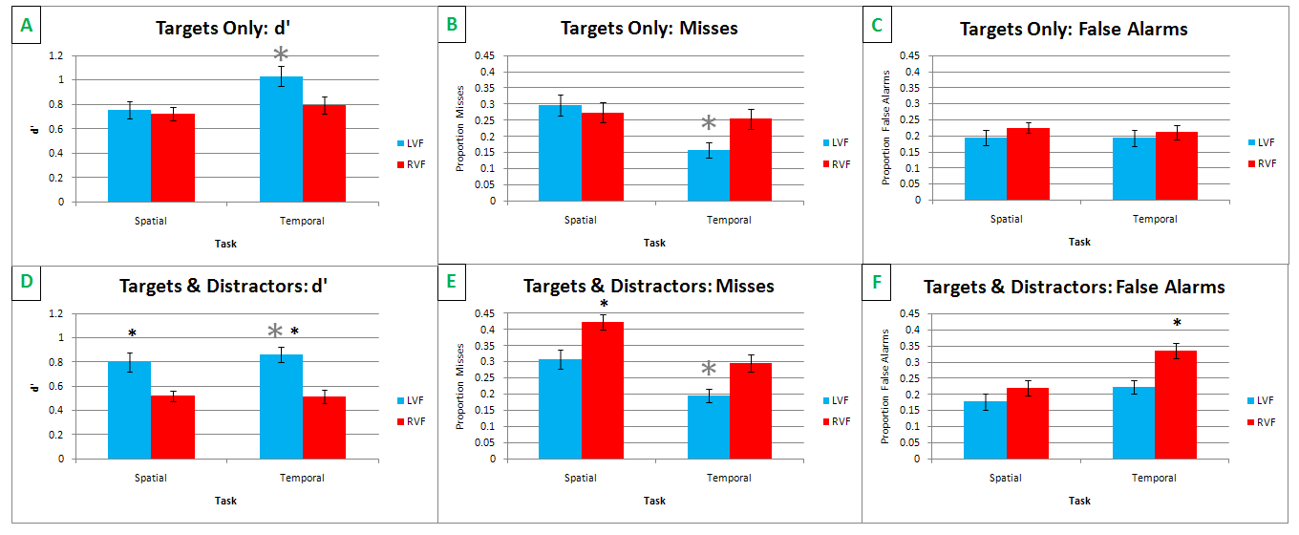
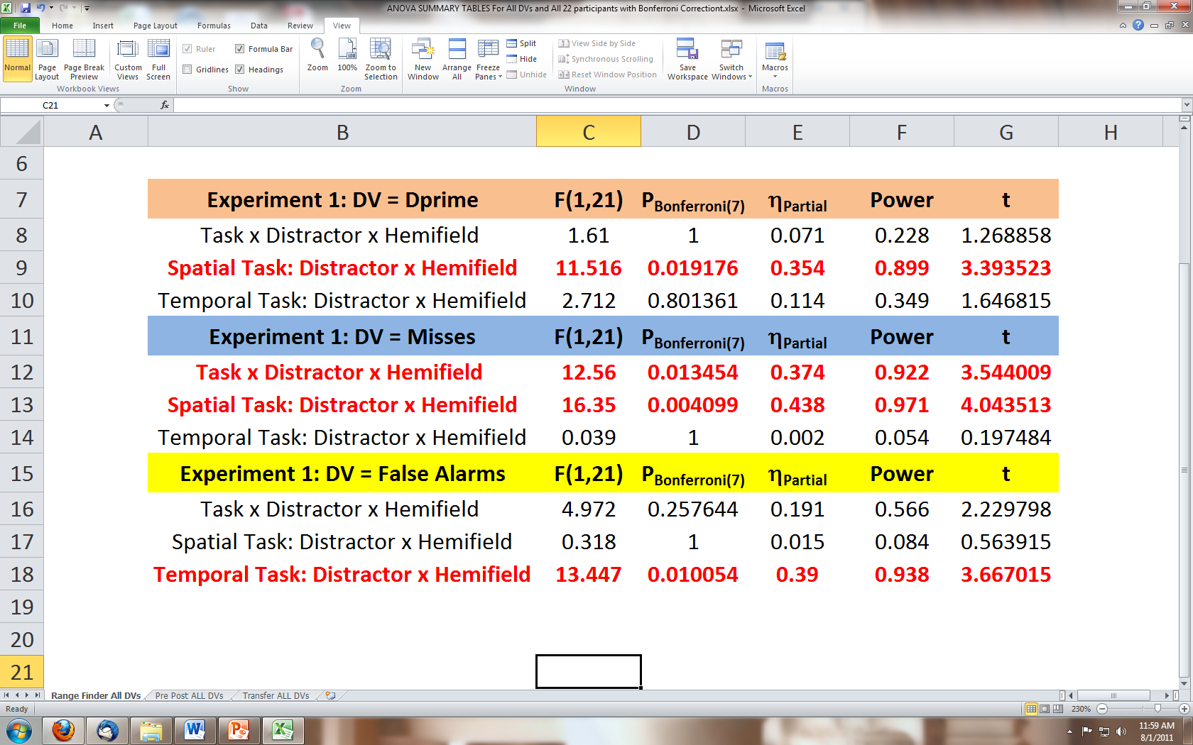
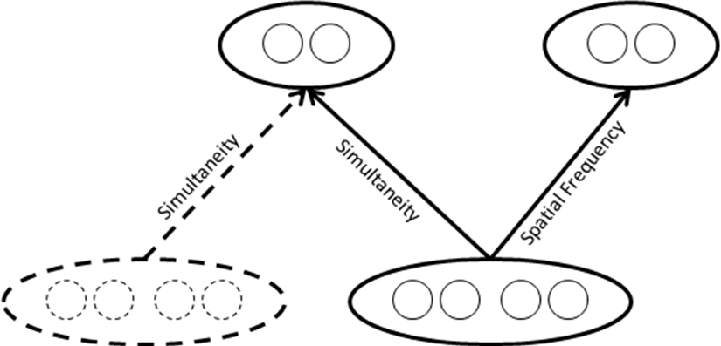
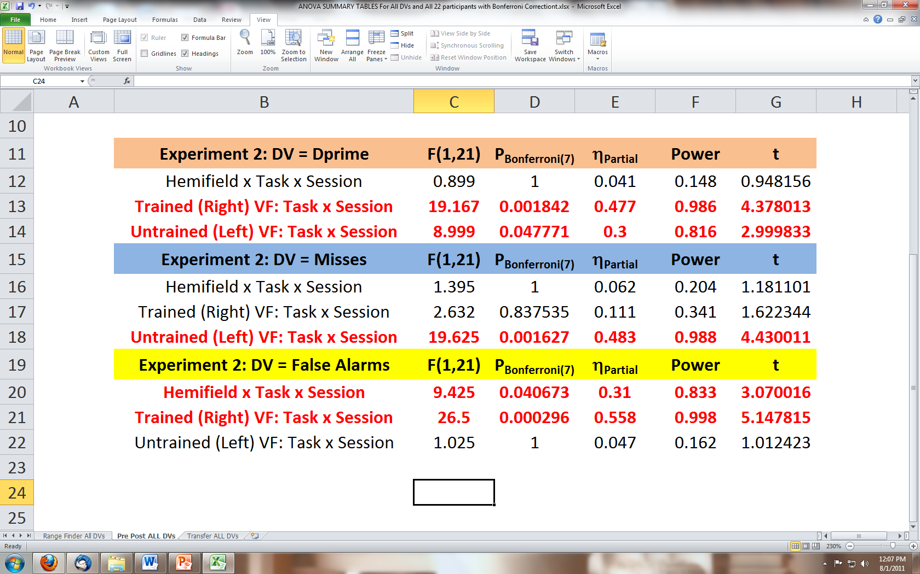
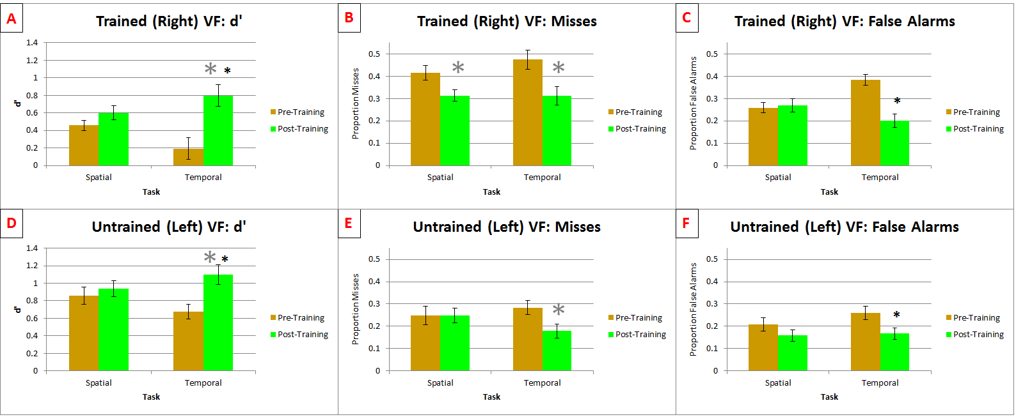
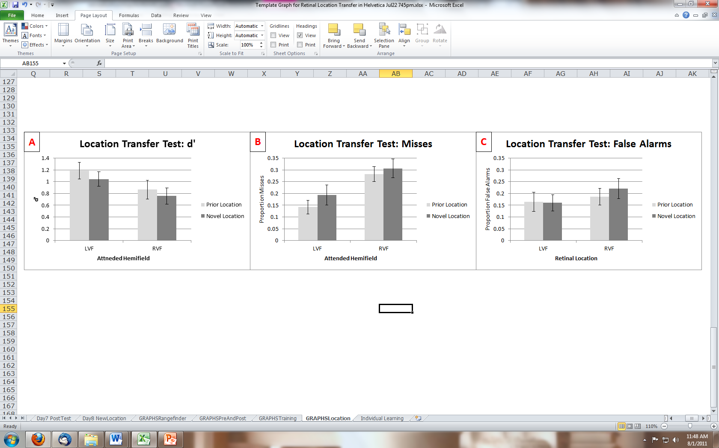
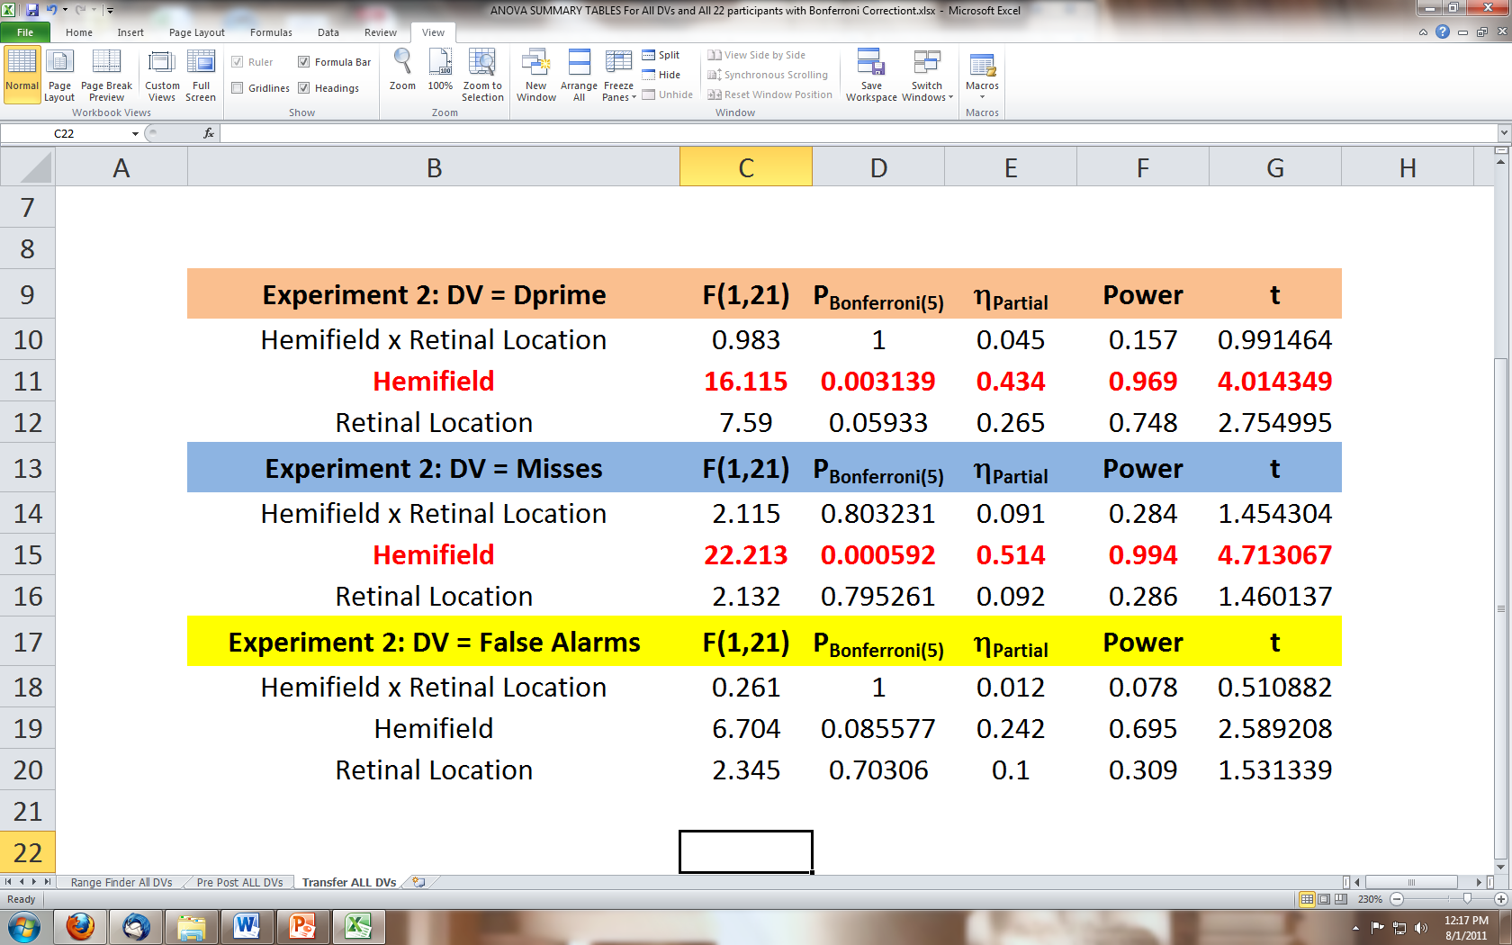
Hastening Visual Attention with Practice: A Perceptual Learning Study
Michael Vawter & Nestor Matthews
Department of Psychology, Denison University
Introduction
Method
Discussion
Attention can be operationalized as the selection of a sensory event. Attention has a measurable temporal precision ("frame rate")^{1,2}. Several studies indicate that attention's temporal precision is worse in the right (relative to left) hemifield³⁻⁵. Here we exploited this hemifield effect to reverse engineer the neural events limiting attention's temporal precision. Although temporal precision can be measured many ways, theory⁶ and prior data^{7,8} suggest that simultaneity measurements are the most precise. We measured the ability to attend to simultaneity, using signal detection theory⁹ and a modified version (fig. 1) of an extant framework¹⁰ for interpreting perceptual learning data.
A
B
C
D
E
F
G
H
I
8°
23°
15°
8°
23°
15°
Exp 1 revealed an intrinsic RVF timing deficit that arose from low acuity, not from neural noise. Furthermore, distractors caused an additional impairment that was attentional in nature. This attentional impairment was task-specific; distractors generated excessive integration on the timing task and low acuity on the spatial task. These task-specific effects occurred despite the fact that the spatial and temporal differences were co-presented.
Exp 2 revealed evidence for task specificity, and against hemifield and retinal location specificity. In each hemifield significantly greater improvement occurred on the temporal task than on the spatial task. This task specificity rules out the stimulus-driven stage (bottom solid oval, fig. 1) as the limiting factor. RVF training on the temporal task significantly improved temporal precision by comparable amounts in each hemifield. This hemifield generalization - combined with the task specificity - implicates either the decision stage (upper left oval, fig. 1) or the connection between the stimulus-driven and decision stages. These two possibilities were teased apart in the retinal location transfer test (dotted lines, fig. 1) . Here, we observed that learning generalized to a new retinal location, implicating the decision stage rather than the connection.
This study was conducted to reveal why and when attention to simultaneity fails in the RVF. We found an intrinsic component that reflects low acuity, and an attentional component that reflects excessive integration. Training significantly reduced each of those failures. The improvement seems to have occurred at the decision stage.
Which
Letter?
Target
Timing?
Same = S
Different = D
24.5°
14°
11.5°
19°
24.5°
14°
11.5°
19°
n
19°
14°
24.5°
19°
24.5°
11.5°
11.5°
14°
350 ms
200 ms
200 ms
66 ms
100 ms
34 ms
200 ms
Fixation?
Simultaneity?
15°
23°
8°
15°
23°
8°
Results
Trained Retinal Locations
Transfer Test Retinal Locations
Experiment 1: Intrinsic vs Attentional Effects
*
Experiment 2: Perceptual Learning
Figure 1
References
Bottom Line
1. Rogers-Ramachandran & Ramachandran ,(1998). PMID: 9474377
2. Aghdaee & Cavanagh, (2007). PMID: 17574644
3. Woo, Kim & Lee, (2009). PMID: 18809233
4. Battelli, Pascual-Leone & Cavanagh , (2007). PMID: 17379569
5. Kelly & Matthews, (2011). PMID: 21602558
6. DeValois & DeValois, (1990). Spatial Vision. Oxford.
7. Van Eijkj et al. (2010). PMID: 21097865
8. Love et al. (2011). VSS Abstract: 36.429
9. Green & Swets, (1966). Signal detection theory and psychophysics. New York.
10. Petrov, Dosher & Lu (2005). PMID: 16262466
http://denison.edu/~matthewsn/perceptuallearningsimultaneity.html

