Slide 1

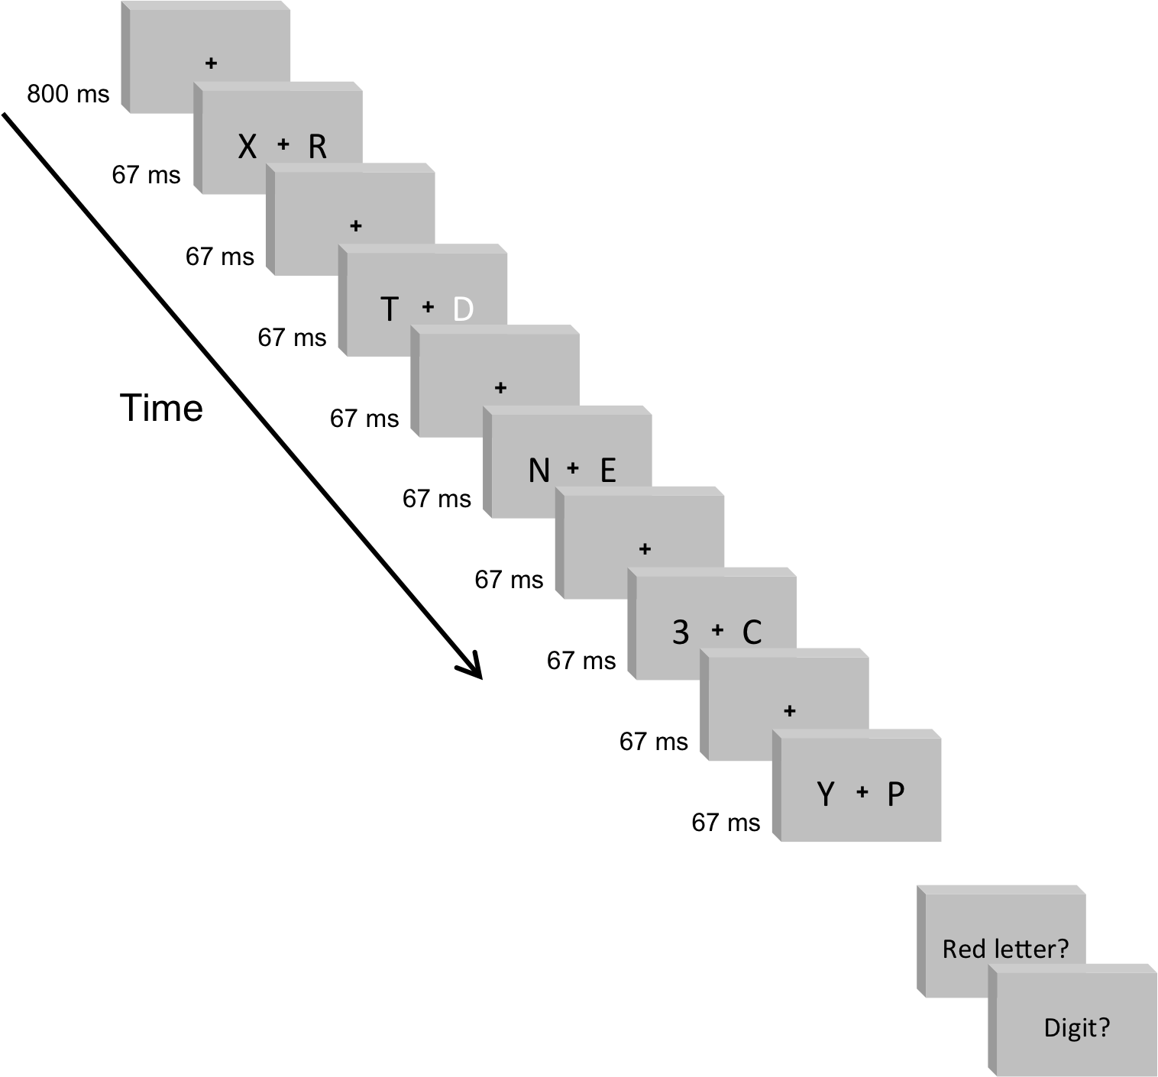
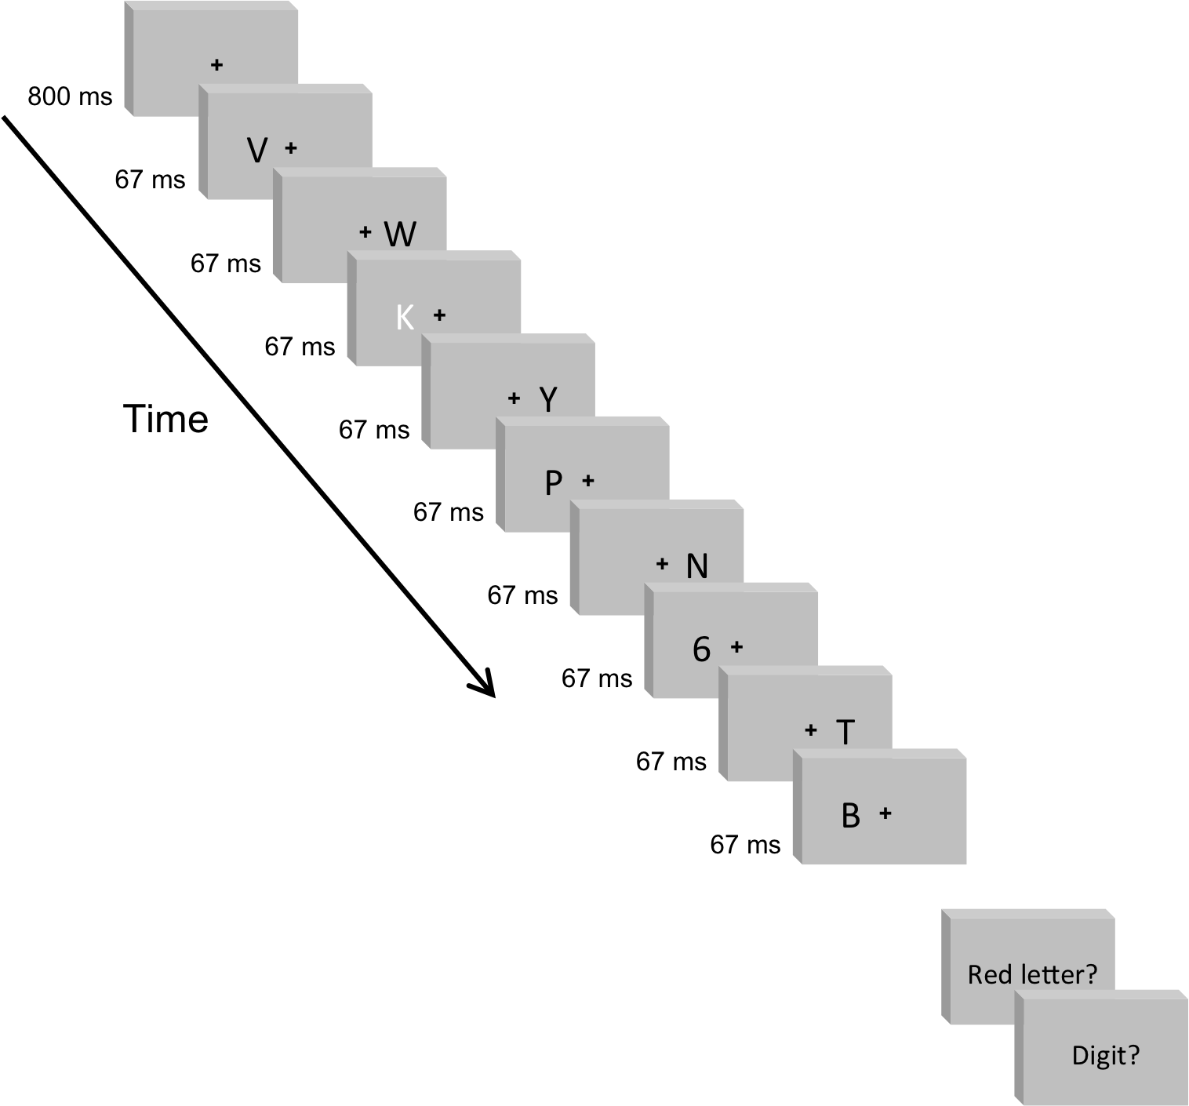

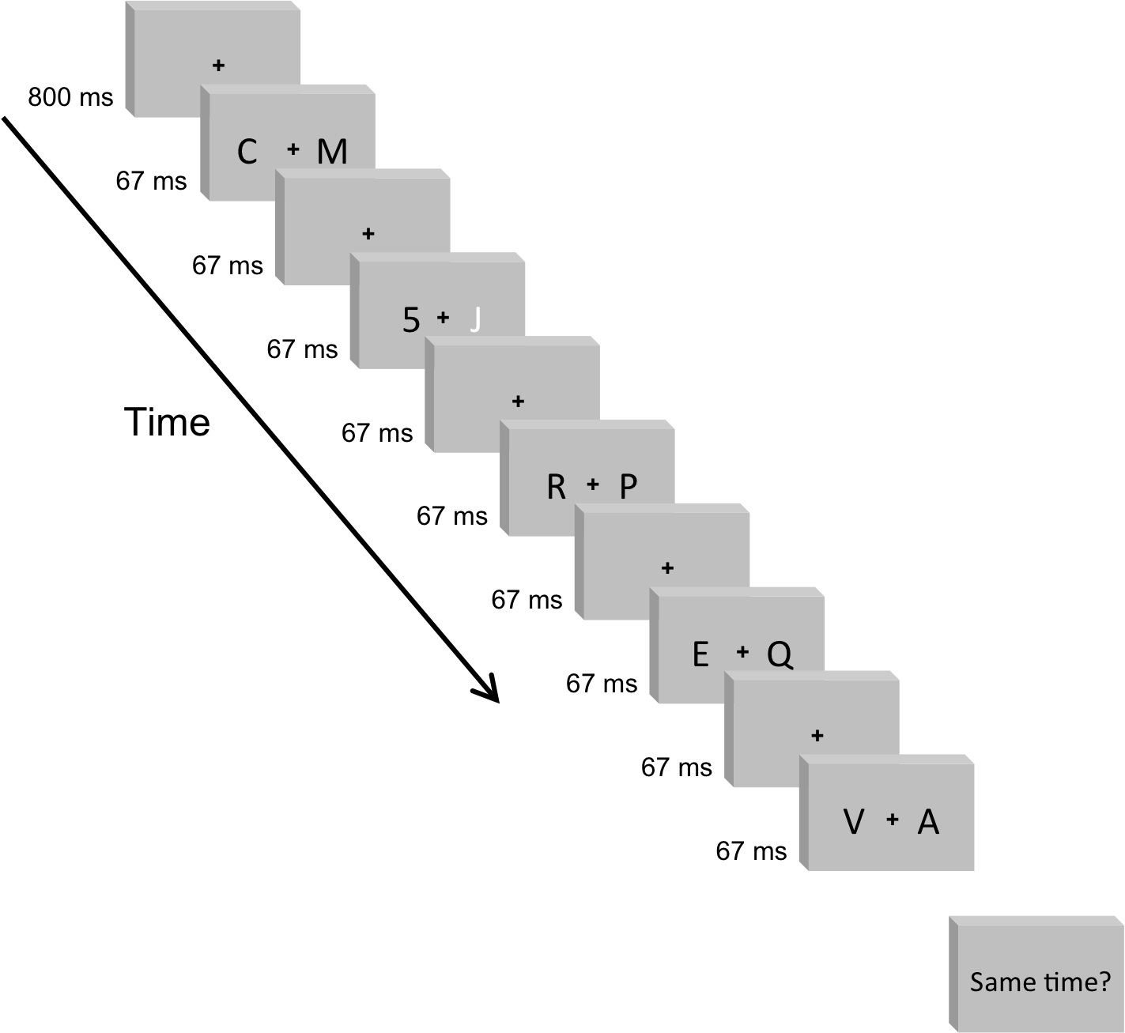
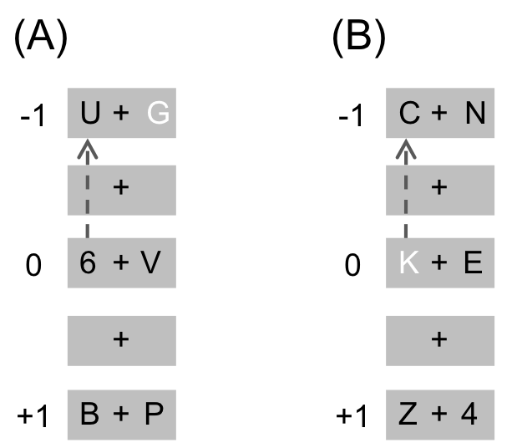
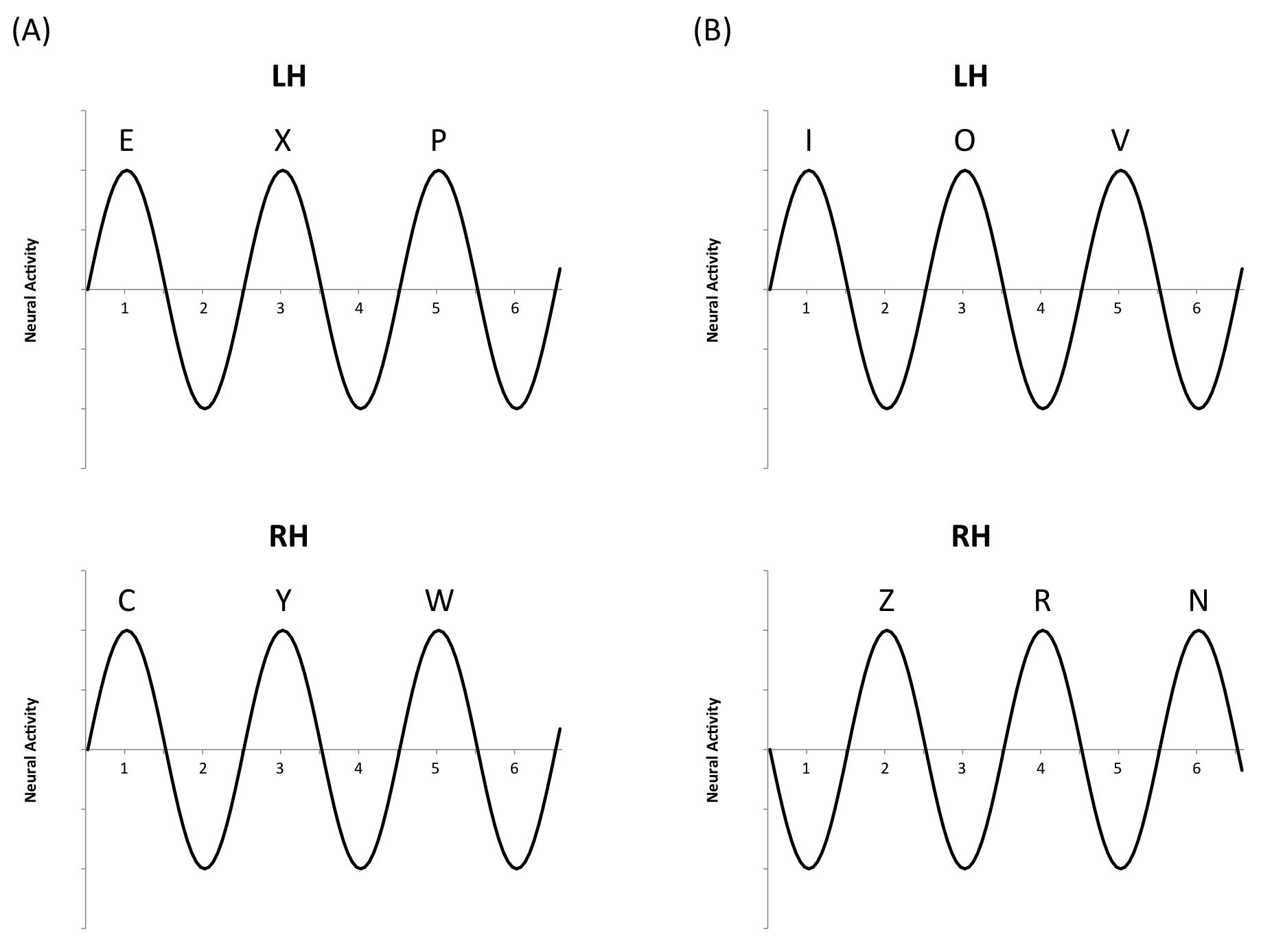
The Left Visual Field Advantage in Asynchronous Dual-Stream RSVP Tasks:
An Investigation of Potential Neural Mechanisms
Andrew Clement & Nestor Matthews – Department of Psychology, Denison University
Introduction
The present study investigated the timing of the human visual system, particularly instances when the visual system’s speed limit becomes asymmetrical across the left and right visual fields. Specifically, research reveals that participants perform reliably better in the left visual field (LVF) compared to the right one (RVF).¹⁻⁷ This persistent asymmetry has been shown to occur in both high-level identification tasks¹⁻⁵ and low-level simultaneity tasks.⁶⁻⁷ Here, we attempted to synthesize this range of approaches by using a single experimental paradigm.
The paradigm in question, known as dual-stream rapid serial visual presentation (RSVP), presents two streams of visual stimuli at relatively high speeds and requires participants to identify two targets (T1 & T2) within the streams.²⁻⁵ However, in the present study we used several novel variations of this paradigm that either modified the synchrony of the stimuli or altered the requirements for identifying the targets.
These variations of the RSVP paradigm enabled us to test several hypotheses regarding LVF advantages and the timing of human vision. First of all, by asynchronously presenting stimuli (see Figure 1)⁸⁻⁹ we investigated whether the visual system’s speed limit is set locally or globally.^{1,10-11} Secondly, modifying the identification requirements and presence of T1 enabled us to determine whether salient attentional cues play a role in LVF advantages.^{1,12} Lastly, asking participants to judge the simultaneity of targets provided us with more precise information about the timing asymmetries underlying LVF advantages.⁶⁻⁷
Acknowledgements
This study was made possible by contributions from the Reid and Polly Anderson Endowment and the Sigma Xi Grants-In-Aid of Research Program.
Methods
Discussion
Experiment 1 yielded a typical pattern of results in which there was an LVF advantage for T2|T1 accuracy but not for T1 accuracy. However, there were no significant differences between the synchronous and asynchronous paradigms, suggesting that the visual system’s speed limit is set locally (separately in the two visual fields) rather than globally (across visual fields).^{1,10-11}
Experiment 2A also revealed that visual speed limits are set independently in the two visual fields.^{1,10-11} In particular, the results indicated that T2|T1 accuracy for the laterally faster triple letter paradigm decreased when targets appeared in the same visual field. T2 accuracy also increased relative to T1 accuracy for the R,L condition in the triple letter paradigm, revealing a focused LVF advantage.¹³ The results of Experiments 2B and 2C expanded upon these findings, indicating that neither attention to a salient T1 nor the physical presence of this target are necessary for LVF advantages to occur.¹
Lastly, Experiment 3’s results revealed a cross-over interaction that helps clarify previous findings regarding LVF advantages. In specific, these results suggest that the neural response for RVF stimuli is delayed relative to that for LVF stimuli. ^{2,5,14} Thus, stimuli presented at close temporal distances may appear simultaneous or non-simultaneous, depending on whether a probe target appeared in the LVF or RVF (see Figure 2).
References
1. Scalf et al. (2007). [PubMed ID: 17469970]
2. Verleger et al. (2008). [PubMed ID: 18564053]
3. Śmigasiewicz et al. (2010). [PubMed ID: 20546763]
4. Verleger et al. (2010). [PubMed ID: 20401472]
5. Verleger et al. (2011). [PubMed ID: 21265863]
6. Matthews & Kelly (2011). [PubMed ID: 21602558]
7. Matthews et al. (2012). [PubMed ID: 22303023]
8. VanRullen & Dubois (2011). [PubMed ID: 21904532]
9. Hanslmayr et al. (2011). [PubMed ID: 21592583]
10. Alvarez & Cavanagh (2005). [PubMed ID: 16102067]
11. Alvarez et al. (2012). [PubMed ID: 22637710]
12. Buschman & Miller (2007). [PubMed ID:17395832]
13. Potter et al. (2002). [PubMed ID: 12421061]
14. Vul et al. (2008). [PubMed ID: 18181792]
Synchronous Identification Task
Asynchronous Identification Task
Triple Letter Identification Task
Simultaneity Task
Results
Experiment 1: Synchronous vs. Asynchronous
Experiment 1: T1 ANOVA | F(1,18) | P | μ_{P}² | Power
Paradigm | 2.13 | 0.162 | 0.106 | 0.282
Side Change | 0.272 | 0.608 | 0.015 | 0.078
T2 Side | 0.195 | 0.664 | 0.011 | 0.07
Experiment 1: T2|T1 ANOVA | F(1,18) | P | μ_{P}² | Power
Paradigm | 1.526 | 0.233 | 0.078 | 0.216
Side Change | 0.103 | 0.752 | 0.006 | 0.061
T2 Side | 15.224 | 0.001 | 0.458 | 0.958
Experiment 2A: Asynchronous vs. Triple Letter
(T1 Present, T1 & T2 Identification)
Experiment 2A: T1 ANOVA | F(1,15) | P | μ_{P}² | Power
Paradigm | 53.126 | p<.001 | 0.78 | 1
Side Change | 1.355 | 0.263 | 0.083 | 0.193
T2 Side | 31.226 | p<.001 | 0.676 | 0.999
Paradigm x Side Change | 1.463 | 0.245 | 0.089 | 0.205
Paradigm x T2 Side | 17.676 | 0.001 | 0.541 | 0.975
Side Change x T2 Side | 3.663 | 0.075 | 0.196 | 0.433
3-Way Interaction | 5.979 | 0.027 | 0.285 | 0.628
Experiment 2A: T2|T1 ANOVA | F(1,15) | P | μ_{P}² | Power
Paradigm | 10.346 | 0.006 | 0.408 | 0.852
Side Change | 16.025 | 0.001 | 0.517 | 0.962
T2 Side | 17.016 | 0.001 | 0.531 | 0.971
Paradigm x Side Change | 15.225 | 0.001 | 0.504 | 0.954
Paradigm x T2 Side | 8.226 | 0.012 | 0.354 | 0.764
Side Change x T2 Side | 0.002 | 0.966 | 0 | 0.05
3-Way Interaction | 0.976 | 0.339 | 0.061 | 0.152
Experiment 2B: Asynchronous vs. Triple Letter
(T1 Present, T2 Identification)
Experiment 3: Simultaneity
Figure 2.
Experiment 2B: T2 ANOVA | F(1,12) | P | μ_{P}² | Power
Paradigm | 18.102 | 0.001 | 0.601 | 0.973
Side Change | 7.345 | 0.019 | 0.38 | 0.702
T2 Side | 8.949 | 0.011 | 0.427 | 0.784
Paradigm x Side Change | 20.054 | 0.001 | 0.626 | 0.984
Paradigm x T2 Side | 0.162 | 0.695 | 0.013 | 0.066
Side Change x T2 Side | 2.667 | 0.128 | 0.182 | 0.324
3-Way Interaction | 0.469 | 0.506 | 0.038 | 0.097
Figure 1.
Experiment 2C: Asynchronous vs. Triple Letter
(T1 Absent, T2 Identification)
Experiment 2C: T2 ANOVA | F(1,12) | P | μ_{P}² | Power
Paradigm | 51.464 | p<0.001 | 0.811 | 1
T2 Side | 14.48 | p=0.003 | 0.547 | 0.937
Paradigm x T2 Side | 0.316 | p=0.584 | 0.026 | 0.081
Experiment 3: D' ANOVA | Wilks Λ | F | DF | P | μ_{P}² | Power
Probe Side | 0.988 | 0.182 | (1,15) | 0.676 | 0.012 | 0.069
SOA | 0.062 | 11.733 | (9,7) | 0.002 | 0.938 | 0.996
Probe Side x SOA | 0.09 | 7.909 | (9,7) | 0.006 | 0.91 | 0.964
Experiment 3: False Alarm ANOVA | Wilks Λ | F | DF | P | μ_{P}² | Power
L Probe x R Probe | 0.974 | 0.407 | (1,15) | 0.533 | 0.026 | 0.092
www.denison.edu/~matthewsn/righthemifieldrsvpdeficits.html

