Slide 1
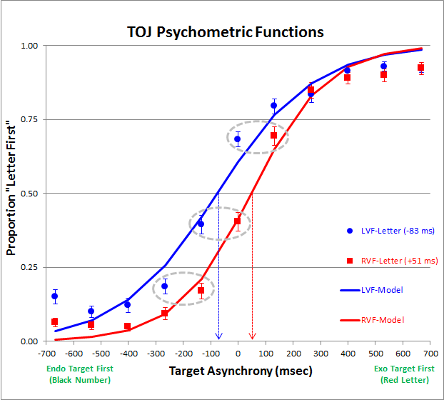
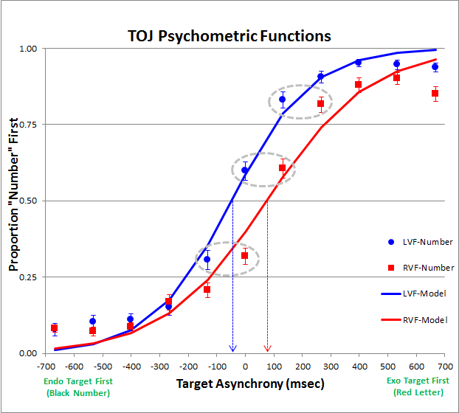
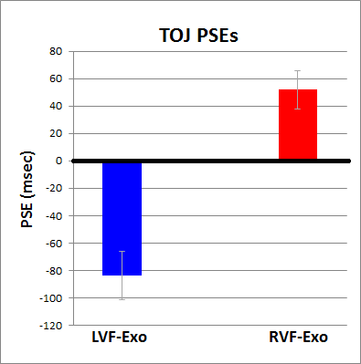
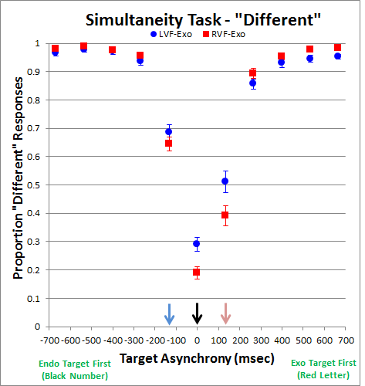
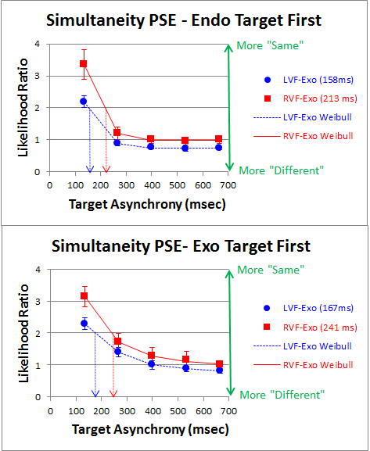
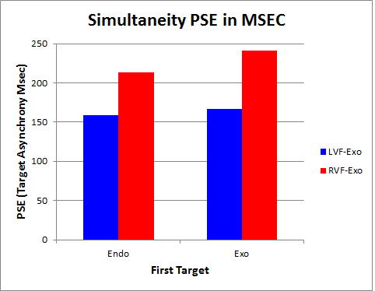
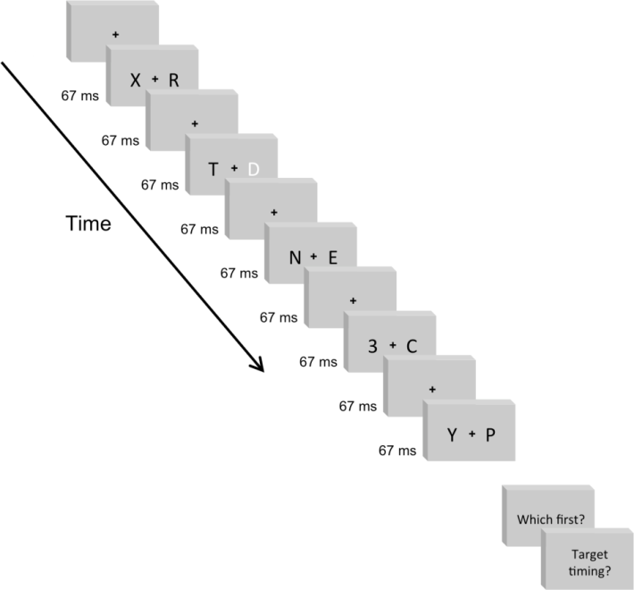
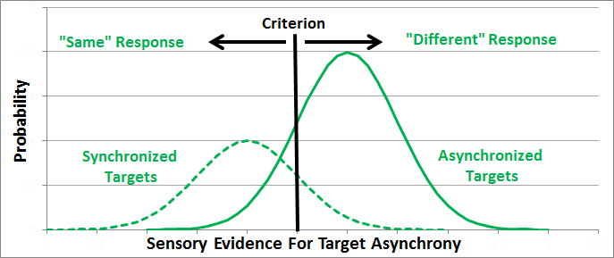
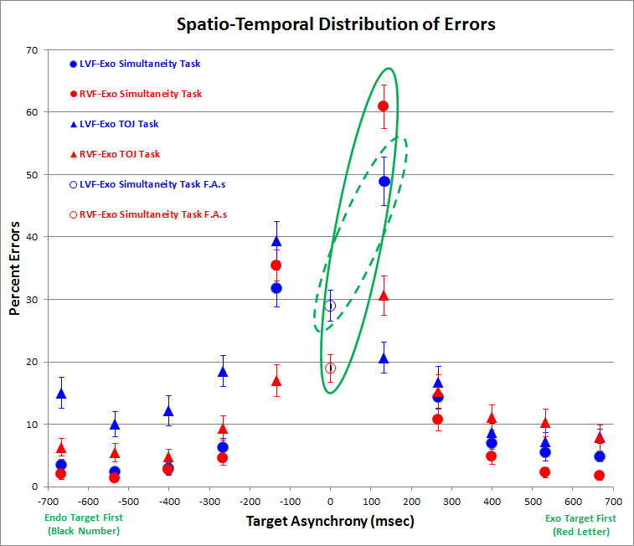
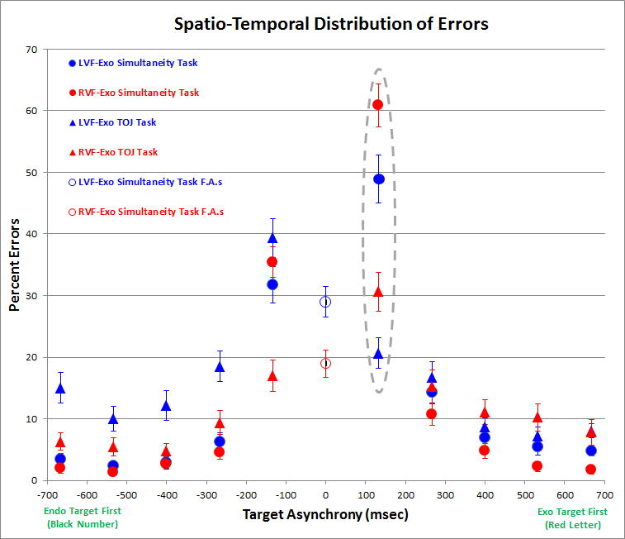
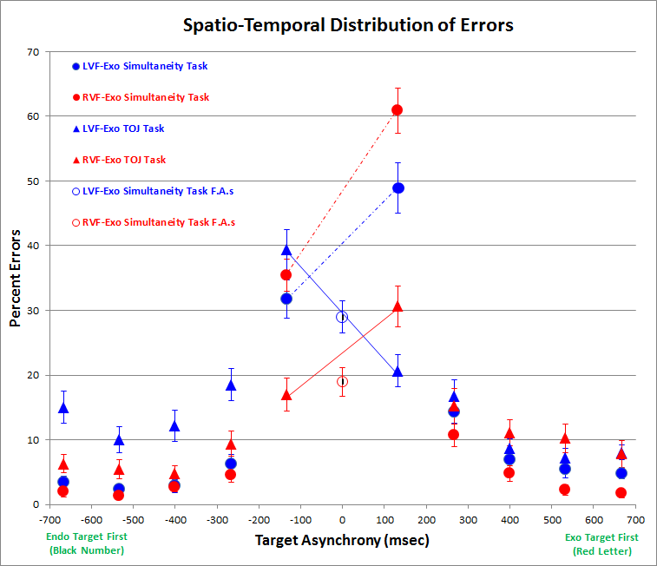
Remapping Time Across Space
Poster #
56.455
Nestor Matthews¹, Leslie Welch², Elena Festa², Andrew Clement¹
¹Denison University - Department of Psychology; ²Brown University - Cognitive, Linguistic & Psychological Sciences
Introduction
Results
Discussion
In principle, the neural resources that govern attention to the left visual field (LVF) could be independent of those governing attention to the right visual field (RVF). Consistent with this possibility, tasks that push the limits of attention’s temporal resolution often reveal significantly better performance for LVF- than for RVF-attended targets^{[1-6]}. Likewise, Verleger et al.^{[7,8]} found that N2pc (parietal contralateral) ERPs - a marker of selective attention^{[9]} - peaked ~50 msec earlier for LVF than for RVF targets on a dual-stream RSVP identification task.
Verleger et al.’s^{[7,8]} hastened ERPs to LVF targets raise important perceptual questions. Are LVF targets perceived sooner than RVF targets? If so, how might the visual system reconcile these timing differences to estimate simultaneity across the LVF and RVF? We approached these questions by presenting dual-stream RSVP displays similar to Verleger et al.’s^{[7,8]} , and requiring each participant to make temporal order judgments (TOJs) and simultaneity judgments.
To summarize, we found the following five results:
(1) A ~134 msec hastened perception of LVF targets on TOJ task;
(2) Patterns of simultaneity-task responses that disconfirm those predicted from the hastened perception of LVF targets on TOJ task;
(3) Greater PSEs when judging simultaneity on RVF-exo trials relative to LVF-exo trials;
(4) Significantly more errors on the simultaneity task than on the TOJ task when Exo-targets preceded Endo-targets by 133 msec;
(5) A significant three-way (Task by Exo-hemifield by Target-Order) interaction in error rates at the briefest (133 msec) target asynchrony.
TOJ Task
Which Came First,
Letter or Number?
Task-Specific Decision Rules
TOJ Task
If { [ LVF_{ETA} minus RVF_{ETA} ] + bias } < 0,
“LVF first”, else “RVF first”.
Simultaneity Task
(1) If the exogenous target is in the LVF
add a delay to LVF_{ETA}, else increase the bias.
(2) If | LVF_{ETA} minus RVF_{ETA} | > bias,
“Different”, else “Same”.
Simultaneity Task
Did the Letter & Number
Appear at the Same time or Different Times?
*
Method
Bottom Line
These experiments demonstrate that the visual system remaps a hastened neural response to LVF targets by using hemifield-specific rules within the decision-stage of simultaneity judgments. This hemifield-specific remapping would effectively compensate for the cross-hemifield asymmetries in neural response latencies that could otherwise impair simultaneity estimates.
Error Analysis
Retinal Stimulation
Identical Across Tasks.
I.V.s
Task (TOJ vs Simultaneity)
Exo-hemifield (LVF vs RVF)
Target Order (Endo-1st vs Exo-1st)
D.V.
Perceived Timing (PSE & SDT Criterion)
References
Hollander et al. (2005). PMID: 15488903
Scalf et al. (2007). PMID: 17469970
Smigasiewicz et al. (2010). PMID: 20546763
Kelly & Matthews (2011). PMID: 21602558
Matthews et al. (2012). PMID: 22303023
Bosworth et al. (2012). PMID: 22051893
Verleger et al. (2011). PMID: 21265863
Verleger et al. (2013). PMID: 23451226
Hopf et al. (2000). PMID: 11073872
Poster: http://denison.edu/~matthewsn/vss2013remappingtime.html

