Slide 1



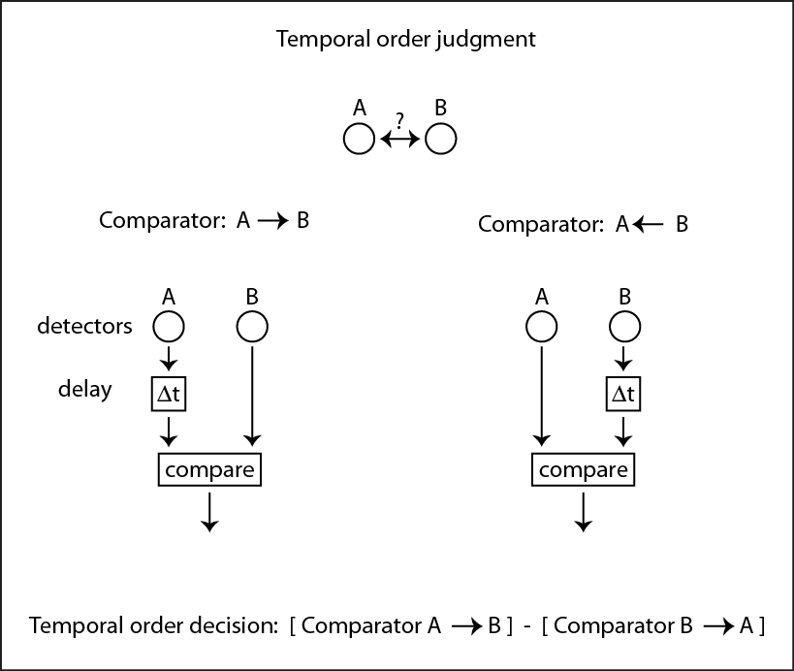
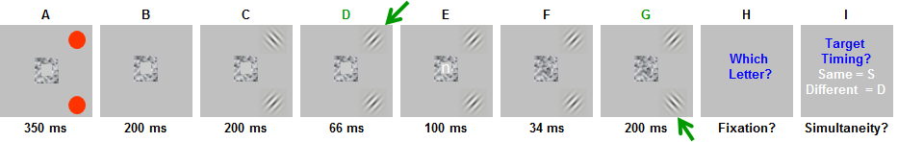
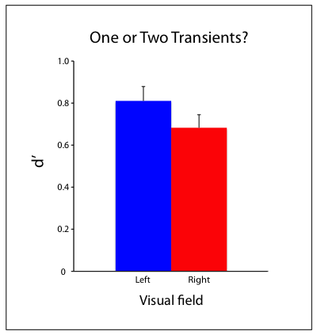
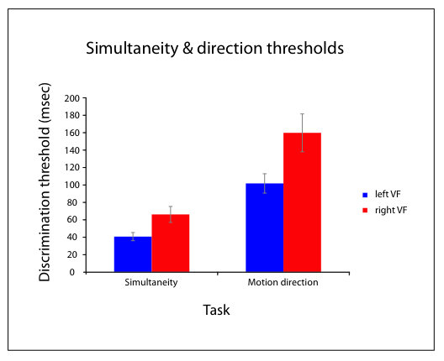
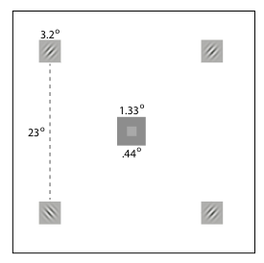
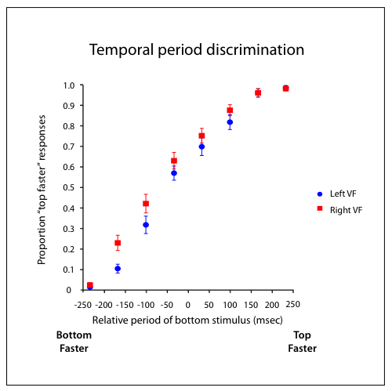
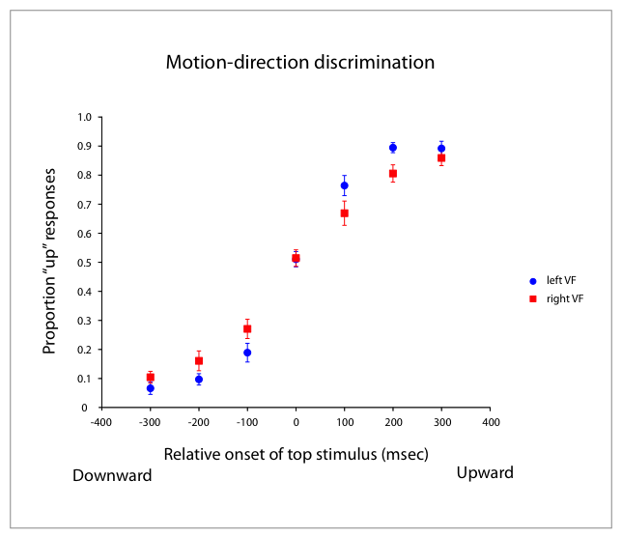
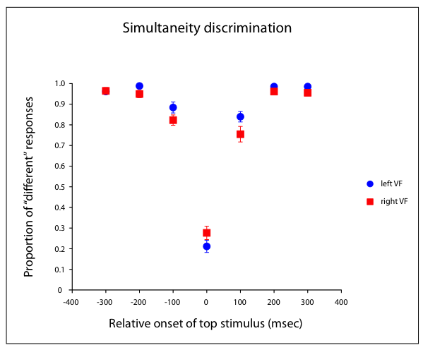
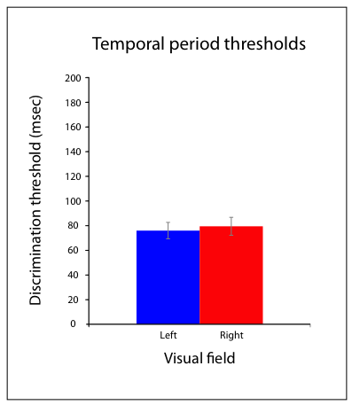
Hemifield asymmetries in attention-based motion discrimination
Poster #
63.320
Leslie Welch¹ and Nestor Matthews²
¹Brown University - Cognitive, Linguistic & Psychological Sciences, ²Denison University - Department of Psychology
Introduction
Results
Discussion
Previous research has shown performance asymmetries between right and left hemifields on attention-based tasks with a disadvantage for right visual field (VF). For example, Battelli et al. (2007) reviewed evidence for worse performance in right VF on high-level motion tasks. Which aspects of spatiotemporal processing could be responsible for the hemifield performance difference?
Experiment 1: Previously, Matthews et al. (2012) found similar hemifield differences for a simultaneity task, and we include a replication here. The task Matthews et al. used was not ostensibly a motion task; subjects indicated whether two targets appeared simultaneous or not. We tested an explicit motion task, motion direction discrimination, using the same stimuli as the simultaneity task.
Experiment 2: One aspect of spatiotemporal processing that could lead to poor performance is that right VF temporal acuity could be poor compared with left VF at an early stage prior to attention processing. This possibility is relatively unlikely given the large literature on V1 neural responses that do not show any hemifield differences in temporal processing (e.g. Hubel and Wiesel, xxx or Movshon and Tolhurst, xxx). To test temporal acuity, we compared temporal period (1/ temporal frequency) discrimination in right VF and left VF.
Experiment 3: Another potential difference in temporal processing is that attention may not code transients with the same fidelity in the two hemifields. To test this idea, one or two targets changed during the course of a trial, and subjects indicated the number of transients.
Simultaneity
Did the Gabors change at the Same time or Different times?
Performance on the simultaneity and motion-direction tasks both showed hemifield asymmetries with worse performance in right VF. However, temporal period discrimination and counting transients did not.
Our findings can be interpreted within a framework similar to that used for low-level motion detection, but with a large separation (23 deg) between sampling regions tuned to orientation- transients rather than luminance-transients.
Motion direction
Was the motion
Upward or Downward?
*
Temporal period
Which flickered faster?
Top or Bottom?
Count transients
How many changed?
One or Two?
Bottom Line
These experiments support the idea that the problem with high-level motion tasks is not at a low-level motion processing stage and are consistent with other attention-based hemifield asymmetries (refs). In addition, the problem is not simply that transients are not represented with equal fidelity in right and left VFs. Instead, the hemifield asymmetries are due to processing limitations at the level of attention-based motion (Batelli, Cavanagh) or, equivalently, third-order motion processing (Lu and sperling).
Why are there hemifield asymmetries? Attention-based motion processing has a lower sampling rate (estimated () Hz, Cavanagh) than low-level motion (estimated () Hz, ref). Perhaps the sampling rate is even higher in left VF reflecting the double parietal coverage. ...
Method
References
Hollander et al. (2005). PMID: 15488903
Scalf et al. (2007). PMID: 17469970
Smigasiewicz et al. (2010). PMID: 20546763
Kelly & Matthews (2011). PMID: 21602558
Matthews et al. (2012). PMID: 22303023
Bosworth et al. (2012). PMID: 22051893
Verleger et al. (2011). PMID: 21265863
Verleger et al. (2013). PMID: 23451226
Hopf et al. (2000). PMID: 11073872
Poster: http://denison.edu/~matthewsn/vss2013welchmatthews.html

