Slide 1


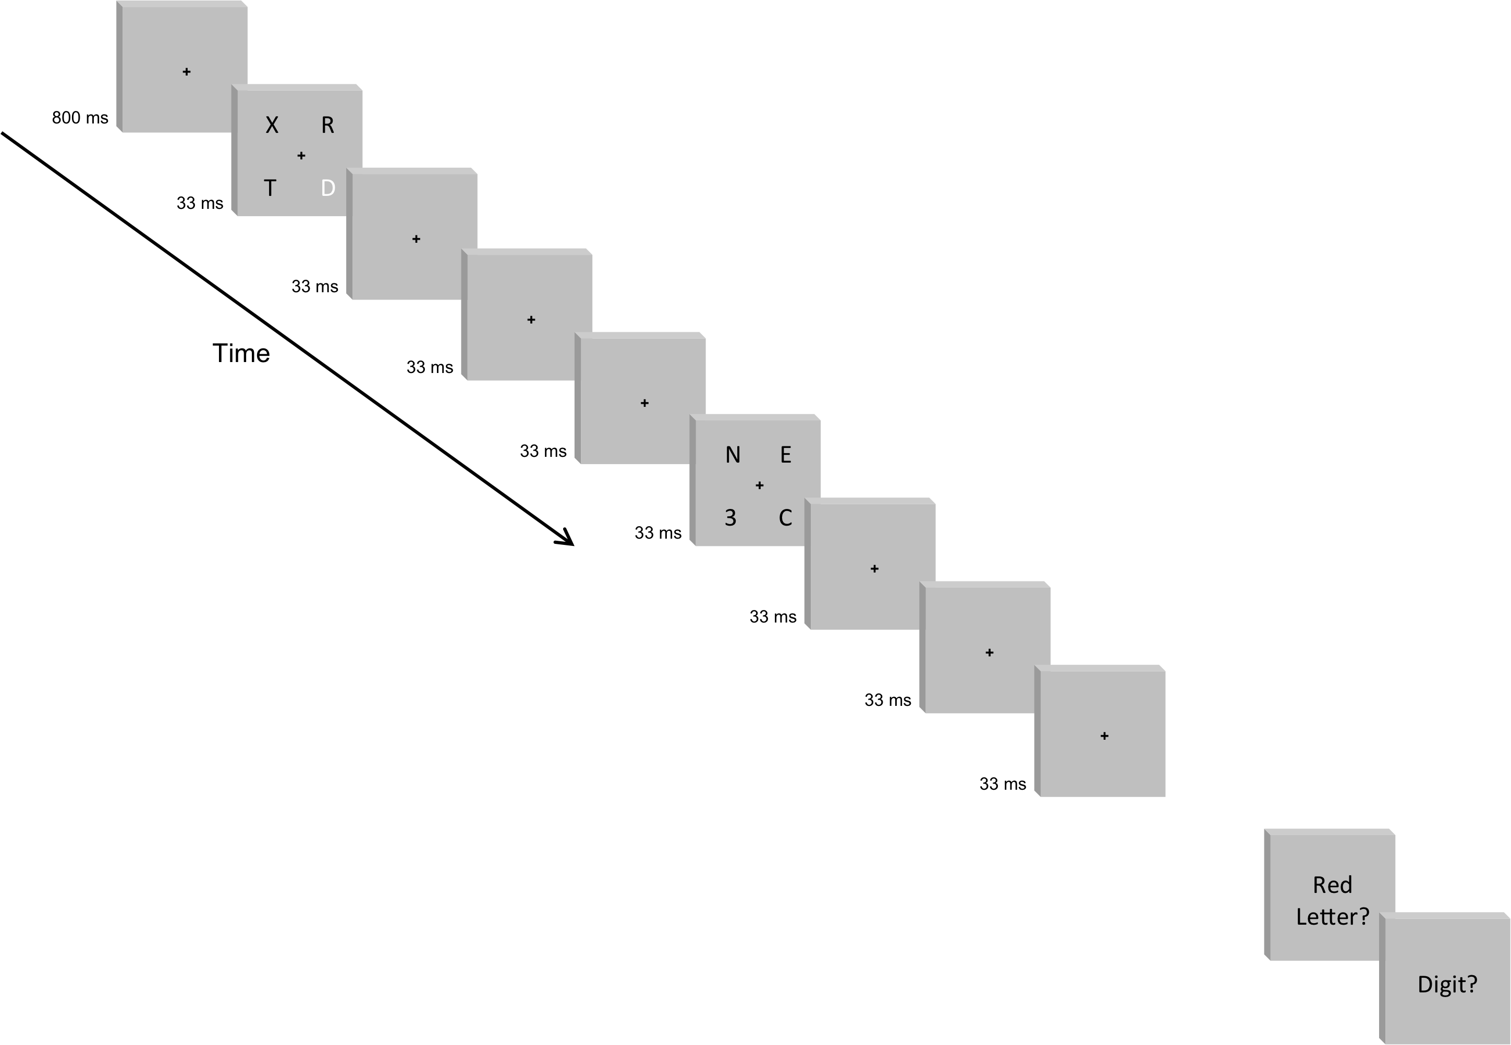

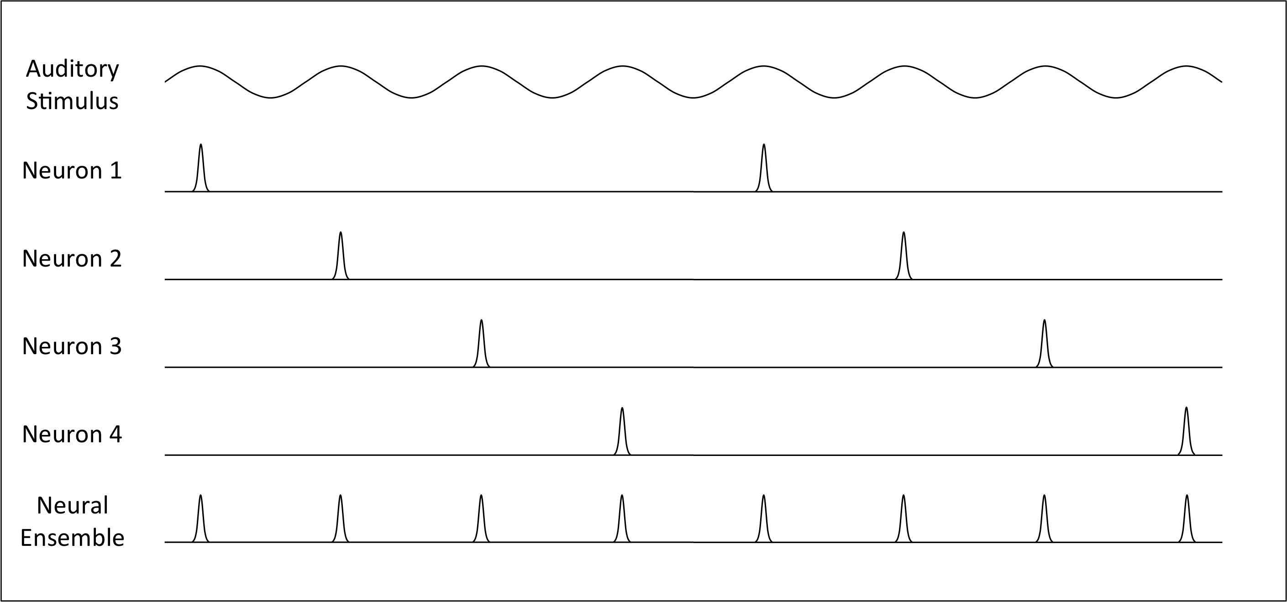

#56.4070 Attentional Volleying Across Visual Quadrants
Andrew S. Clement^{1,2} & Nestor Matthews¹
¹Department of Psychology, Denison University, ²Department of Psychology, University of Notre Dame
Introduction
In 1937, Ernest Wever and Charles Bray proposed the volley theory to explain how relatively slow neural firing rates might register high auditory frequencies.¹ The theory posits that distinct neural ensembles synchronize at various phases of a stimulus to increase an organism’s temporal precision (see Figure 1). Although this neural-ensemble volleying was proposed as a theory of auditory perception, it might be construed as a more general principle that helps organisms solve time-based problems through biologically manageable episodes.
In the present study, we investigated whether neural resources that govern attention to each visual quadrant might volley to improve temporal precision beyond the canonical ~7 Hz limit.² Although visual attention samples multiple locations at a relatively constant rate, recent evidence suggests that separate neural resources control attention to different regions of the visual field.³⁻⁸ If this is the case, neural resources for each visual quadrant may operate at separate ~7 Hz rates, allowing attention to volley across quadrants.
To test this hypothesis, we had participants view four-stream RSVP displays containing two targets (T1 and T2).⁴ Participants reported the identities of both targets on each trial.⁹⁻¹¹ The four streams flashed either synchronously at 7.5 Hz, or asynchronously with new information occurring at 7.5 Hz per quadrant, 15 Hz per lateral hemifield, and 30 Hz globally. In a flicker-discrimination control experiment, participants viewed four-stream RSVP displays that were presented simultaneously or sequentially at 15 or 30 Hz. For this task, participants reported whether the streams flashed synchronously or asynchronously.
External Resources
Methods
Discussion
In the target-identification experiment, the synchronous and asynchronous conditions generated statistically indistinguishable, near-ceiling identification accuracy for T1 identification. This null effect occurred despite the asynchronous condition’s 30 Hz global presentation rate, which is approximately four times the canonical ~7 Hz attentional sampling rate. Similarly, the asynchronous condition reduced T2|T1 identification accuracy by only 4.5 percentage points. This decrement is only half the cost associated with shifting T2 from the left to the right visual hemifield. Thus, increasing the global presentation rate to 30 Hz produced little or no impairment in attentional performance. Higher T2|T1 accuracy in the left visual hemifield also reveals a left visual field advantage for attention in temporally demanding tasks.⁹⁻¹¹
In the flicker-discrimination control experiment, participants reliably discriminated synchronous and asynchronous displays at 15 Hz. Discrimination for these displays approached ceiling level. Although participants’ discrimination performance declined for synchronous and asynchronous displays at 30 Hz, their performance remained well above chance. In fact, discrimination on these displays corresponded to 88 percent correct without response bias. Together, these high discrimination rates suggest that the null and small effects observed in the previous experiment cannot be due to discrimination failures.
Conclusions
The present study reveals accurate attentional performance for spatially distributed targets presented at four times the canonical ~7 Hz limit.² This finding supports the possibility that neural resources governing attention to each visual quadrant operate at separate ~7 Hz rates.⁶⁻⁸ By entraining to stimuli at separate rates, these neural resources can volley to improve attention’s temporal precision.
References
1. Wever & Bray (1937). [PubMed ID: N/A]
2. VanRullen et al. (2007). [PubMed ID: 18042716]
3. Alvarez & Cavanagh (2005). [PubMed ID: 16102067]
4. Scalf et al. (2007). [PubMed ID: 17469970]
5. Alvarez et al. (2012). [PubMed ID: 22637710]
6. Matthews et al. (2013). [PubMed ID: 23818678]
7. Spaak et al. (2014). [PubMed ID: 24599454]
8. Gray et al. (2015). [PubMed ID: 25855167]
9. Holländer et al. (2005). [PubMed ID: 15488903]
10. Verleger et al. (2009). [PubMed ID: 18564053]
11. Śmigasiewicz et al. (2010). [PubMed ID: 20546763]
Synchronous Condition
Asynchronous Condition
Results
Experiment 1: Synchronous vs. Asynchronous Target Identification
Figure 1.
Experiment 1: T1 ANOVA | F(1,25) | p | η²_{p} | Power
Timing | 0.194 | 0.664 | 0.008 | 0.071
T2 Side | 5.309 | 0.030 | 0.175 | 0.601
Side Change | 1.738 | 0.199 | 0.065 | 0.245
Timing x T2 Side | 1.000 | 0.327 | 0.038 | 0.161
Timing x Side Change | 0.003 | 0.956 | <0.001 | 0.050
T2 Side x Side Change | 0.003 | 0.960 | <0.001 | 0.050
3-Way Interaction | 1.145 | 0.295 | 0.044 | 0.177
Experiment 1: T2|T1 ANOVA | F(1,25) | p | η²_{p} | Power
Timing | 13.721 | 0.001 | 0.354 | 0.945
T2 Side | 9.336 | 0.005 | 0.272 | 0.836
Side Change | 0.042 | 0.840 | 0.002 | 0.054
Timing x T2 Side | 5.504 | 0.027 | 0.180 | 0.616
Timing x Side Change | 1.090 | 0.306 | 0.042 | 0.171
T2 Side x Side Change | 7.460 | 0.011 | 0.230 | 0.747
3-Way Interaction | 1.258 | 0.273 | 0.048 | 0.190
Experiment 2: 15 Hz vs. 30 Hz Flicker Discrimination
Exp2: t-test | t(15) | p | η²_{p} | Power
Flicker Rate | 7.521 | <0.001 | 0.790 | 0.79
Exp 2: One-Sample T-test | Test Value | p
15 Hz Flicker 30 Hz Flicker | d’=0 d’=0 | <0.001 <0.001
http://www.denison.edu/~matthewsn/
vss2015clementmatthews.html

