Slide 1


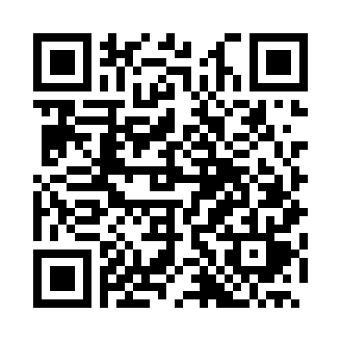
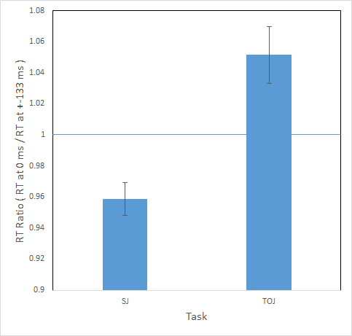
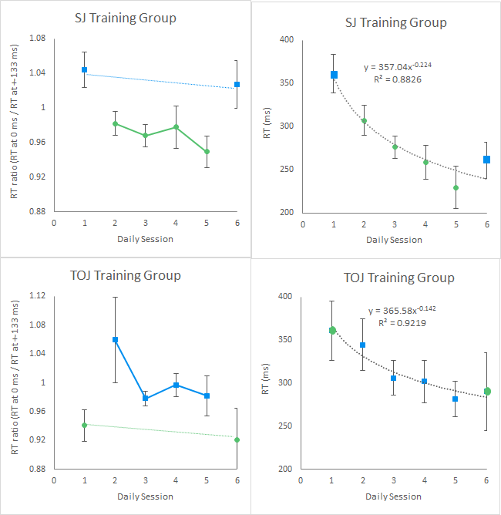
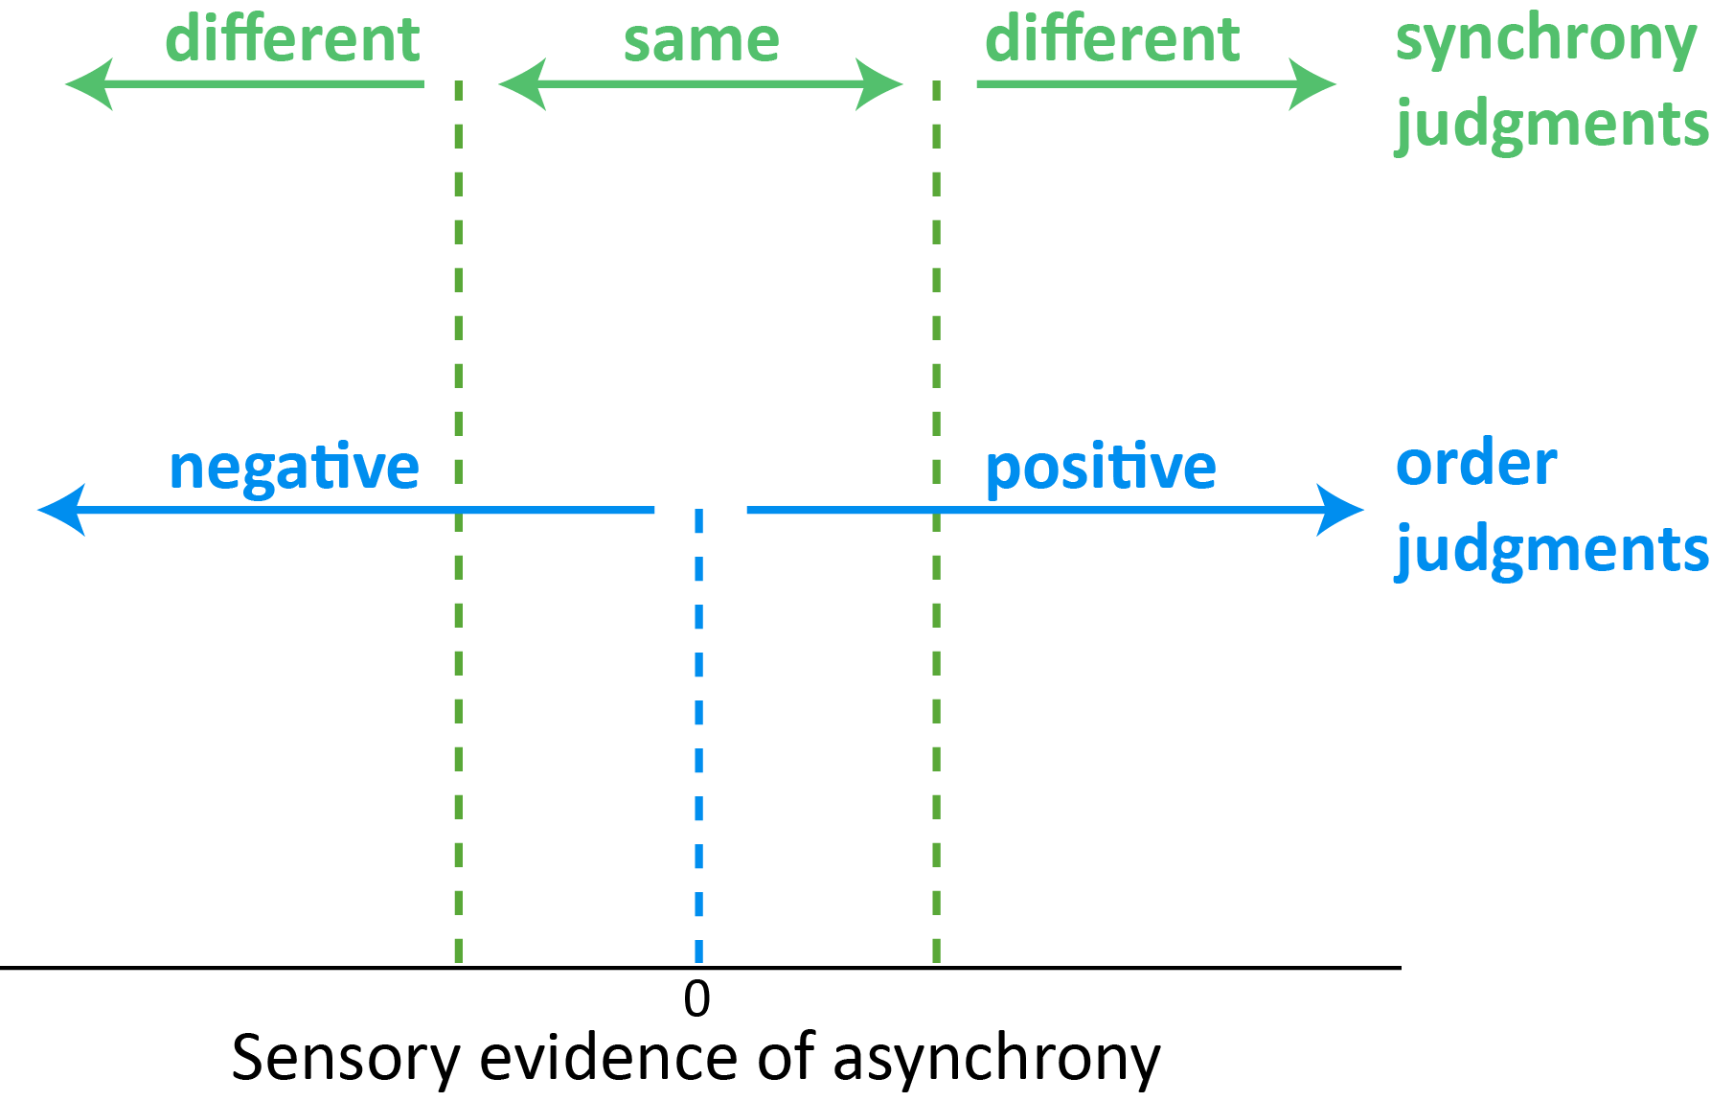
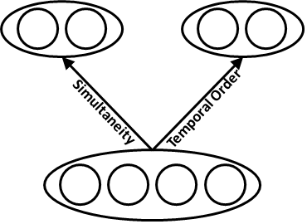
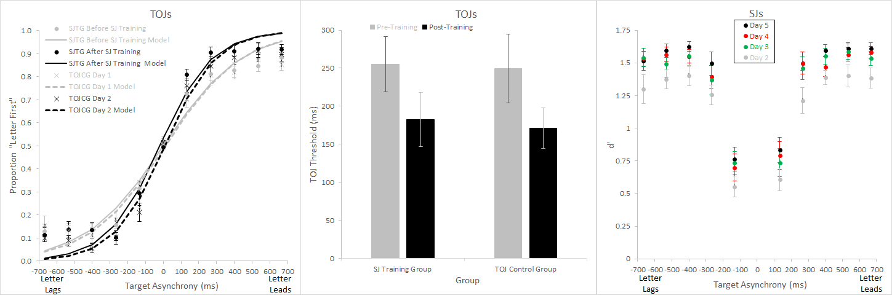
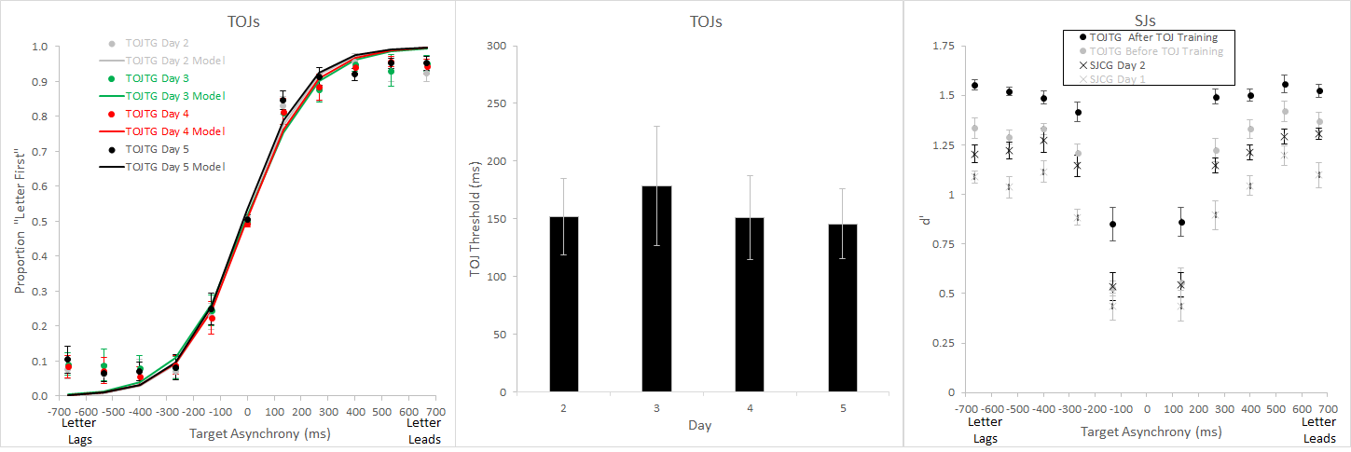
Perceptual Learning on Simultaneity and Temporal Order Judgments
Poster #
56.3003
Nestor Matthews¹, Leslie Welch², Rebecca Achtman¹
¹Denison University - Department of Psychology; ²Brown University - Cognitive, Linguistic & Psychological Sciences
Introduction
Method
Results
Discussion
SJs and TOJs both depend on arrival-time differences, yet may rely on distinct boundaries in temporal decision space.
Example Trials
Reaction Time
Under identical retinal stimulation, SJs and TOJs exhibited distinct reaction time patterns, and temporal precision failed to exhibit transfer-of-training effects.
The results demonstrate distinct decision-related and/or “read-out” factors² – rather than stimulus-driven neural factors – set the limit on SJ and TOJ performance.
Temporal Order Judgment (TOJ)
Which Came First?
Letter or Number
E
+
D
n = 47
+
n = 47
time
3
+
N
Order Judgment: Letter 1st
Synchrony Judgment (SJ)
Did the Letter & Number appear at the
Same time or Different times?
D
+
3
+
time
N
+
E
Sync Judgment: Same time
Temporal Precision
SJ Training Group & TOJ Control Group
Decision-Related
Neural Units
RSVP Stream
Training schedule
Day 1
Days 2 - 5
Day 6
“Read-Out”
Two target types
+
D
[red letter]
3
[black number]
SJ Training Group
n = 9
Pre-train
TOJ
SJ Training
Post-train
TOJ
67 ms
X
+
R
Stimulus-Driven Neural Units
67 ms
+
Targets always in different hemifields
67 ms
E
+
D
TOJ Control Group
n = 9
TOJ
TOJ
Time
67 ms
+
TOJ Training Group & SJ Control Group
67 ms
C
+
E
References
67 ms
+
TOJ Training Group
n = 11
Pre-train
SJ
Post-train
SJ
67 ms
3
+
N
TOJ Training
67 ms
+
1. Matthews et al. (2013). PMID: 23818678
Petrov, et al. (2005). PMID: 16262466
Y
+
P
67 ms
SJ Control Group
n = 10
SJ
SJ
RSVP stimuli were identical for both tasks¹
Poster: http://denison.edu/~matthewsn/vss2015matthewswelchachtman.html

