Slide 1



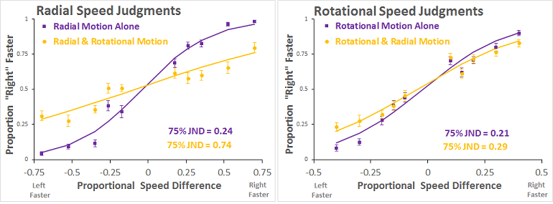
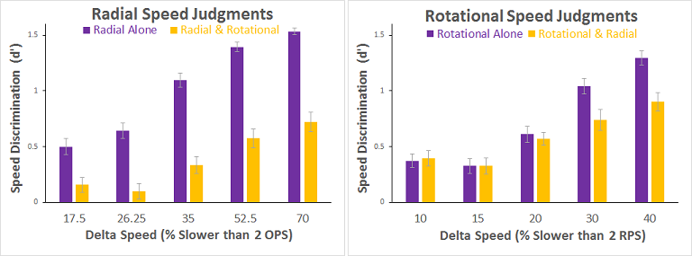
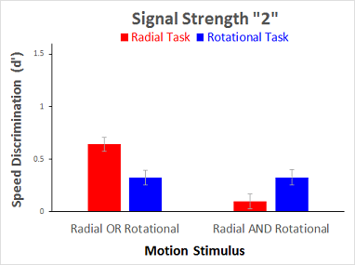
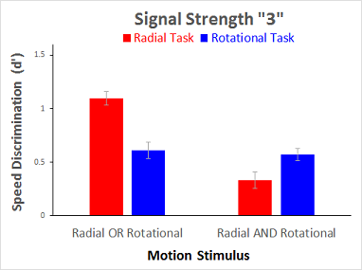
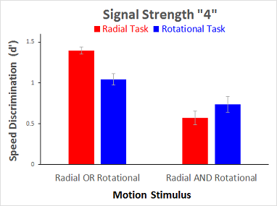
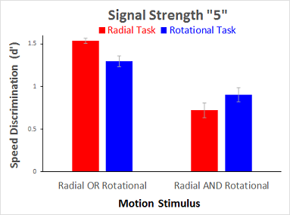
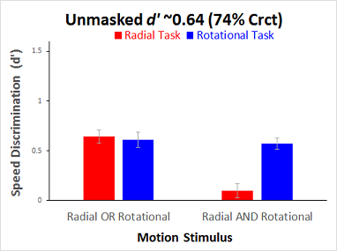
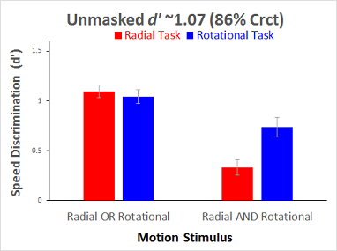
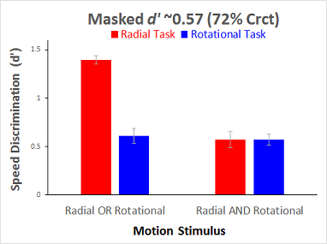
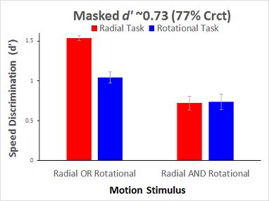
A Comparison of Radial and Rotational Plaid Speed Judgments
Poster #
36.4035
Nestor Matthews¹, Leslie Welch², Allison Murphy¹, Megan Puritz¹
¹Denison University - Department of Psychology; ²Brown University - Cognitive, Linguistic & Psychological Sciences
Introduction
Results
Discussion
The Medial Superior Temporal (MST) region of the primate visual system responds to both radial and rotational motion [1-3]. Despite this shared MST activity, prior studies reveal differences between radial and rotational judgments of random dot stimuli [4-9]. Here, we used plaid stimuli to investigate differences between radial and rotational speed judgments. After pilot data revealed little or no effect for opposite motion directions, we investigated whether combining radial and rotational motion differentially affects radial and rotational speed discrimination.
Descriptive Statistics
Combining radial and rotational motion impaired radial speed discrimination significantly more than rotational speed discrimination. This differential impairment occurred across signal strengths, and also after controlling for either “masked” and “unmasked” performance levels.
The results from our plaid stimuli extend those from prior random-dot studies that also showed distinctions between these MST-mediated (radial versus rotational) motion judgments [4-9].
Future experiments are needed to determine whether the present task effects reflect local speed differences, which can influence radial and rotational speed judgments [10-13].
Interaction at a Given Signal Strength
Method
Task-by-Stimulus Interaction
 | F(1,23) | p | pEta^2 | Power
d' | 17.203 | <0.001 | 0.428 | 0.978
RT | 9.777 | 0.005 | 0.298 | 0.849
Task-by-Stimulus Interaction
 | F(1,23) | p | pEta^2 | Power
d' | 53.110 | <0.001 | 0.698 | ~1
RT | 3.805 | 0.063 | 0.142 | 0.464
Task-by-Stimulus Interaction
 | F(1,23) | p | pEta^2 | Power
d' | 21.370 | <0.001 | 0.482 | 0.993
RT | 12.625 | 0.002 | 0.354 | 0.925
Task-by-Stimulus Interaction
 | F(1,23) | p | pEta^2 | Power
d' | 13.249 | 0.001 | 0.366 | 0.936
RT | 7.333 | 0.013 | 0.242 | 0.737
Participants: 24 Denison University students.
Task: Which side (L/R) contained faster radial motion (radial motion task), or faster rotational motion (rotational motion task)?
Stimuli: On each trial, a pair of bilaterally presented plaids either rotated, radiated, or both. One plaid moved at the standard speed: 2 octaves per second or 2 revolutions per second, respectively, in radial and rotational trial-blocks. The other moved slower by various amounts.
References
Interaction at a Given Performance Level (d’)
Tanaka & Saito (1989). PMID: 2769351
Duffy & Wurtz (1991a). PMID: 1875243
Duffy & Wurtz (1991b). PMID: 1875244
Geesaman & Qian (1996). PMID: 8944287
Bex & Makous (1997). PMID: 9425552
Bex et al., (1998). PMID: 9536513
Geesaman & Qian (1998). PMID: 9666990
Shirai et al., (2006). PMID: 17138275
Xiao et al., (2006). PMID: 16597350
Werkhoven et al., (1993). PMID: 8474842
Barraza & Grzywacz (2002). PMID: 12367744
Barraza & Grzywacz (2003). PMID: 12868642
Barraza & Grzywacz (2005). PMID: 16023697
Task-by-Stimulus Interaction
 | F(1,23) | p | pEta^2 | Power
d' | 29.077b | 0.000 | 0.558 | 0.999
RT | 6.868b | 0.015 | 0.23 | 0.709
Task-by-Stimulus Interaction
 | F(1,23) | p | pEta^2 | Power
d' | 14.097b | 0.001 | 0.38 | 0.949
RT | 2.974b | 0.098 | 0.115 | 0.379
Task-by-Stimulus Interaction
 | F(1,23) | p | pEta^2 | Power
d' | 48.944b | <0.001 | 0.68 | ~1
RT | 36.200b | <0.001 | 0.611 | ~1
Task-by-Stimulus Interaction
 | F(1,23) | p | pEta^2 | Power
d' | 25.889b | <0.001 | 0.53 | 0.998
RT | 11.311b | 0.003 | 0.33 | 0.896
Poster: http://personal.denison.edu/~matthewsn/vss2016matthewsetal

