Slide 1



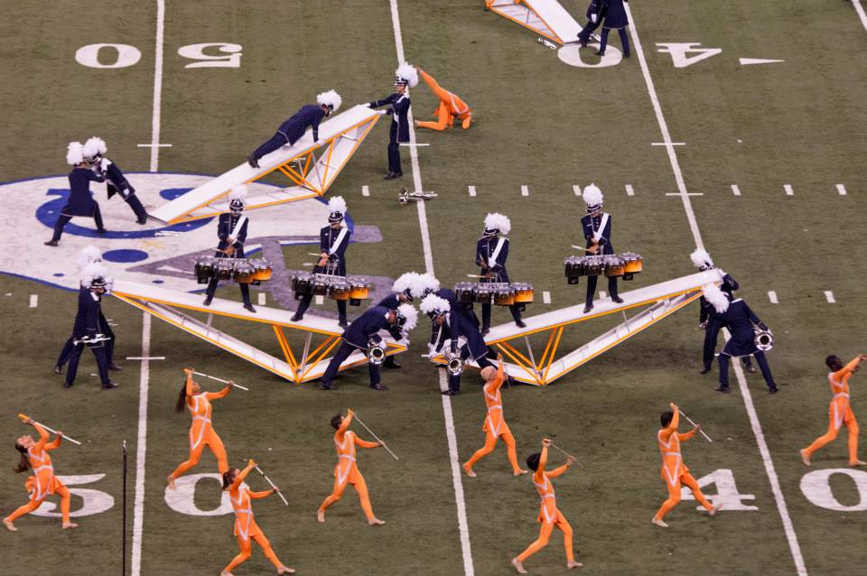

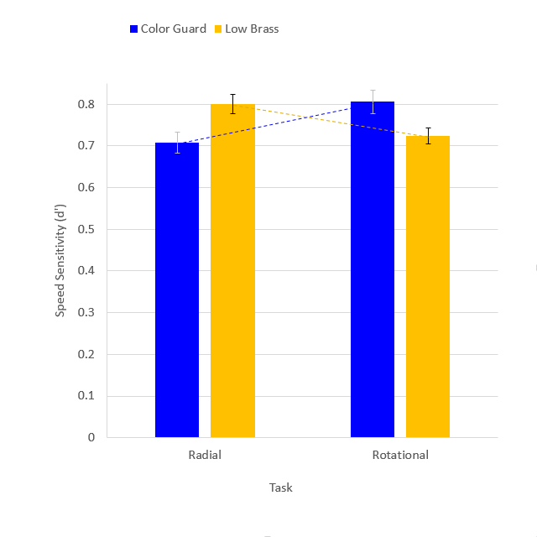
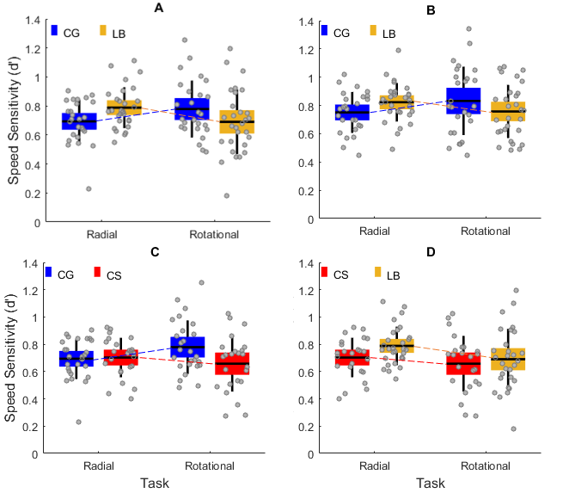
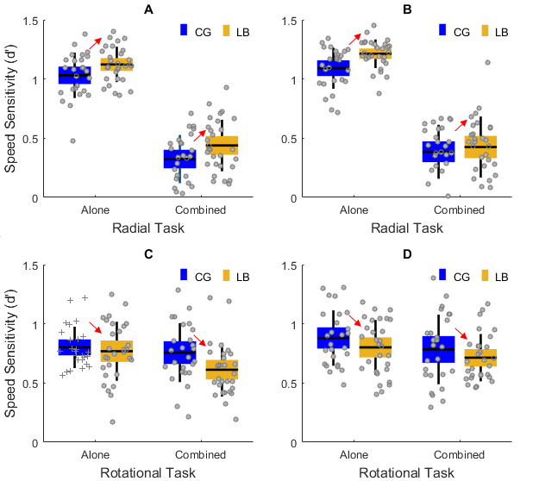
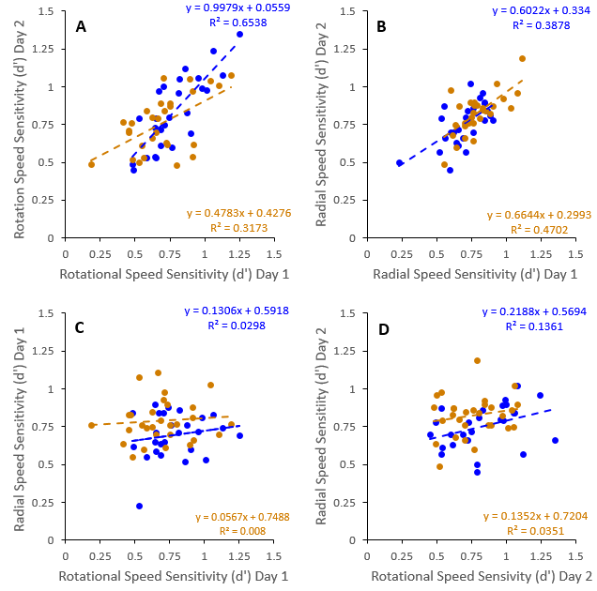
18093371
Visual Speed Sensitivity in the Drum Corp Color Guard
Poster #
33.4061
Nestor Matthews¹, Leslie Welch², F. Daniel Coplin³, Allison Murphy¹, Megan Puritz¹
¹Denison University – Psychology; ²Brown University - Cognitive, Linguistic & Psychological Sciences; ³College of Wooster - Psychology
Introduction
Results
Discussion
Drum corps color guard experts spend years developing skills in spinning rifles, sabers, and flags. Their expertise provides a unique window into factors that govern sensitivity to the speed of rotational and radial motion. To the extent that shared neural events govern rotational and radial speed sensitivity, one would expect expertise on either task to transfer to the other. One similarly would expect shared neural events to generate correlations between rotational and radial speed sensitivity. We tested these predictions psychophysically.
Group-by-Task Interaction
Replicability & Specificity
We found a modest but reliably reproducible and specific group-by-task interaction; color guard speed sensitivity exhibited a rotational motion advantage and radial motion disadvantage. Additionally, rotational and radial speed sensitivity failed to predict each other.
The results could be explained by a dissociation between the neural events governing rotational and radial speed sensitivity [1-5].
An alternative explanation entails decomposing our rotational and radial motions into local linear motion components [6-11]. However, a linear decomposition explanation requires non-intuitively assuming that color guard experts exhibit heightened sensitivity to fast local speeds, and decreased sensitivity to slow local speeds.
Method
Generalizability Across Stimulus Conditions & Days
Correlations Within-Tasks, Not Between-Tasks
Participants: 26 color guard (CG) experts, 29 low brass (LB) experts, 24 college students (CS).
Task: Which side (L/R) contained faster radial motion (radial motion task), or faster rotational motion (rotational motion task)?
Stimuli: On each trial, a pair of bilaterally presented plaids either rotated, radiated, or both. One plaid moved at the standard speed: 2 octaves per second or 2 revolutions per second, respectively, in radial and rotational trial-blocks. The other moved slower by various amounts.
References
Tanaka & Saito (1989). PMID: 2769351
Duffy & Wurtz (1991a). PMID: 1875243
Duffy & Wurtz (1991b). PMID: 1875244
Wall et al. (2008). PMID: 18547254
Gilmore et al. (2007) PMID: 18093371
Barraza & Grzywacz (2002). PMID: 12367744
Barraza & Grzywacz (2005). PMID: 15963549
Clifford et al. (1999). PMID: 10343803
Freeman & Harris (1992). PMID: 1502814
Koenderink & van Doorn (1976). JOSA, 1976
Wurfel et al. (2005). PMID: 16023697
Day 1 Day 2
Poster: http://personal.denison.edu/~matthewsn/vss2017matthewsetal

