Slide 1



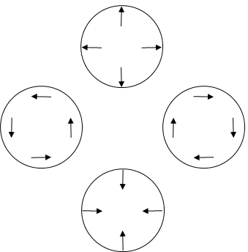
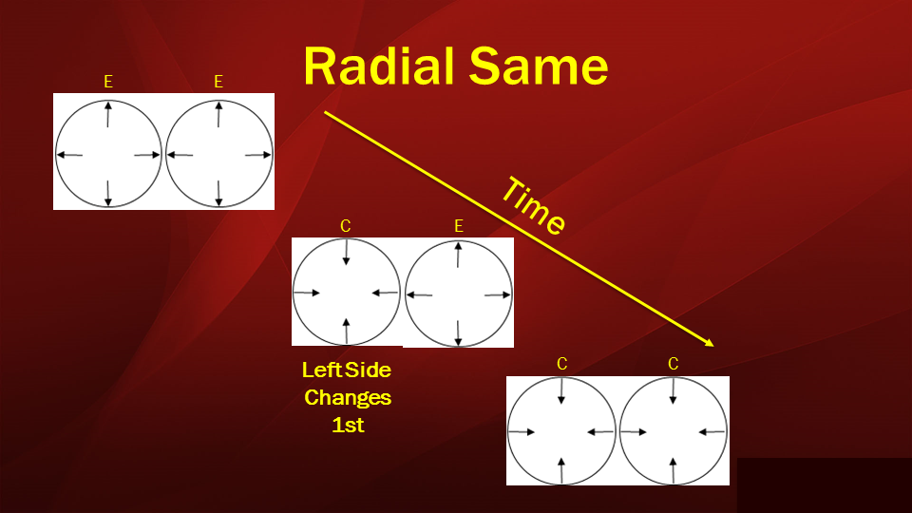
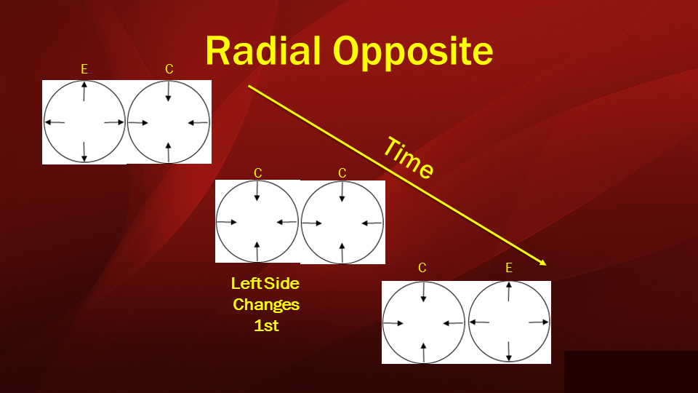
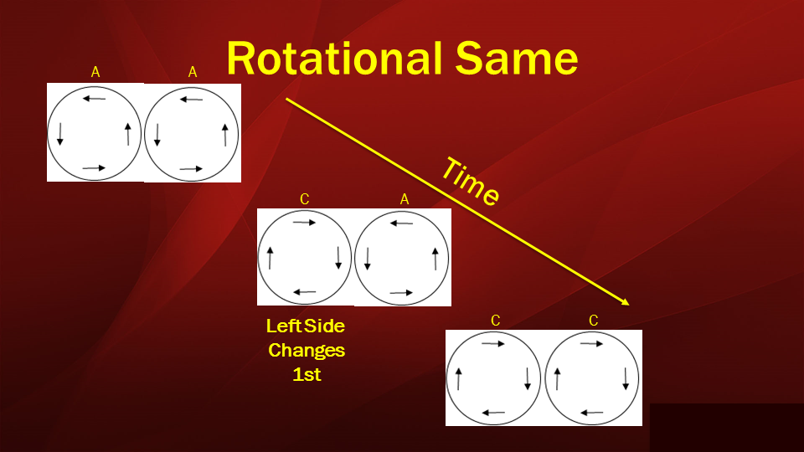
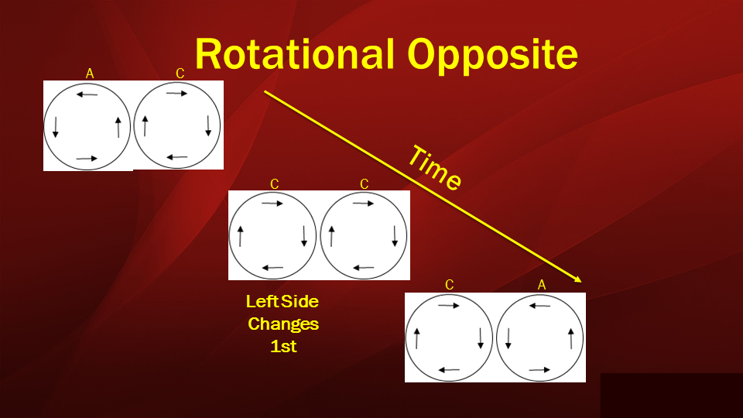
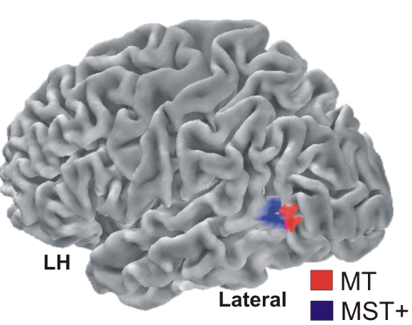
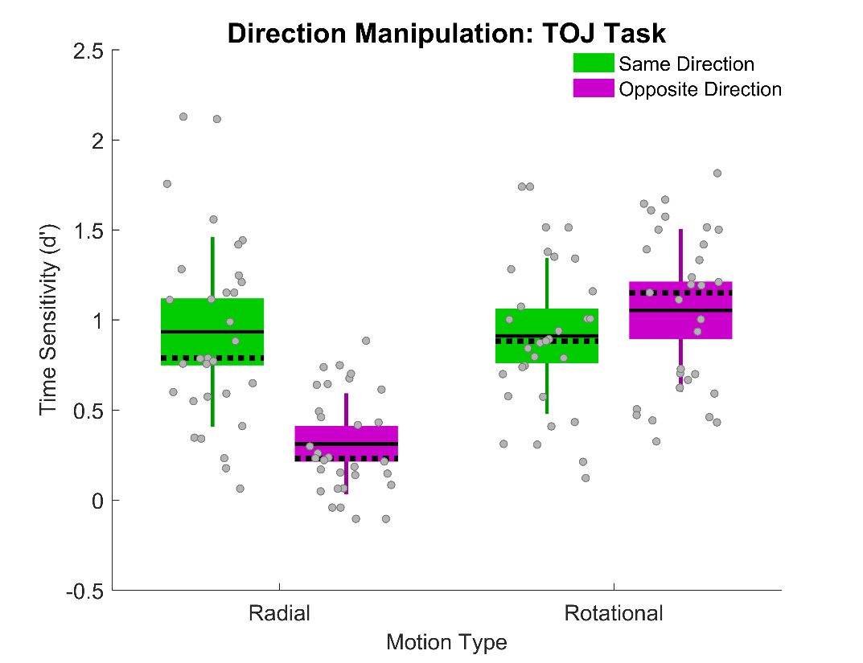
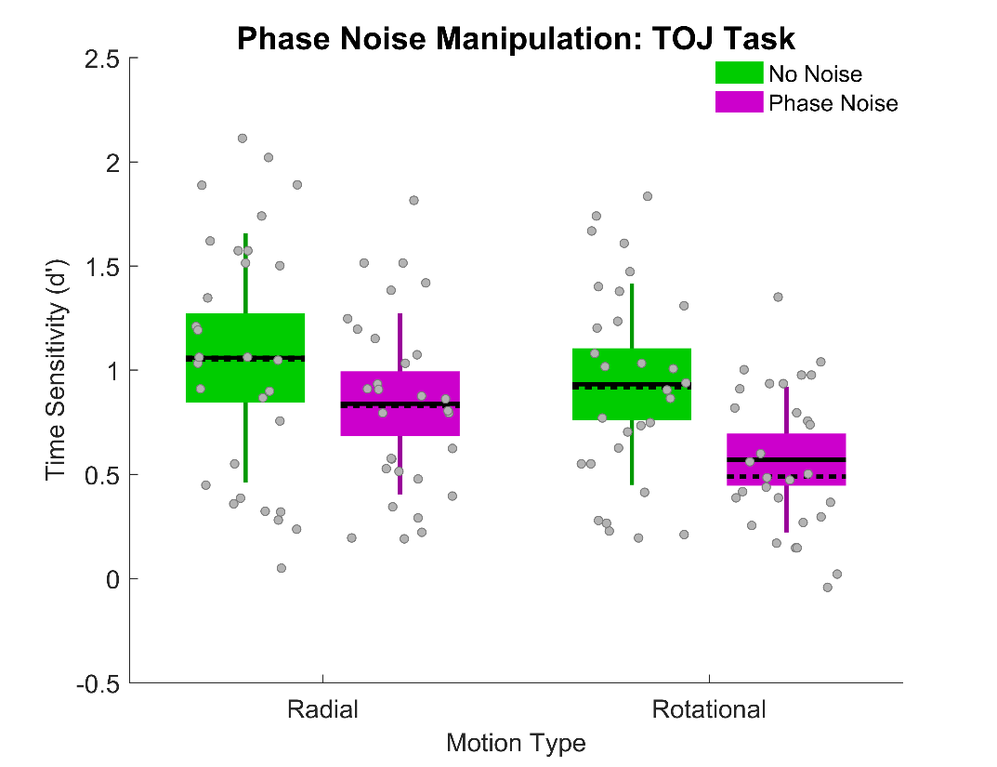
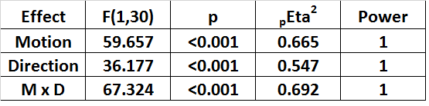
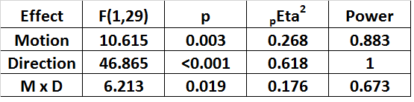
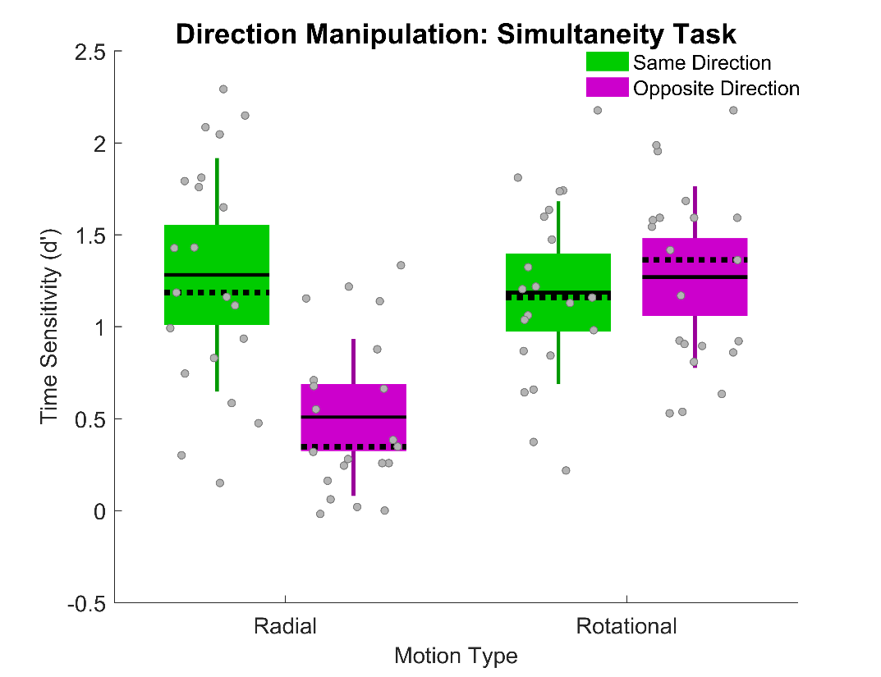
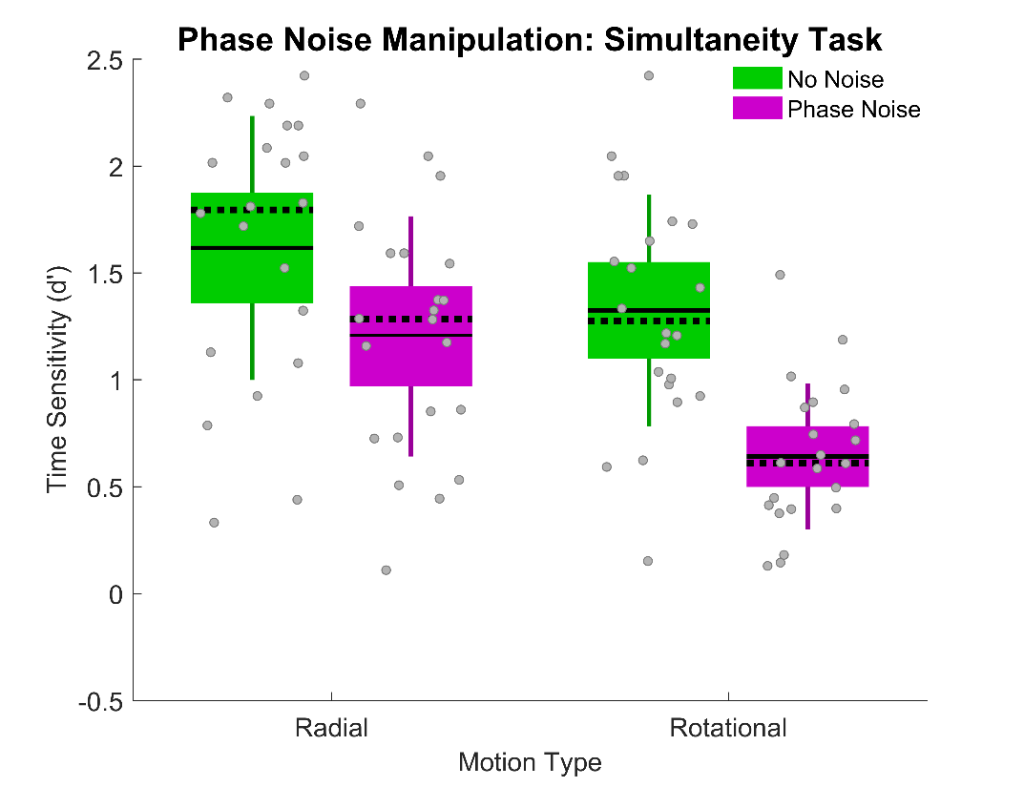
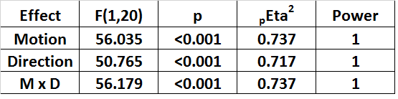
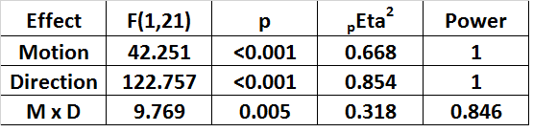
Double Dissociation in Radial & Rotational Motion-Defined Temporal Order Judgments
Poster #
26.456
Leslie Welch¹, Nestor Matthews², Elena Festa¹, Kendra Schafer²
¹Brown University - Cognitive, Linguistic & Psychological Sciences; ²Denison University – Psychology
Introduction
TOJ Task: Left or Right First? SJ Task: Same or Different Time?
Discussion
Contrary to a shared-mechanism account, Exp 1 revealed distinct temporal order judgment (TOJ) patterns for radial and rotational motion. Reversing the initial directions impaired radial TOJs, but improved rotational TOJs.
Contrary to a shared-mechanism account, Exp 2 revealed distinct temporal order judgment (TOJ) vulnerabilities for radial and rotational motion. Phase noise generated larger impairments on rotational TOJs than on radial TOJs.
Exp 3 & 4 confirmed and extended Exp 1 & 2’s TOJ results to simultaneity judgments (SJs).
Conclusion – The findings suggest a double dissociation between the neural events that limit how precisely we judge asynchronies defined by these two types of MST-mediated motion.
Results
Exp 1
Exp 2
Motion Physics – The figure above shows that radial motion can be converted to rotational motion (and vice versa) by rotating local linear motion vectors 90 degrees.
Motion Physiology – Radial and rotational motion register in the Medial Superior Temporal (MST) region of the primate visual system, according to prior neurophysiological research [1-7].
Exp 3
Exp 4
Research Question
References
Do shared or distinct neural events limit how precisely we judge asynchronies defined by these two types of MST-mediated motion?
Tanaka & Saito (1989) PMID: 2769351
Duffy & Wurtz (1991a) PMID: 1875243
Duffy & Wurtz (1991b) PMID: 1875244
Smith et al. (2006) PMID: 16420463
Gilmore et al. (2007) PMID: 18093371
Wall et al. (2008) PMID: 18547254
Strong et al. (2017) PMID: 28365777
Stimuli & data available on the Open Science Framework: https://osf.io/knvxj/
Poster: http://personal.denison.edu/~matthewsn/vss2018welchmatthewsfestaschafer

