Slide 1


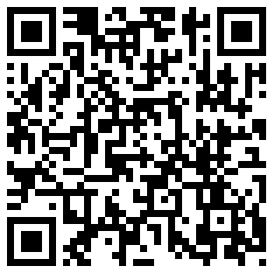
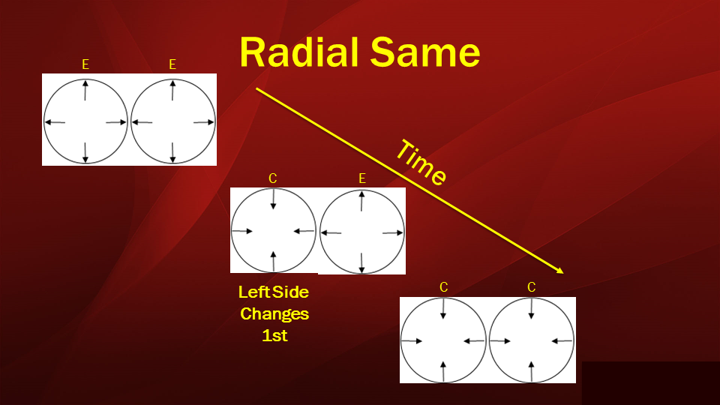
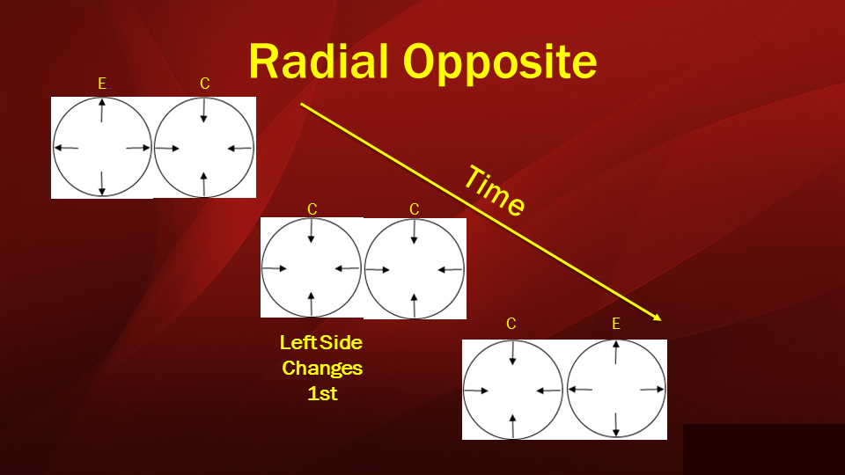
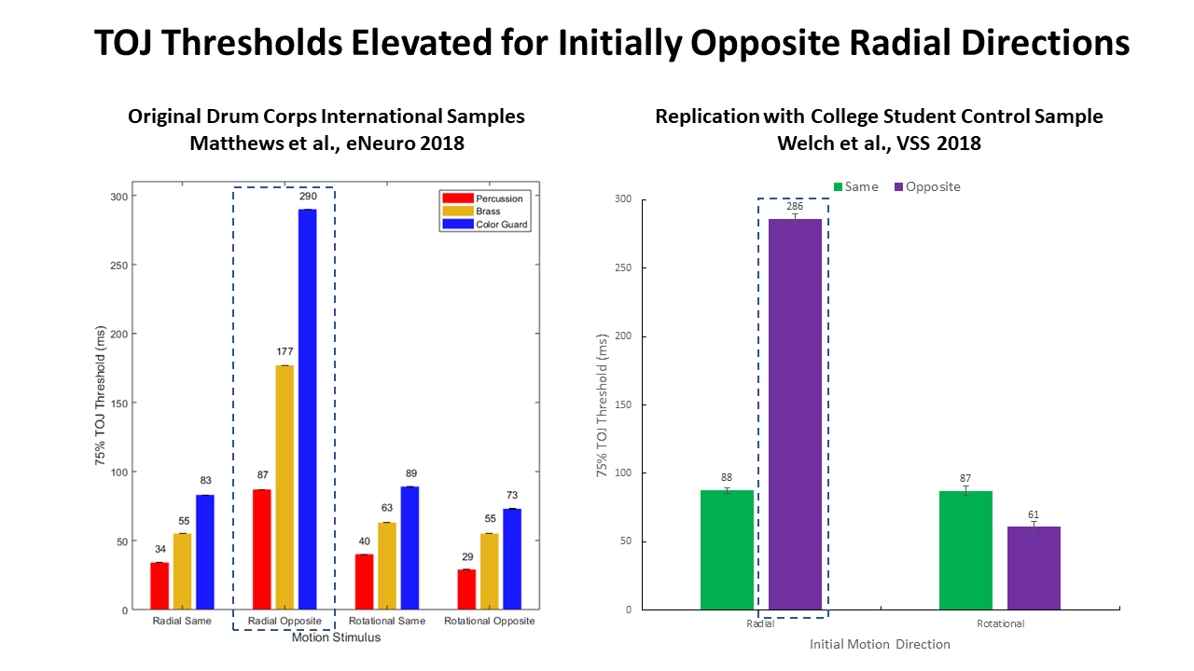
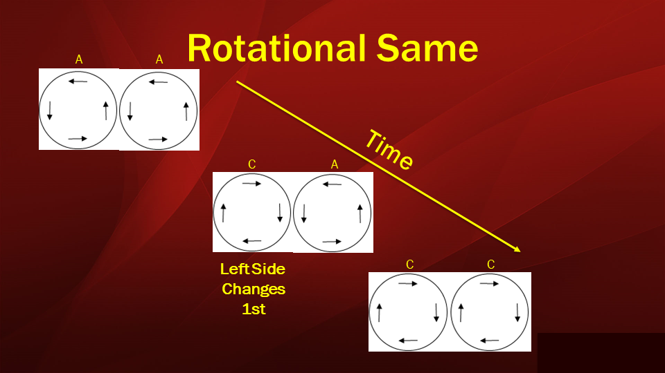
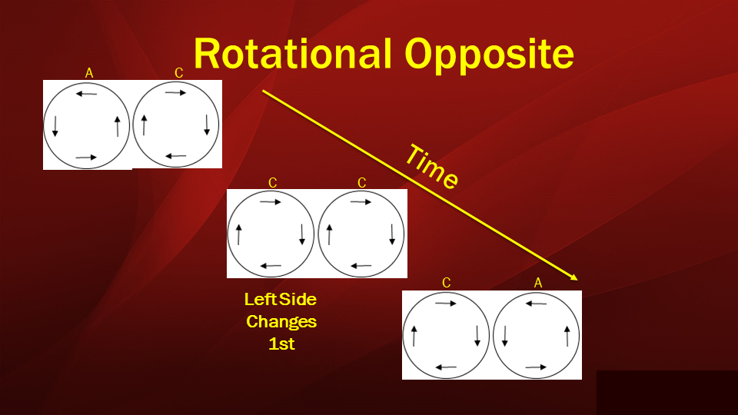
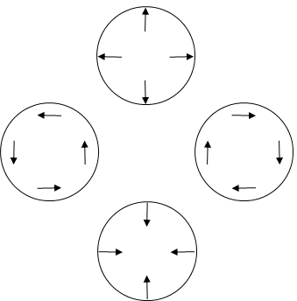
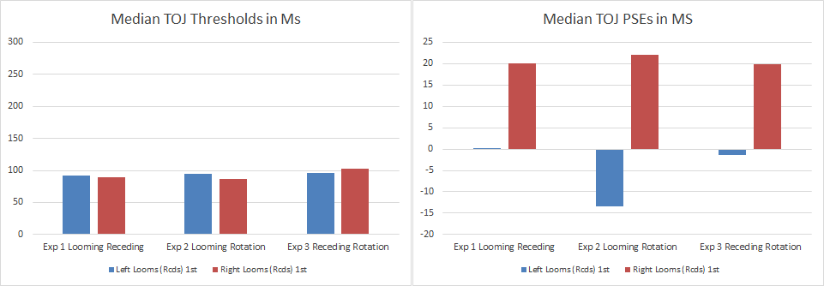
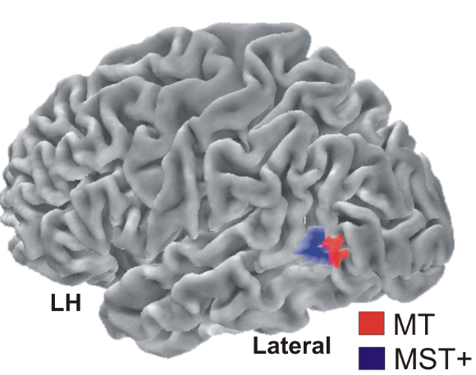
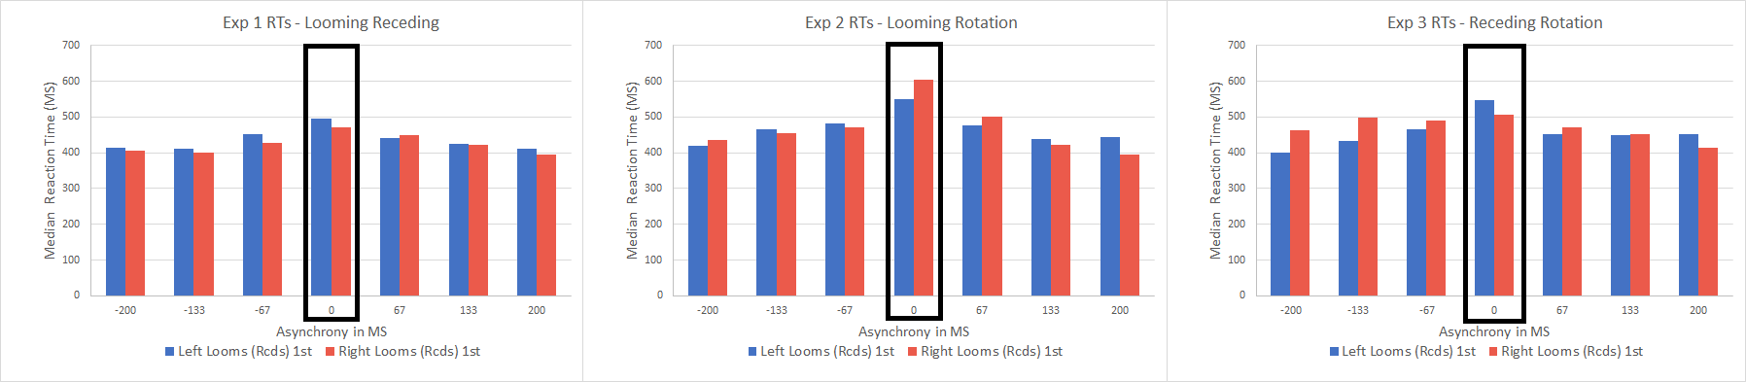
Depth from Motion Alters Radial & Rotational Motion-Defined Temporal Order Judgments
Poster #
43.467
Nestor Matthews¹, Leslie Welch², Elena Festa², Anthony Bruno¹
¹Denison University – Psychology; ² Brown University - Cognitive, Linguistic & Psychological Sciences
Introduction
Hypotheses & Predictions
Participants, Stimuli & Task
Discussion
Temporal Order Judgments (TOJs) reflect the visual system’s timing sensitivity.
Contrary to the local linear motion cue hypothesis, prior experiments reveal ~3-fold TOJ threshold variations that depends on motion type (radial vs rotational) and direction (same vs opposite) [2,3] .
76 college students completed 21,280 TOJ trials.
Contrary to the APE and PG hypotheses, TOJ thresholds decreased ~2.5-fold (more than 150 ms) relative to prior experiments conducted with similar (but differently paired and blocked) stimuli and the same population.
Contrary to the APE hypothesis, psychometric-function biases (PSE shifts) never exceeded 25 ms, and peak-RTs exhibited no skew [5].
The data match the DU hypothesis’ predictions.
Conclusions – Depth from motion can generate dissociations between radially and rotationally defined TOJs. The finding also provide evidence for a global-to-local (course-to-fine) spatial sequence in visual timing sensitivity. This follows from the fact that manipulating the certainty of global motion configurations generated ~2.5- to 3-fold TOJ threshold variations while local linear motion cues remained constant.
Stimuli: Bilaterally presented plaids rotated or radiated before changing direction.
Task: Which side changed direction first (L or R)?
Exp 1 (n=26), one stimulus initially loomed while the other initially receded.
Exp 2 (n=22), one stimulus initially loomed then receded; the other stimulus rotated.
Exp 3 (n=28), one stimulus initially receded then loomed; the other stimulus rotated.
In principle, TOJs for radial and rotational motion could depend on how precisely the visual system registers local linear motion cues [1,2].
All experiments had looming stimuli to test APE, eliminated common-fate motion cues to test PG, and eliminated depth-cue uncertainty to test DU.
Here we tested three additional hypotheses.
The Attentional Prior Entry (APE) hypothesis predicts elevated TOJ thresholds, large (>100 ms) TOJ psychometric-function biases (PSE shifts), and peak-reaction-times (peak-RTs) skewed toward initially looming stimuli [4].
Results
*286 ms threshold with depth-uncertainty
The Perceptual Grouping (PG) hypothesis predicts elevated TOJ thresholds when motion stimuli fail to provide common-fate motion cues.
References
Pitzalis et al., (2013). PLoS One.
Matthews, Welch & Festa (2018). eNeuro.
Welch, Matthews, Festa & Schafer (2018). VSS Poster.
Franconeri & Simons (2003). Perception & Psychophysics.
Matthews, Welch, Achtman, Fenton & FitzGerald (2016). PLoS One.
The Depth Uncertainty (DU) hypothesis predicts reductions in TOJ thresholds after reducing depth-from-motion uncertainty.
Stimuli & data available on the Open Science Framework: https://osf.io/knvxj/
Poster: http://personal.denison.edu/~matthewsn/vss2019matthewsetal.html

